Slide 1
The Science of Suds
Nathan Turner
Senior Industry Technical Consultant
B. Paul Smith
Business Development Manager
Jermaine Mitchell
Corporate Account Manager
October 28, 2025

Slide 2
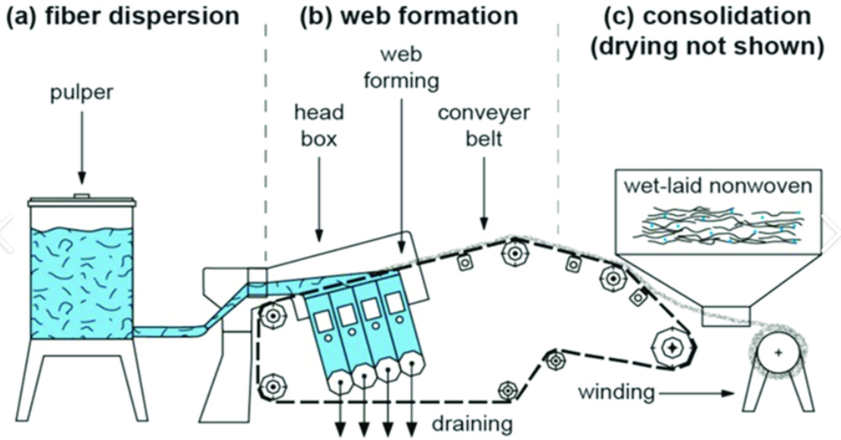
Is Foaming Always Undesirable in a Fiberglass Mat Manufacturing Process?
Wet-Laid Process
PROCESS OVERVIEW
  Wet-Laid process disperses chopped glass fibers in water slurry forming uniform mats by draining water on moving screens.
CHEMICAL ADDITIVES ROLE
  Dispersants, viscosity modifiers, and antifoams optimize fiber dispersion and minimize foam for consistent mat quality.
APPLICATIONS AND BENEFITS
  Used in roofing shingles, wallboard, and insulation backers, the process enables high-speed, scalable manufacturing.

Slide 3

Is Foaming Always Undesirable in a Fiberglass Mat Manufacturing Process?
Foam as a Carrier Medium
Foam suspends and distributes fiber uniformly, enhancing fiber orientation and reducing clumping
Role of Surfactants
Surfactants lower surface tension to form stable foam, allowing air incorporation in the slurry
Advantage of Customization
Process enables high porosity customization of mat density and thickness for specialty uses

Slide 4
What Causes Foaming in the Fiberglass Mat Process?
SURFACTANTS:
Surfactants are often added to improve fiber dispersion by reducing surface tension.
However, they also promote foam formation by stabilizing air bubbles in the slurry.
MECHANICAL AGITATION:
High shear mixing and turbulence in the slurry system can entrain air.
This entrained air, when stabilized by surfactants, leads to persistent foam.
WHITE WATER RECIRCULATION:
The reuse of process water (white water) can accumulate surfactants and other foaming agents over time.
This increases the likelihood of foam formation unless properly managed.
VISCOSITY MODIFIERS:
These chemicals are used to control fiber dispersion and flocculation.
Some modifiers can indirectly contribute to foaming by altering fluid dynamics and stabilizing bubbles.
ENTRAINED AIR FROM PUMPING SYSTEMS:
Improper pump design or operation can introduce air into the slurry.
This air, combined with surfactants, leads to foam buildup in the headbox and forming section.
HIGH MICROBIOLOGICAL LEVELS IN THE WHITEWATER:
The overgrowth of filamentous bacteria can promote foaming in fiberglass mat manufacturing and similar water-based industrial processes.

Slide 5
What is Foam?
Definition:
1. A mass of small bubbles formed on or in liquid
2. A colloidal dispersion of a gas in a liquid

Slide 6
Where does the foam come from?
In most systems the presence of a surface active agent (surfactant) is necessary to create stable foam. The surfactant spreads or absorbs at the air-liquid interface formed when gas is introduced and subsequently stabilizes the gas in the liquid.
A great example is the surfactant (aka – soap) that is formed when the cooking chemicals in the Kraft pulping process combine with the resin, rosin and fatty acids found in the wood chips.

Slide 7
What is a Defoamer?
Definition:
A defoamer is a chemical agent added to a liquid to remove surface foam and help release entrapped air.
A defoamer must be able to destabilize the layer of surface active agent present at the air-liquid interface which results in foam rupture and bubble coalescence.

Slide 8
Types of Defoamers
Surfactant based
Particulate based
Particulate based are broken down into three classes:
a. Oil-based (Silica and EBS particulates)
b. Water-based fatty alcohol (C16 or higher fatty alcohol particulates)
c. Silicone-based (Silica particulates)

Slide 9
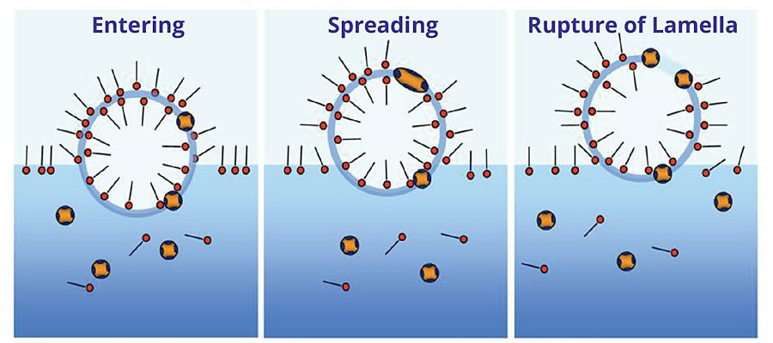
How Does a Defoamer Work?
There are several mechanisms that are employed to disrupt and destroy foam:
Reduction of surface tension
Insoluble mono-layers
Surfactant substitution
Particulate penetration

Slide 10
Choosing the Proper Defoamer
Two major POINTS to consider when choosing the correct defoamer:
Type of defoamer
Appropriate product/formulation

Slide 11




The Type of Defoamer is dictated by Several Factors
Type of Process
Customer Restrictions
Process Parameters
(pH, conductivity, temperature)
Cost Considerations

Slide 12
What’s Next?
The formulator has two options:
Use an Existing Product
Create a Customized Formulation
**There are pros and cons for each approach!**

Slide 13
Foam Cell Recirculator
Device used to generate foam – glass cylinder with graduated markings(cm) connected to a centrifugal pump.
**Foam height vs. time is measured in centimeters
**Knockdown and stamina are measured

Slide 14
Existing Product
This route is chosen if the opportunity is such that it does not allow time for a new product to work its way through the set-up process.
Pros
Quick Turnaround
Easy Sample Prep And Familiarity
With Product Application
Numerous Formulations/Products
Cons
Performance Efficiency loss

Slide 15
Customized Formulation
This route is chosen if the sales process allows time for a new product to be set-up.
Pros
Better performance
Cost efficiency
Cons
Time consuming SAP set-up process
Time-consuming sample prep
Potential unfamiliarity with product application

Slide 16
The Type of Defoamer is dictated by Several Factors
i. Type of Process
ii. Customer Restrictions
iii. Process Parameters:
a. pH
b. conductivity
c. Temperature
iv. Cost Considerations

Slide 17
Chemistry Options
Oil-Concentrate
Water-extended Oil-based
Surfactant Based

Slide 18
What is Oil-Concentrate?
Oil Concentrate Composition & Formulation Process
Formulation Process
To develop a customized oil concentrate, formulators begin by assembling a formulation kit, which includes:
Pre-made samples to evaluate varying ratios of silica and/or EBS
Performance additives for testing compatibility and effectiveness
Raw materials for on-site sample creation based on foam cell testing insights
These samples are tested for performance, and the optimal formulation is selected and submitted for commercialization.
Composition Overview
Oil concentrates are primarily composed of:
Base Oil (typically >80% of total content)
Silica
EBS (Ethylene Bis Stearamide)
Silicone Polyethers
Polyols
Esters
Polymers

Slide 19
Oil-based Defoamers
Oil is the carrier
Actives may include EBS (amide), hydrophobic silica, or surfactants
Combat surface foam and/or entrained air
Benefits:
Good persistence
Easy to feed and handle
Disadvantages:
Potential for deposit due to oil and amide
Can cause size and strength problems
VOC’s
Regulatory: FDA, Not BfR, Not Kosher
Notes:
Oil-based hot stock defoamers are typically formulated with 90-98% oil and 2-10% active ingredients, such as silica, silicone, or ethylene bis Stearamide (EBS). The concentration of actives is limited because higher loading of actives causes the viscosity of the oil/achieves emulsion to rise to unpumpable levels. These formulations work well to eliminate surface foam, but they have little effect on entrained air.
Potential drawbacks to the use of oil-based defoamers include reduced sizing and inference with other important sheet properties, deposits, and VOC emissions. Hydrocarbon carrier oils in defoamer products are a major source of VOC emissions.
Oil helps form deposits. Hydrocarbon in oil-based antifoams have a high affinity for the components of pitch and slime deposits. These antifoam hydrocarbons often become part of existing deposits, increasing their volume, severity, and control costs.
Numerous laboratory studies have shown that the hydrocarbons in oil-based defoamers can adversely affect the retention efficiency of many sizing agents by solubilizing resinate particles and preventing the precipitation onto fiber. Many surfactants in formulated Antifoam products act as wetting agents, in direct opposition to sizing.

Slide 20

Water-extended Oil-based
Benefits:
Good surface foam control
Reduced potential for deposit
Less potential impact to Sizing
Disadvantages
Oil and water are both carriers (less oil than oil-based products)
Typically used on Fiberglass mat applications.
Cannot be formulated on-site
This chemistry is comprised of: oil, silica, EBS, esters, polyols, emulsification surfactants, silicones(if allowed).
Disadvantages:
Regulatory:
FDA
Not BfR

Slide 21
Surfactants (Non-Silicone Containing)
Benefits:
Freight savings
No potential for deposits
Contain no carriers
May or may not contain particulates
Typically 100% Active
Usually blends of surfactants
Disadvantages:
May interfere with sizing – pending chemistry (esters)
In-line water dilution
Regulatory
FDA
Some BfR, not all
Some Kosher, not all

Slide 22
Defoamer Actives
Defoamers
Hydrophobic Particles
Ethylene bis Stearamide wax (EBS)
Wax
Fatty alcohols
Antifoams
Surfactants
Fatty esters
Polyethylene glycol ester (PEG ester)
Polypropylene glycol (PPG)
Emulsifiers and Spreading Agents
Hydrophobic silica
Notes:
Hydrophobic particles arrange themselves between the gas/liquid interface of the bubble and interrupt the arrangement of the molecules in the bubble will to produce localized weak points. The disrupt wall breaks, causing entrained air bubbles to coalescefrom

Slide 23
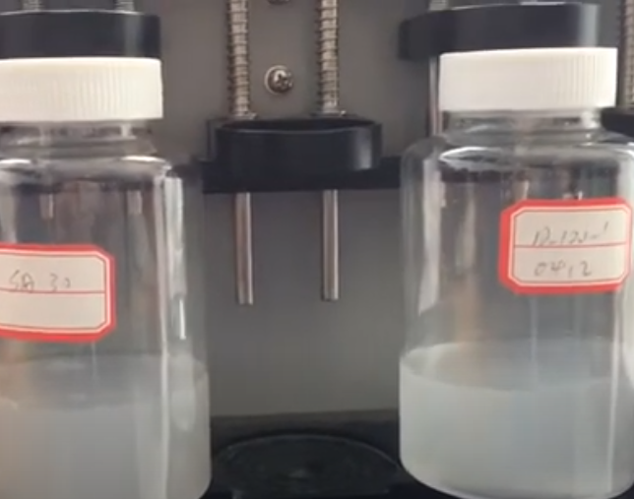
Selection of the Proper Antifoam
Silicone Defoamer Testing Procedure
Foam Shake Test
Purpose: Quick screening for defoaming speed and persistence.
Procedure: Shake a mixture of foaming liquid and defoamer in a sealed container; observe foam collapse.
Use: Fast QC checks or preliminary screening.

Slide 24
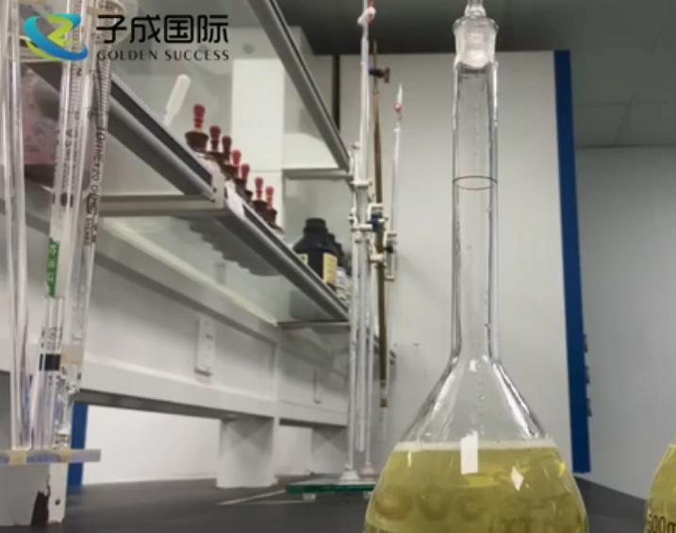
Selection of the Proper Antifoam
Comparison testing of defoaming agent for PCB cleaning - YouTube
Cylinder Shake Test
Purpose: Measures foam knockdown and suppression over time.
Procedure: Shake a defoamer dispersion in thickened water and record foam height at intervals.
Use: Evaluates both defoaming and antifoaming properties.

Slide 25
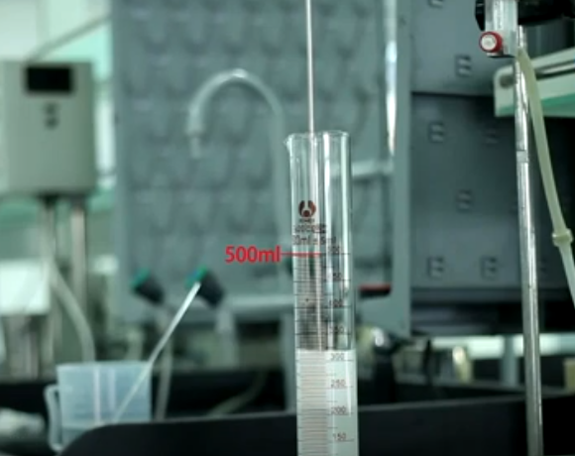
Selection of the Proper Antifoam
SIXIN Air Bubble Test Present - for Defoamer Antifoam
Dynamic Foam Testing (Air Sparging or Drum Test)
Purpose: Simulates continuous foam generation, mimicking industrial conditions.
Procedure: Air is bubbled through the test liquid; foam volume and collapse time are measured.
Use: Ideal for evaluating defoamers under shear and continuous foaming, as seen in fiberglass mat production.

Slide 26
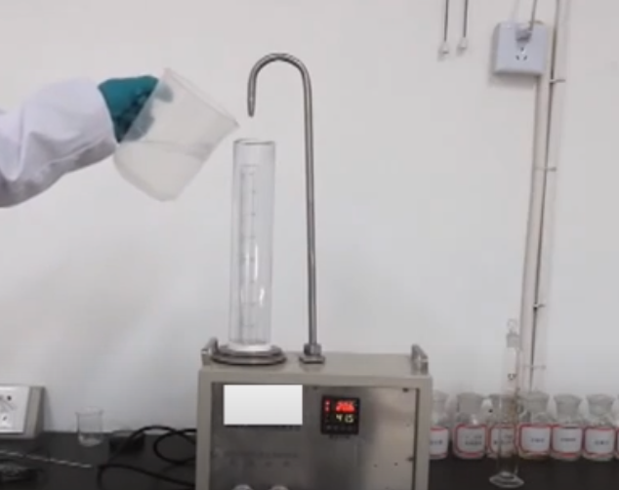
Selection of the Proper Antifoam
Modified Ross-Miles Foam Cell Test
Ross-Miles Foam Test
Purpose: Measures initial foam height and foam stability over time.
Procedure: A surfactant solution is dropped from a fixed height into a reservoir, generating foam. Foam height is recorded at intervals.
Use: Good for baseline comparisons under static conditions.

Slide 27
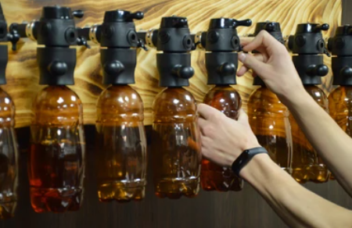
Program Selection
Most defoamers are water with oil emulsion
  Contain paraffin, silicone and silica
  Beware that formulations with EBS can result in buildup on the tank wall
Use handheld entrained air device to determine
the proper feed points
Certain defoamer chemistries should be avoided due to interactions in whitewater
Ensure proper mixing of defoamer at the injection point

Slide 28
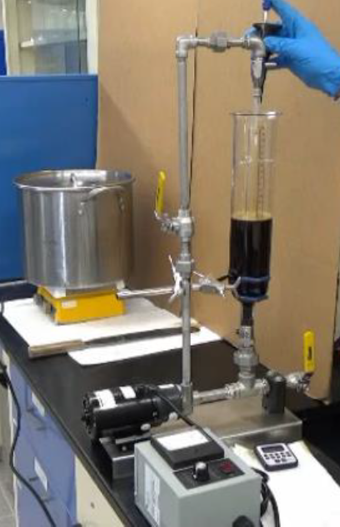
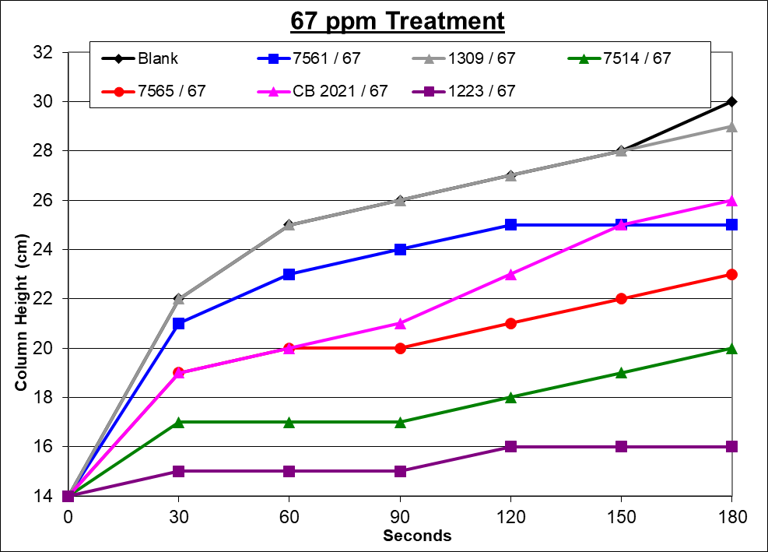
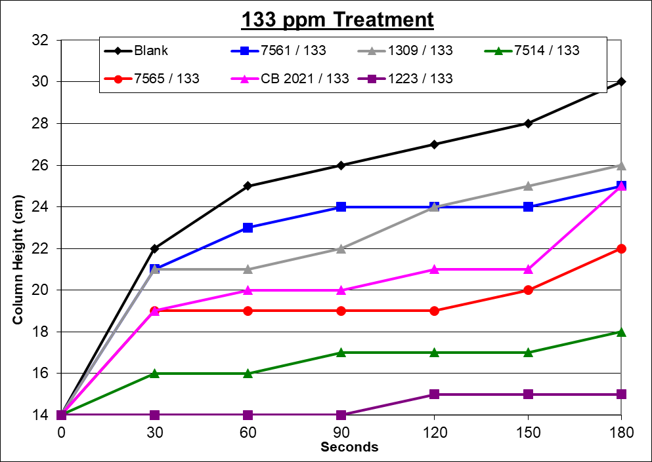
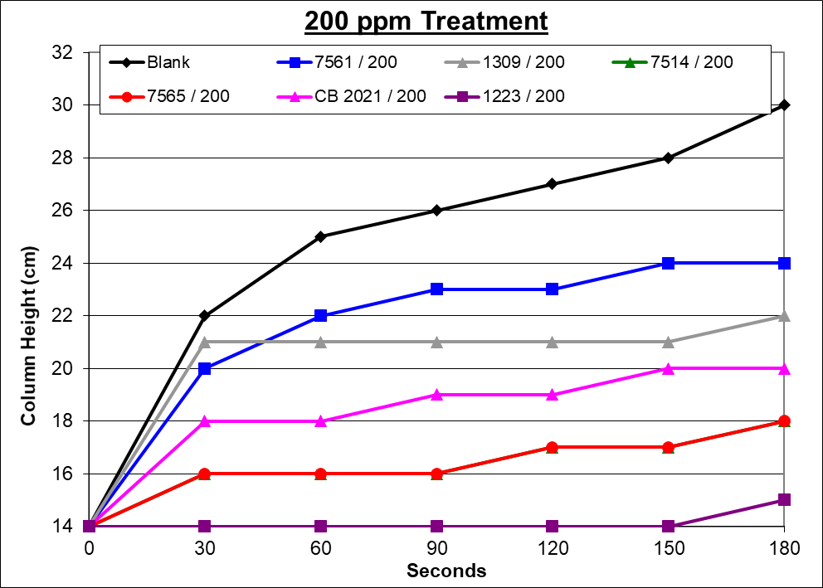
Screening - Recirculator Use
Obtain Solution containing all additives – No Defoamer
If can only obtain sample after the defoamer addition, turn defoamer off for ~0.5 hrs. before sampling
Use a water bath to keep sample at process temperature
500ml of sample utilized for each test run
Defoamer sample should be added neat - 10µL = 20ppm
Anti-foam performance: add defoamer to sample while transferring to Foam Cell
Defoaming performance: add defoamer once the foam column reaches a certain height, then documenting reduced height over time

Slide 29
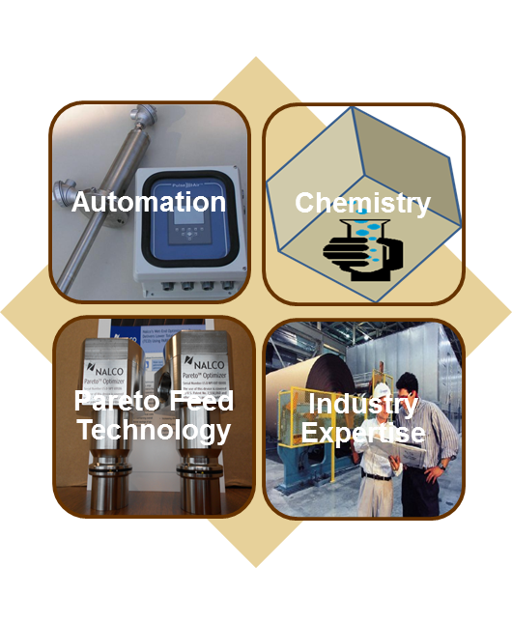
Surface & Entrained Air Control
Automated Antifoam Technology
On-line entrained air measurement
Defoamer injection/delivery system
Entrained air on-line monitoring
Application knowledge to deliver:
Enhanced sheet quality
Increased productivity
Improved stability and cost reduction

Slide 30
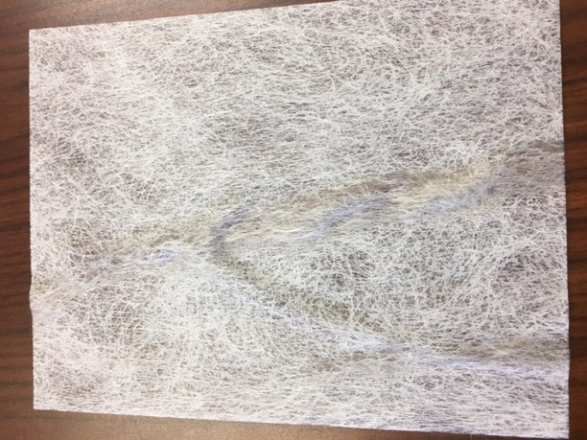
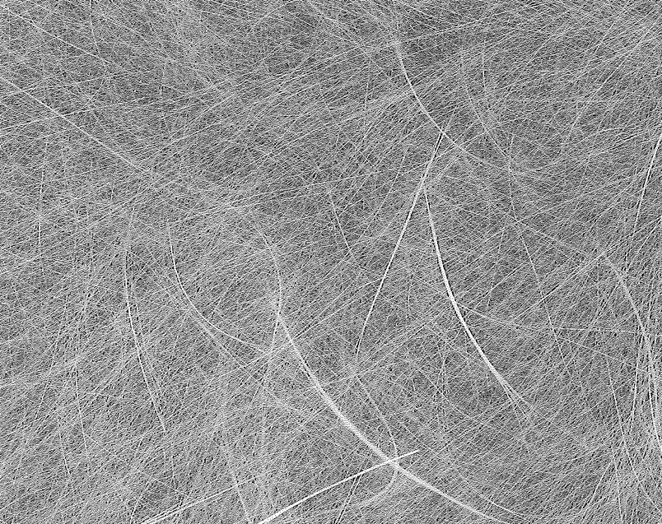
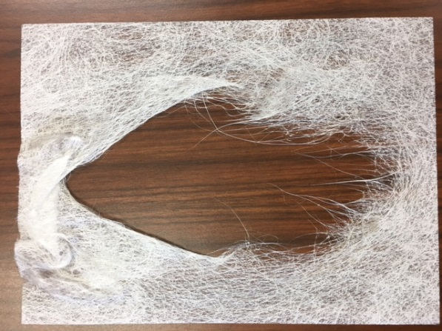
Why does hitting the target matter?
Antifoam overfeed
Antifoam underfeed
Reduced tensile/tear
Slow down or potential for tear-outs/wrinkling
Increase foaming
Reduce dispersancy ($)
Foam
Floaters / Islands / Icebergs
Holes in the mat
Inconsistent caliper
Wrinkles
Poor Dispersion
Hole

Slide 31
What Impacts Antifoam Performance?
Temperature
Other Antifoams
Bacterial population
Feeding Method
Other Antifoams
Agitation
Chemistry ineffective at high temperatures
Where, how much, dump/spray
Bacterial respiration produces foam
Interactions and clumping
Too much agitation causes foam

Slide 32
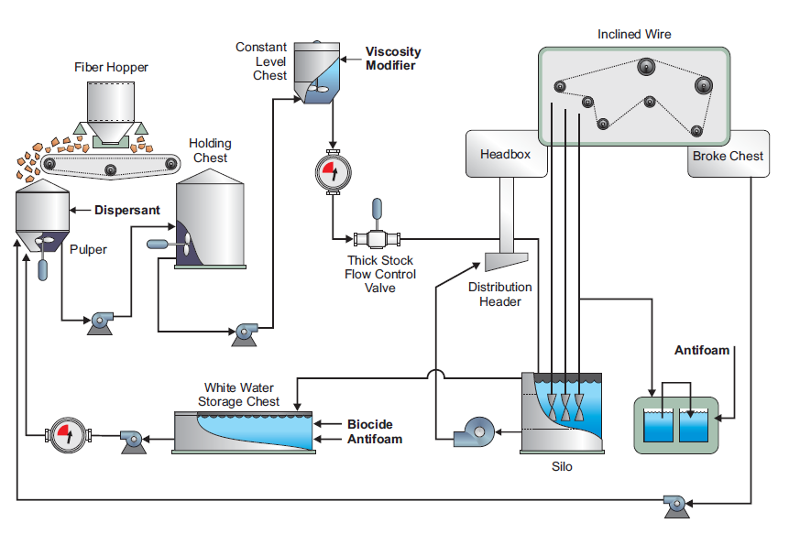
Whitewater Process – Feed Points
Viscosity Modifier
Binder Antifoam
Antifoam
Dispersant
Antifoam
Biocide Antifoam

Slide 33
Troubleshooting starter guide

Slide 34
Surety of Supply Program
Process Automation Platform
SAFETY
FEED & CONTROL
Minimal handling with bulk or hands-free delivery and closed, neat feed system with operator training to ensure safety in supply
Ability to set dosage targets and limits to ensure optimal performance, quality and product usage
DATA MANAGEMENT
PREVENTATIVE MAINTENANCE
Reports & visibility to product dosage trends, inventory and alarms to ensure your system operation
Monthly and Annual maintenance by trained service personnel to ensure optimal equipment performance and life

Slide 35
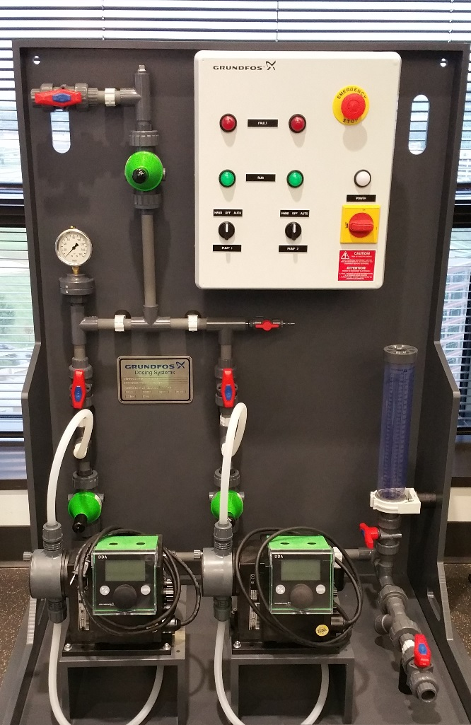
Example Skid
Smart pump with flow monitoring capability
Chemistry compatible pump and piping
Back-up pump
Calibration column

Slide 36
Questions, comments, etc.

Slide 37

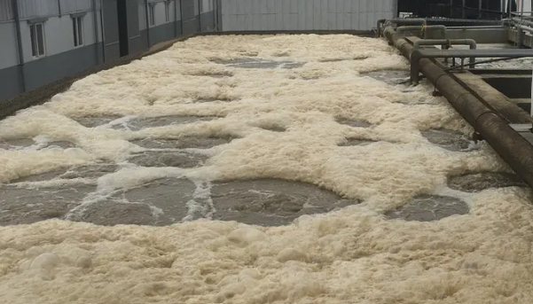
The Science of suds
Nathan Turner
Senior Industry Technical Consultant
B. Paul Smith
Business Development Manager
Jermaine Mitchell
Corporate Account Manager
29 October 2025

