Slide 1
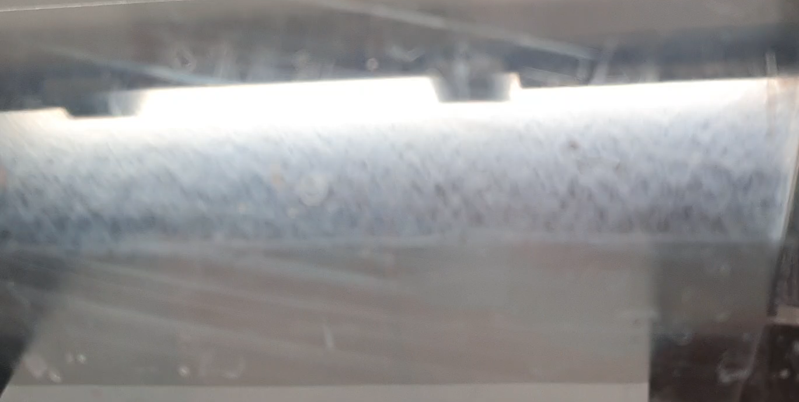
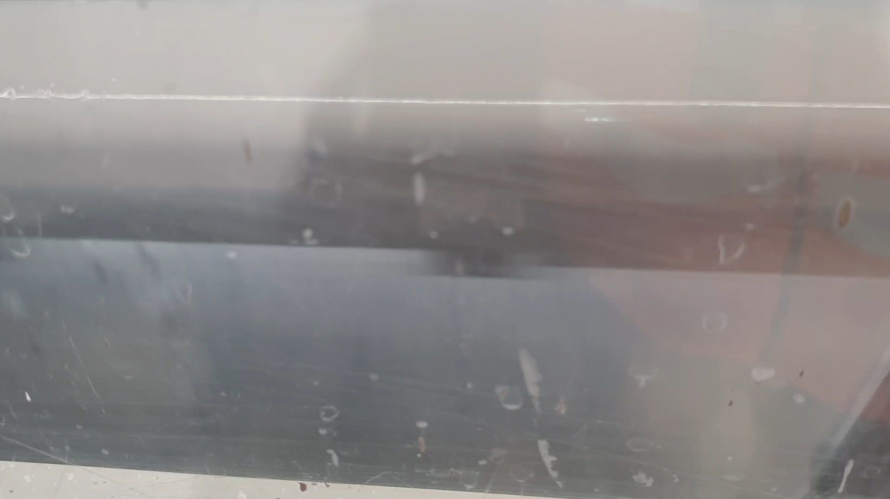
Homonization
Formulations with two and three passages through homogenizer
15% of of CMC
Improved curtain eveneness with three passages through the homogenizer

