Slide 1
The Challenge of Biofilms
Douglas B McIlwaine, Ph.D.
Corporate Scientist
ChemTreat, Inc.

Slide 2
Acknowledgements
Alexsandra Corrigan
Mackenzie Moore
Ben Niemaseck
Darla Goeres – Montana State University

Slide 3
Agenda
What is a biofilm
Why do they form
How to treat them

Slide 4
What do the following have in common?

Slide 5
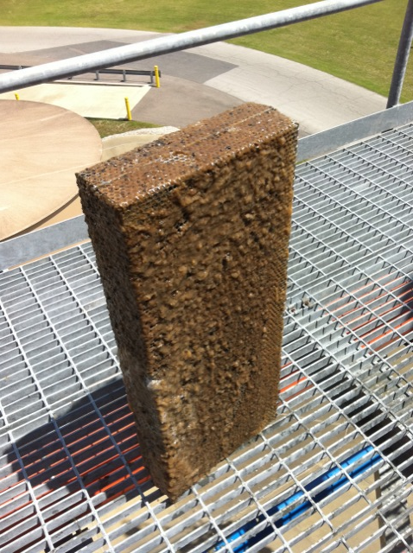
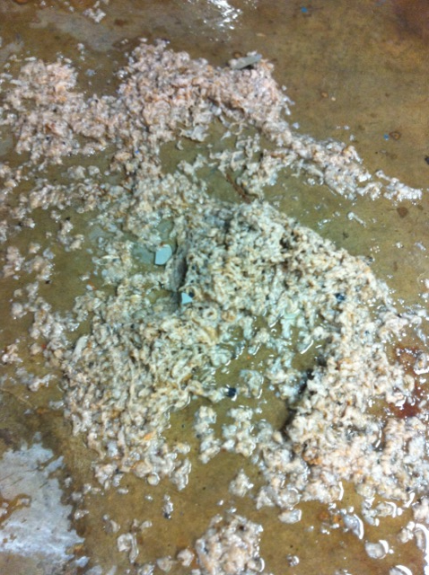
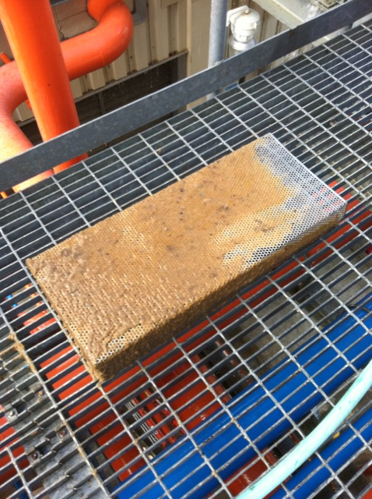
Cooling Tower Screens

Slide 6
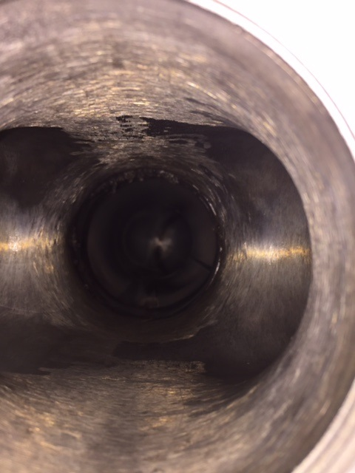
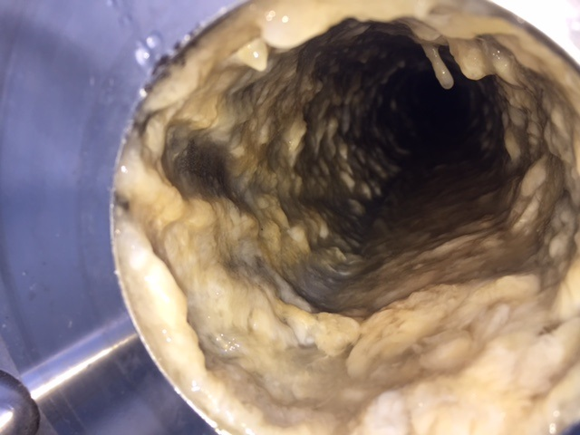
Before Cleaning
The pipe after cleaning

Slide 7
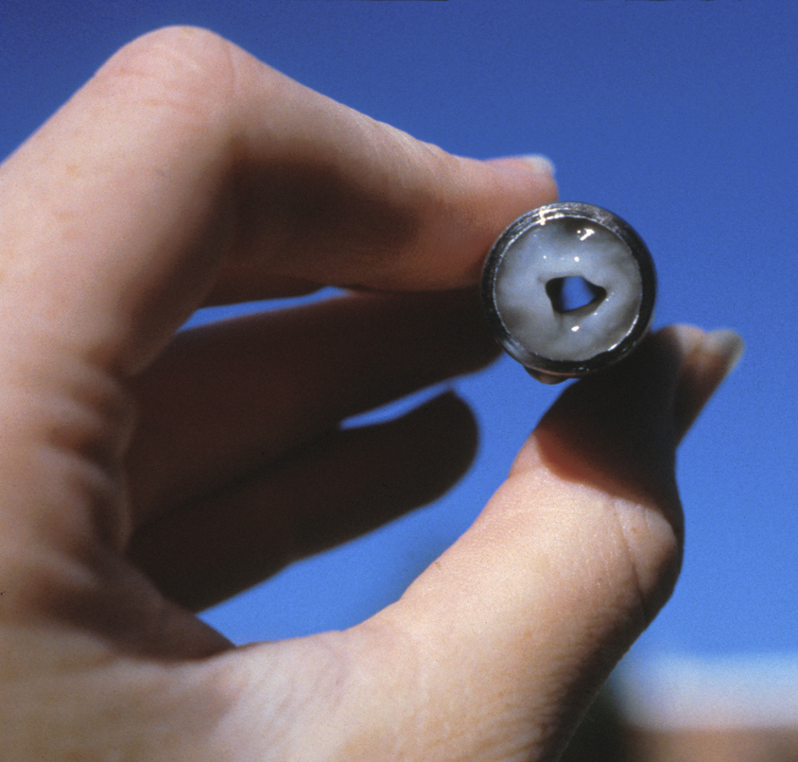
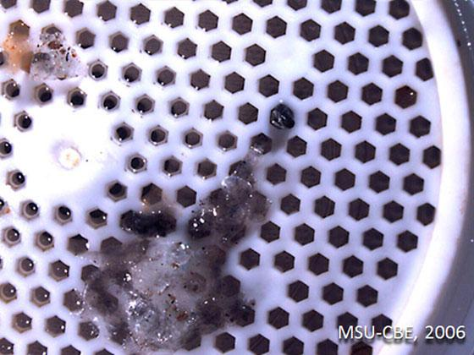
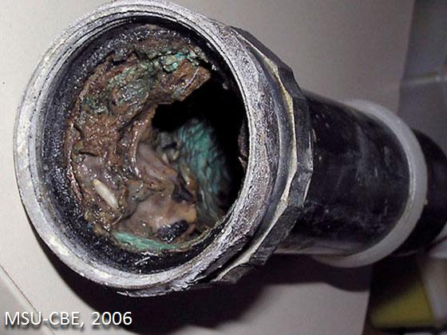
Center for Biofilm Engineering at MSU - Bozeman

Slide 8
What Do They Have in Common?
All are pictures of biofilms
A biofilm is a consortium of microbial cells immobilized at a substratum and frequently embedded in an organic polymer matrix of microbial origin
Biofilm formation is generally in response to a stress placed upon the microbes
Biofilms impact our lives in many ways
  Medical
    Chronic wounds, surgical implants, cystic fibrosis
  Industrial
    Industrial water & oilfield, Microbiologically Influenced Corrosion
  Food
    Spoilage, contamination in food prep facilities
    Beneficial in some areas (fermentations)
  Environmental
    Bioremediation

Slide 9
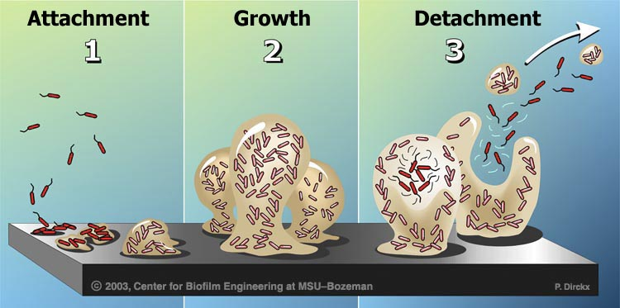
The Biofilm Development Process
A microbe attaches to a surface, then starts to secrete the protective slime and calls
for others to join it (signaling)
  Ted talk: “How Bacteria Talk” by Bonnie Bassler
  “…all bacteria can talk to each other. They make chemical words, they recognize those words, and they turn on group behaviors that are only successful when all of the cells participate in unison. And so now we have a fancy name for this: we call it quorum sensing.”
“…bacteria always control pathogenicity
with quorum sensing”
Four steps to biofilm formation
Reversible attachment
Proliferation and irreversible attachment to form microcolonies
Growth to form cell clusters
EPS formation
Microbial Pathogenesis 181 (2023) 106182
Biofilm formation is generally in response to a stress placed upon the microbes

Slide 10
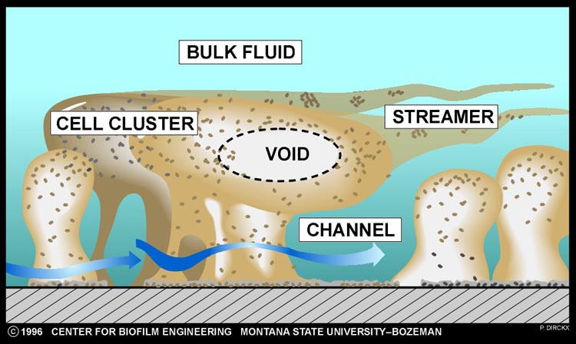
Biofilm Structure
“Water may course through channels,
but it does not percolate the cell clusters
themselves. The dense aggregation of
bacterial cells and their extracellular
polymers within cell clusters precludes
fluid flow.”
“This means that water channels
can expose the surfaces of clusters
or channels but they do not allow free
access of solutes to the interior of
cell clusters.”
Diffusion in Biofilms
JOURNAL OF BACTERIOLOGY
Mar. 2003, p. 1485–1491

Slide 11
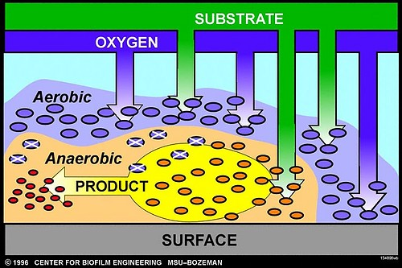
Microbial Diversity in a Biofilm
The outer layers of a biofilm are aerated and contain aerobic bacteria.
The biofilm near the metal surface contains contain less oxygen and will sustain the growth of anaerobes.
It is the anerobic part of a biofilm where Microbiologically Influenced Corrosion can occur.
“A healthy biofilm is a diverse biofilm.” – Bill Costerton (former director of the Center for Biofilm Engineering

Slide 12
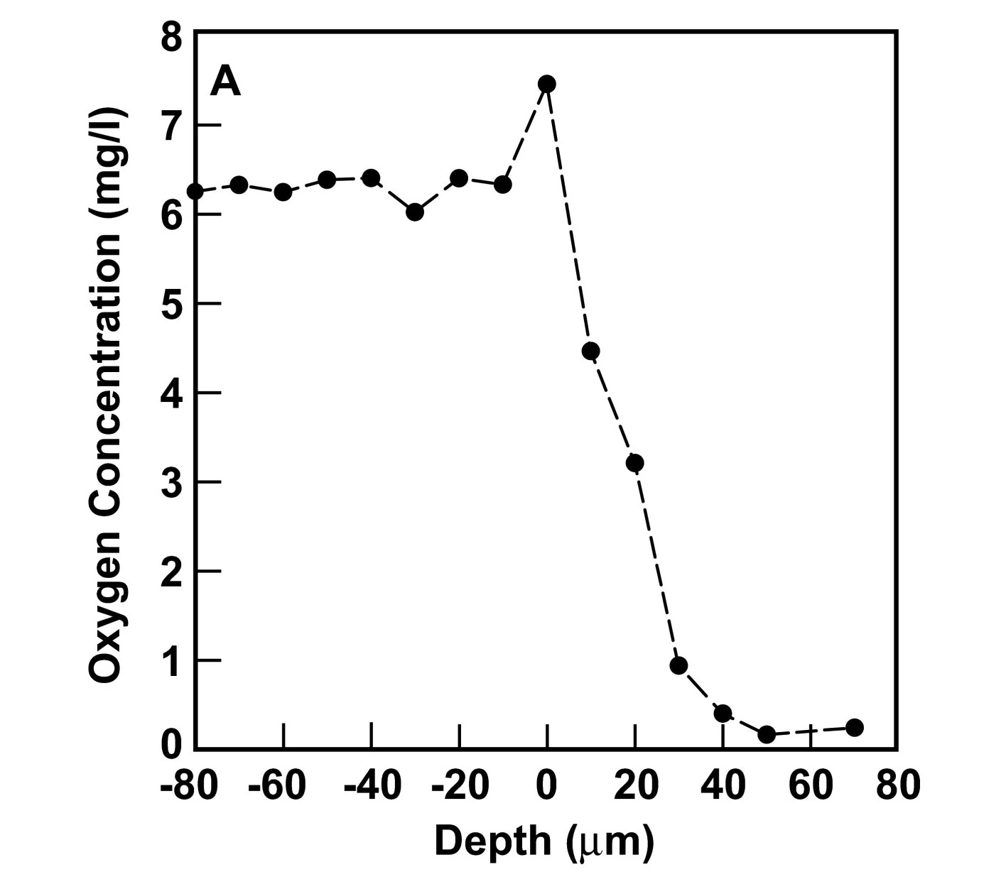
Oxygen Gradient in a Biofilm
An oxygen microelectrode was used to demonstrate the presence of oxygen concentration gradients in this system
The oxygen concentration in the flowing fluid above the biofilm was approximately 6 mg l⁻¹.
Oxygen concentration decreased to 0.2 mg l⁻¹ or less inside the biofilm.
Folsom, J.P., Richards, L., Pitts, B. et al. Physiology of Pseudomonas aeruginosa in biofilms as revealed by transcriptome analysis. BMC Microbiol 10, 294 (2010).

Slide 13
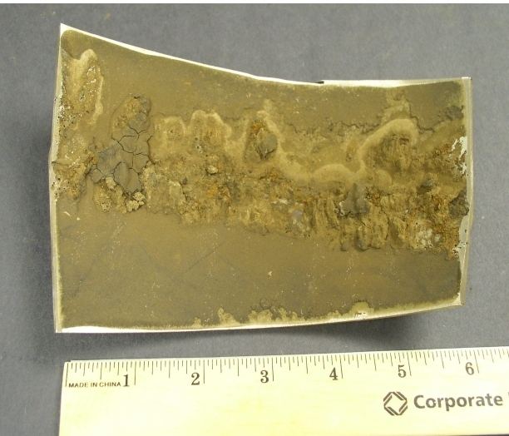
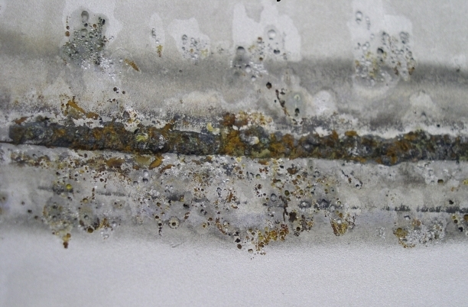
Microbiologically Influenced Corrosion

Slide 14
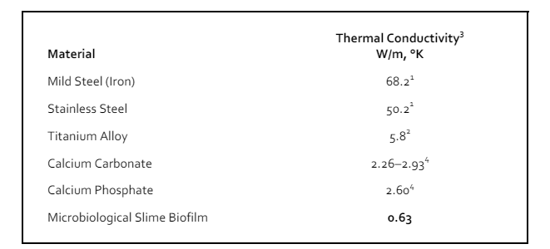
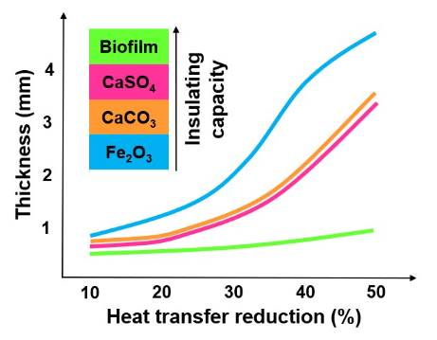
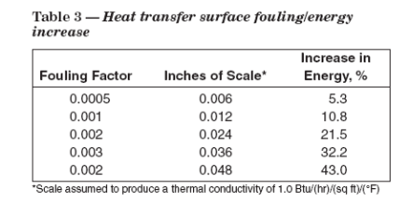
Insulating Properties of Biofilm
Thermal conductivity relates to the ability of a substance to transfer heat
Biofilm has nearly 4 times less ability to transfer heat than a calcium-based film

Slide 15
Strategies for Controlling Biofilm
Using Biocides:
  Concentration and contact time are key
  Method of addition is important
  Higher dosages for short contact times provides for more penetration and kill than lower dosages for longer contact times
    Extent of kill is primarily diffusion controlled
    Grobe, K.J., Zahller, J., and Stewart, P.S., 2002. “Role of Dose Concentration in Biocide Efficacy Against Pseudomonas aeruginosa Biofilms,” J. Ind. Microbiol. Biotechnol. 29, 10 – 15.

Slide 16
Biofilm Tolerance Towards Biocides
Professor Phil Stewart – Montana State University
The following are not a factor in the resistance of biofilms to antimicrobial treatment:
  Antimicrobial size
  Antimicrobial chemistry
  Substratum composition
  Species composition
Those factors that do affect biofilm tolerance:
  Age of the biofilm
  Cell density within a biofilm
Stewart PS. 2015. Antimicrobial tolerance in biofilms. Microbiol Spectrum 3(3):MB-0010-2014.

Slide 17

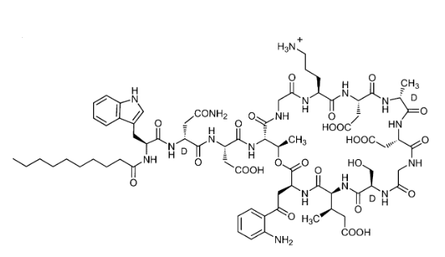
Biofilm Penetration by Antibiotic
Daptomycin was fluorescently labeled then dissolved in
a phosphate buffer and pumped through the capillary biofilm
reactor that contained S. epidermidis biofilm
Daptomycin Rapidly Penetrates a Staphylococcus epidermidis Biofilm
ANTIMICROBIAL AGENTS AND CHEMOTHERAPY, Aug. 2009, p. 3505–3507

Slide 18
Biocide Consumption by Microbes
Cell density within a biofilm was identified as a factor that influenced biofilm tolerance
  High concentrations of microbes can exert a demand on the biocide
Biocide depletion supports the statement that the cell density within the biofilm will affect the efficacy of an antimicrobial
Residual Glutaraldehyde Concentration in the Presence of Different Populations of Enterobacter aerogenes
Live Microbes Non-Viable Microbes
Time (Hrs) 115 48 25 115 48 25
0 36.5 28 28.6 35.4 30.8 27.6
1 7.5 -- -- 32.1 30.9 31.6
1.5 1.9 -- -- -- -- --
2 -- 11.3 19.6 -- -- --
24 0 0 0.3 26.2 26.6 29.9
88 0 0 0 24.0 27.7 28.5
Time
Sample Inital 24 hours
115 Klett 1.05 X 10⁹ 1.42 X 10⁸
48 Klett 3.8 X 10⁸ 1.29 X 10
25 Klett 8.96 X 10⁷ 7.53 X 10⁷

Slide 19
The Key to Biofilm Penetration
The penetration of any substance into a biofilm is limited by¹:
  Diffusion
  Reactivity
Any substance can diffuse into a biofilm
The extent of penetration is limited by the reactivity of the molecule
  Reactive biocides don’t penetrate deeply
    Hypochlorite (bleach) is very reactive, and doesn’t penetrate well
  Nonreactive substances can penetrate fully throughout
  Biocides with less reactively with the biofilm (or substances within) will penetrate more extensively than reactive biocides
¹JOURNAL OF BACTERIOLOGY Mar. 2003, p. 1485–1491

Slide 20
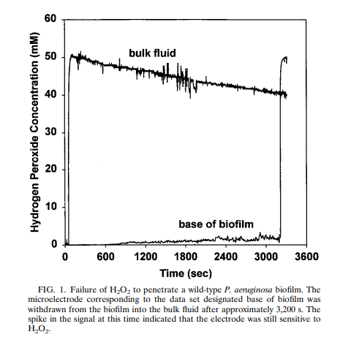
Reactivity Limitation of Peroxide into a Biofilm
Peroxide was not able to penetrate into a thin
biofilm because of the presence of catalase in the biofilm
Effect of Catalase on Hydrogen Peroxide Penetration into Pseudomonas aeruginosa Biofilms
Applied and Environmental Microbiology Volume 66, Issue 2, Feb. 2000

Slide 21
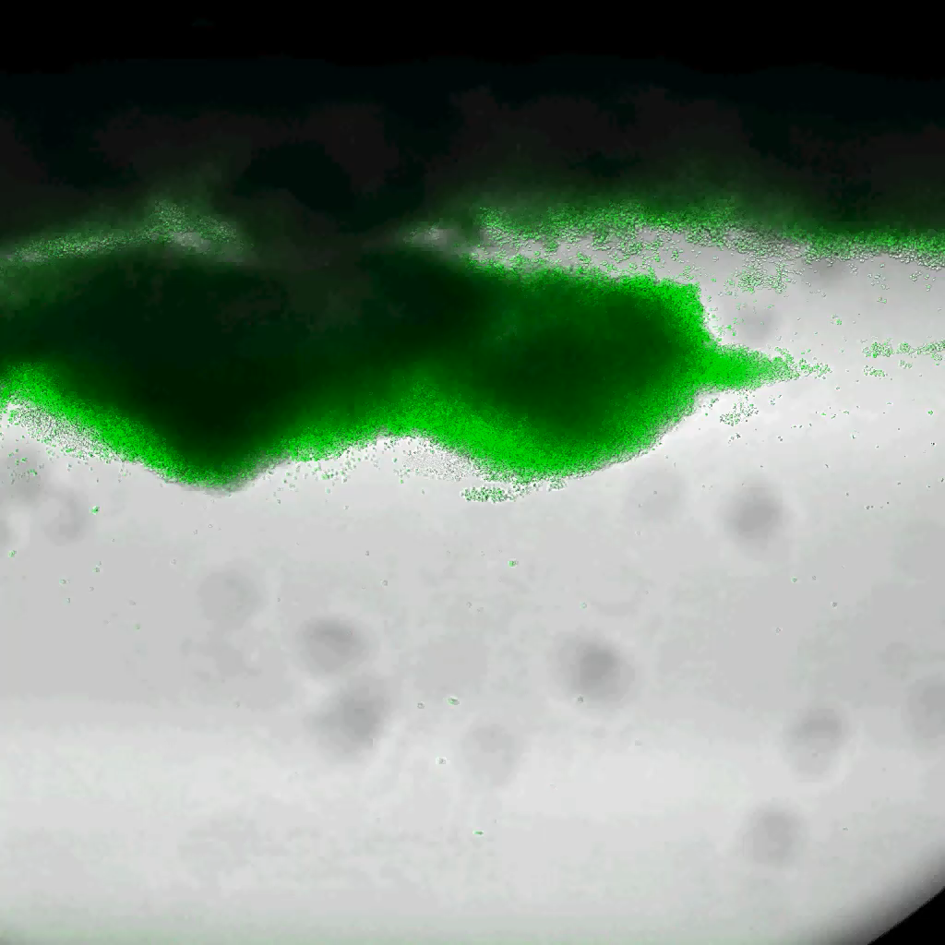
Chlorine (HOCl) Ineffectiveness at Penetrating Biofilm
Chlorine (HOCl) is widely used in industrial water treatment
It is known to be somewhat ineffective against biofilm
The likely reason is that it is too reactive with the biofilm matrix
The video clip shows the relative ineffectiveness of 10 ppm of free chlorine
Spatial and Temporal Patterns of Biocide Action against Staphylococcus epidermidis Biofilms
ANTIMICROBIAL AGENTS AND CHEMOTHERAPY, July 2010, p. 2920–2927

Slide 22
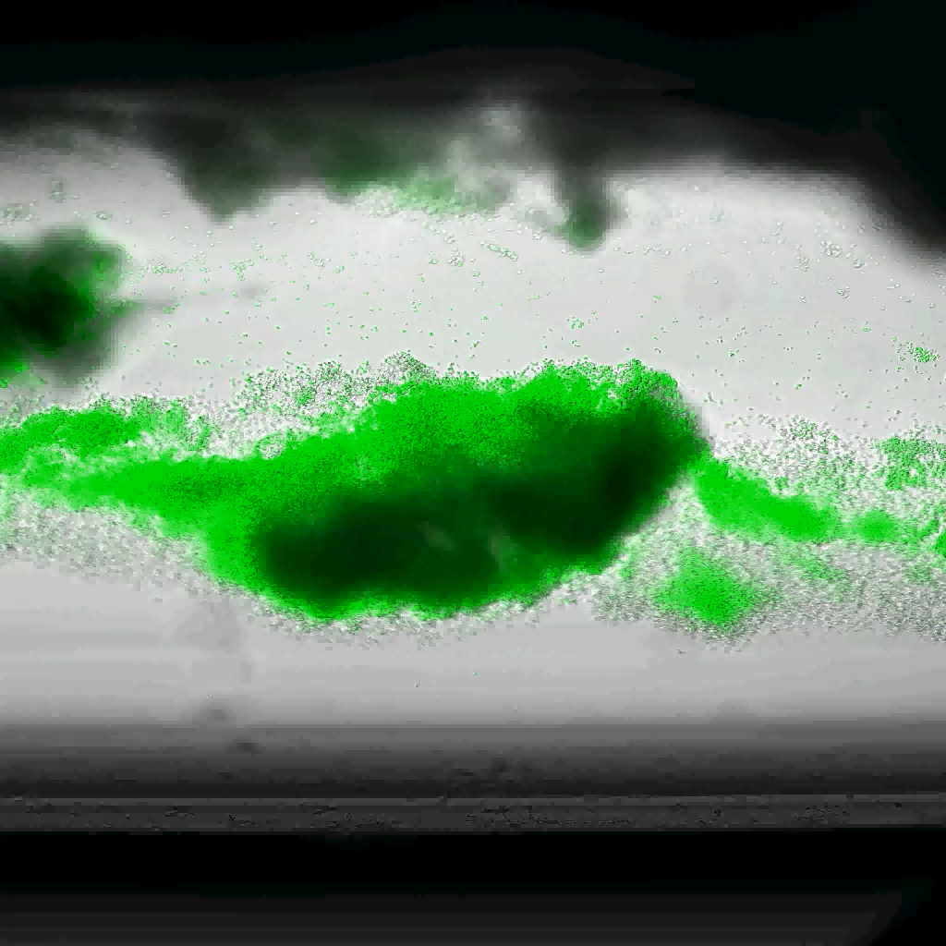
Chlorine (HOCl) Ineffectiveness at Penetrating Biofilm
This video clip shows the effect of 50 ppm of free chlorine
Spatial and Temporal Patterns of Biocide Action against Staphylococcus epidermidis Biofilms
ANTIMICROBIAL AGENTS AND CHEMOTHERAPY, July 2010, p. 2920–2927

Slide 23
Why is it Hard to Eliminate Biofilms?
Several Reasons:
#1 – Misapplication of the biocide
  Not understanding the mode of action of the biocide
    Is the biocide inactivated by sulfide, amines, or high pH
    What is the contact time in the system
    Does the biocide have a fast or slow mode of action
    Using the same biocide because of exclusivity of the product
    What are the incompatibilities of the biocide
  Understanding the mode of action of the biocide, and the parameters of the system are key to effective use of a biocide

Slide 24
Why is it Hard to Eliminate Biofilms?
#2 – Engineering issues
Dead legs – areas of low, or no, flow resulting in stagnant water
  If no flow, then the biocide cannot get to that area
  Dead legs can continuously inoculate a system
Poorly designed cooling towers
Uneven distribution of biocide through system
Sample site | August Clo2 (ppm) | July Clo2 (ppm) | June Clo2 (ppm)
510 | 0.89 | 1.12 | 1.22
W.P. | 3.35 | 0.84 | 1.0
Air Handler | 0.51 | 0.48 | 0.25
580 | 0.14 | 0.54 | 0.13
Sand Filter 1 | 0.59 | 0.94 | 0.74
Sand Filter 2 | 0.64 | 1.08 | 0.92

Slide 25
Why is it Hard to Eliminate Biofilms?
#3 – Genetic responses by the microbes
Sub-biocidal dosages of biocides will cause microbes to form biofilms
  Biofilm formation is the response to a stress
  “Sub-minimum inhibitory concentration of THPS enhances biocorrosion of carbon steel by Pseudomonas aeruginosa” Sci Rep 14, 28918 (2024). https://doi.org/10.1038/s41598-024-70157-4
Activation of genes for efflux pumps
  “Efflux pumps are transport proteins involved in the extrusion of toxic substrates (including virtually all classes of clinically relevant antibiotics) from within cells into the external environment. These proteins are found in both Gram-positive and -negative bacteria as well as in eukaryotic organisms.” Journal of Antimicrobial Chemotherapy, Volume 51, Issue 1, January 2003, Pages 9–11, https://doi.org/10.1093/jac/dkg050
  Efflux has been identified as a potential glutaraldehyde resistance mechanism in Pseudomonas aeruginosa – ASM Journals / 2015. Efflux as a Glutaraldehyde Resistance Mechanism in Pseudomonas fluorescens and Pseudomonas aeruginosa Biofilms. Antimicrob Agents Chemother 59, pp 3433 - 3440
Alterations to cell membrane (isothiazolone resistance)
  “It is proposed that Ps. aeruginosa acquires resistance to isothiazolone by a process of adaptation where the outer membrane protein T is suppressed.” Journal of Applied Bacteriology Volume76, Issue 6, June 1994, pp 576-582 June 1994 Pages 576-582
Industrial biocide resistance mechanisms may be different from antibiotic resistance mechanisms
  Antibiotics generally have very specific modes of action, whereas industrial biocides do not

Slide 26
Why is it Hard to Eliminate Biofilms?
#4 – Biocide treatment programs may be designed based upon cost, rather than effectiveness
  Biocides are expensive, so dosages may be reduced based upon the economics of the account
  Yes, biocides can be expensive, but what is the value of the infrastructure, or product, that is protected by their use?
    A refinery shut down by MIC, or an oil pipeline that experiences a MIC failure
  The EPA labels for each biocide list a range of use concentrations
    Better to start at the high end of the range

Slide 27
Best Strategy for Controlling Biofilm
Regular biocide additions
  Limited portfolio of biocides available
  Understand biocide mode of action, reactivity, limitations
  Type of system, and system parameters, will point to the proper biocide
Limit opportunities for contamination
  Engineering controls (eliminate dead legs)
  Eliminate process leaks
  Cover tanks (if possible)
Monitor the system regularly
  Dip slides, Petri films, qPCR, biofilm coupons
  System performance
No magic bullet exists
  Have to treat the water and the entire system
  No biofilm specific treatment exists

Slide 28
The Challenge of Controlling Biofilms
Biofilms are protective environments
  Harder to kill microbes within a biofilm than microbes in the bulk water
  Usually a diverse microbial population within a biofilm
  Some sessile microbes can deactivate biocides
Deadlegs and stagnant or slow-moving water areas most common environments
Microbes within a biofilm express different genes than planktonic microbes
  That can impact antibiotic susceptibility
  Genes for efflux pumps can be turned on to remove antimicrobials
Biocide dosages based upon economical considerations, not effectiveness
Have to treat the water, not the surface
  No biofilm specific treatment is currently available
The penetration of any substance into a biofilm is governed by*:
  Diffusion
  Reactivity

