Slide 1
TAPPI Tissue 201
Tissue Operations and Runnability Optimization
May 23 – 24, 2023
Miron Construction
Neenah, WI
Course Co-Chairman
Jim Bell (Matt Gregerson)
Jeff Peters

Slide 2
TAPPI Antitrust Policy Statement
TAPPI's aim is to promote research and education, and to arrange for the collection, dissemination and interchange of technical concepts and information in fields of interest to its members. TAPPI is not intended to, and may not, play any role in the competitive decisions of its members or their employers, or in any way restrict competition among companies.
A full copy of the policy has been provided with your registration materials. Please contact TAPPI Staff or the Course Chairs if you have questions.

Slide 3
Antitrust Policy
This course will be held in strict compliance with the
TAPPI Antitrust Policy. Specifically, discussing prices, pricing policy or restraint of competition of any kind
will not be tolerated.

Slide 4
Tissue Curriculum
TAPPI Tissue Division Goal
  A series of complimentary courses addressing the varied educational needs of this vibrant industry segment
  PEER reviewed, peer-organized, non-commercial
  CEU credits
  Refresh and revision of current offerings
T101 – Process and Properties - Bruce Janda
T201 – Operations and Runnability - Jeff Peters/Jim Bell (Matt Gregerson)
T202 – Roll Converting Operations – Bruce Janda/Perini
Ideas for consideration
  T203 – Folded Converting Operations
  T301 – Creping and Yankee Safety
  T302 – Structured Tissue Process and Properties
  T304 – Testing Methods and Management
  T305 – Clothing Selection and Operation
  T306 – Wet End Chemistry
We are interested in your ideas and feedback to make TAPPI Tissue Training better!

Slide 5
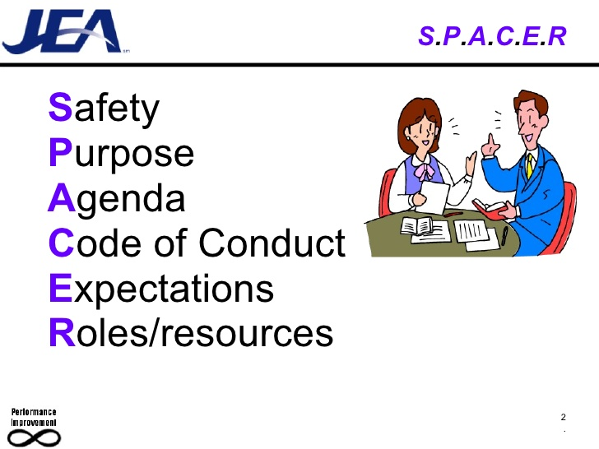
SPACER

Slide 6
SAFETY
Storm Shelter Location/Alert
Evacuation Alarm
Evacuation Routes and Assembly
Emergency Calling 911
Safety Concerns?
Restroom Locations
Let Jeff/Matt know if room is uncomfortable, you can’t see, hear, or anything else is interfering with your experience.

Slide 7
PURPOSE
What Will I Learn?
Discuss the impact of wet end chemistry on the machine operation.
Demonstrate the procedures and principles for improving the cleaning and conditioning of felts and wires.
Recognize causes of tissue runnability problems in the press/Yankee/hood drying system.
Identify runnability problems and opportunities for improvement on the dry end of the paper machine.
Identify problems with the Yankee dryer steam, coating, and hood systems to increase machine productivity.
Professional Development Credits
15 professional development hours or 1.5 Continuing Education Units (CEUs) are available to attendees

Slide 8
AGENDA
DAY 1: Tuesday, May 23rd
MODULE I: STOCK PREPARATION AND WET-END OPERATIONS
7:45 – 8:15 a.m. Welcome and Course Overview – Jeff Peters/Jim Bell (Matt Gregerson)
8:15 – 9:00 a.m. Wet End Chemistry Impacts and Optimization – Robert Melchiors, Nalco
9:00 – 9:45 a.m. Forming Fabric Options and Benefits – Matt Gregersen, Albany
9:45 – 10:00 a.m BREAK
10:00 – 11:00 a.m. Tissue Former/Headbox Operations and Optimization – Bruno Tremblay, Valmet
11:00 – 12:00 p.m. CASE STUDY: MODULE I
12:00 – 12:45 p.m. LUNCH

Slide 9
AGENDA
Day 1 (Continued)
MODULE II: PRESSING AND DOCTORING OPERATION
12:45 – 1:30 p.m. Press Fabric Options and Benefits - Matt Bryer, Albany International
1:30 – 2:15 p.m. Clothing – Cleaning and Conditioning Best Practices – John Neun, Kadant
2:15 – 3:15 p.m. Press Roll Operation and Optimization (SPR, BDR, etc.) – (Bill Bork (substitute for David Williams), Valmet
3:15 – 3:30 p.m. BREAK
3:30 – 4:15 p.m. Creping Best Practices – Jeff Peters, BTG Americas
4:15 – 5:15 p.m. Yankee Coating Systems – David Welsford, Solenis
5:15 - 5:30 p.m. Q&A for Modules I & II

Slide 10
AGENDA
DAY 2: Wednesday, May 24th
7:45 – 8:00 a.m. Day 1 Overview – Jeff Peters/Jim Bell (Matt Gregerson)
8:00 – 9:00 a.m. CASE STUDY: MODULE II
MODULE III: DRYING AND DRY-END OPERATION
9:00 – 10:00 a.m. Yankee Dryers – Safety, Steam, Condensate Systems – Mike Soucy, Kadant
10:00 – 10:15 a.m. BREAK
10:15 – 11:15 p.m. Yankee Hood Design, Operation and Optimization – Yvan Fraser and Don Carpenter (substitutes for Jean Desharnais), Enerquin
11:15 – 12:15 p.m. Thru-Air Drying – Bruno Tremblay, Valmet
12:15 – 1:00 p.m. LUNCH

Slide 11
AGENDA
Day 2: Continued
1:00 – 1:45 p.m. Tissue Calendering - Mark Sorenson, retired Kusters-USA
1:45 – 2:45 p.m. Improving Dry End Performance – Todd VandenHeuvel and Shawn Hougas, Valmet
2:45 – 3:00 p.m. BREAK
3:00 – 400 p.m. Diagnostics & the Tissue Machine – Jeff Peters, BTG
4:30 – 5:00 p.m. CASE STUDY: MODULE III
5:00 – 5:30 p.m. Evaluation and Final Adjournment

Slide 12
CODE OF CONDUCT
Remember the TAPPI Code of Ethics and Antitrust policy
We are all here to learn – Please ask questions!
Please join in and share relevant experience or real data on the topic
Please no sidebar discussions - Share thoughts so we all learn
We have scheduled short breaks, please be prompt in returning
Set cell phones to vibrate!
Parking Lot records unanswered questions/deferrals to later sections

Slide 13
EXPECTATIONS
Participant Expectations
  Introductions before we start
    Name, position, tissue experience
    Key topics or problem you want discussed recorded in parking lot
    Others???
Instructor Expectations
  Participants ask questions/participate!
  Fill out evaluations as each presentation is completed – We need feedback!
  If we are not meeting your expectations – tell us now if you can
  Return evaluations to Bruce in envelope before you leave!

Slide 14
ROLES/RESOURCES
Instructors: panel of experts (15) engaged on all presentations (see biographies)
Participants: share knowledge within TAPPI guidelines
TAPPI notepad for note taking (paper is good - this is TAPPI!)
Course PDF presentations available on flash drive

Slide 15

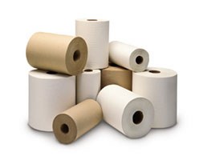
Thank you for your attention…
Any questions?
Jim Bell (Matt Gregerson) and Jeff Peters
Course Co-chairs
Notes:
15

