Slide 1
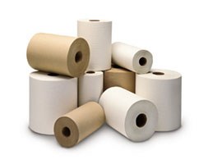

Creping Process Optimization
May 23 – 24, 2023
Miron, Appleton, WI
Jeff Peters
BTG Americas
Tissue Applications Manager
Jeff.peters@btg.com
(269) 823-3137
Notes:
Welcome to the Creping and Doctor Blade Geometry Variables session. We’ve learned a lot about wet-end chemistry, forming and pressing and we finally got that sheet to the Yankee dryer. Now we need to do something with that sheet to provide value and something, we as consumers, want.

Slide 2
Learning Objective
Gain an understanding of the importance of proper maintenance, alignment and calibration of the Yankee blade holders for optimum creping performance and efficiency.

Slide 3
Agenda
Creping Best Practices
Optimizing Blade Holder Performance
Factors Affecting the Creping Process
Maximizing Doctor Blade Life and Sheet Quality
Notes:
What I’d like to focus on today is reviewing the creping best practices, looking at ways to optimize the blade holder performance, discuss some of the factors that affect the creping process and wrapping up with discussing ways to maximize blade life and sheet quality.

Slide 4
Toilet Paper Statistics
What 20th century “convenience” is most taken for granted?
49% – TOILET PAPER!
32% – zipper
19% – frozen foods
If stranded on a desert island with only one “necessity”, what would you choose?
49% chose toilet paper as their greatest island necessity (ahead of food!)
Do most people hang the toilet paper roll with the sheet over or under?
72% – hang sheet over the roll
28%- prefer to hang sheet under the roll
For what other reasons do we use toilet paper?
Nose Care – 61%
Wiping small spills – 17%,
Removing makeup – 8%,
Cleaning mirrors – 7%,
Cleaning a child’s hands/face – 3% (Charmin.com)
To cover the toilet seat, cleaning glasses (Kimberly-Clark)
Source: Paul Burden
Notes:
To help wake everyone up a little bit I’ve compiled some fun Toilet paper statistics.
Have some fun going over these statistics. Ask the class how they hang their roll of toilet paper? Are they obsessed with how they install it? I know I am. If I find a roll that is under, I will change it so the sheet hangs over.
4

Slide 5
Toilet Paper Statistics
Are most people “wadders” or “folders” of toilet paper?
women are more apt to be grabbers and wadders
men tend to be folders
Folders/Stackers: 40%
Wadders: 40%
Wrappers: 20%
In a different survey,
Folders – 52% of men & 38% of women
Wadders – 38% of men & 52% of women
No preference – 6% of men & 7% of women
Don’t know – 4% of men & 3% of women
Source: Paul Burden
Notes:
Again, have some fun with this slide too. Ask the class how many are folders or wadders?
In a different survey, I’m always concerned about the ‘Don’t know’ folks. Next time you go to shake someone’s hand, you may ask yourself, is this person in the ‘Don’t Know’ category?
5

Slide 6
Creping Best Practices
Notes:
Transition Slide

Slide 7
Four Components
Process Stability
  Conventional or Structured
Yankee Coating
Blade Holders
  Creping, Cleaning, Cut-off
Doctor Blades
  Creping, Cleaning, Cut-off
Process
Stability
Yankee
Coating
Doctor
Blades
Blade
Holders

Slide 8
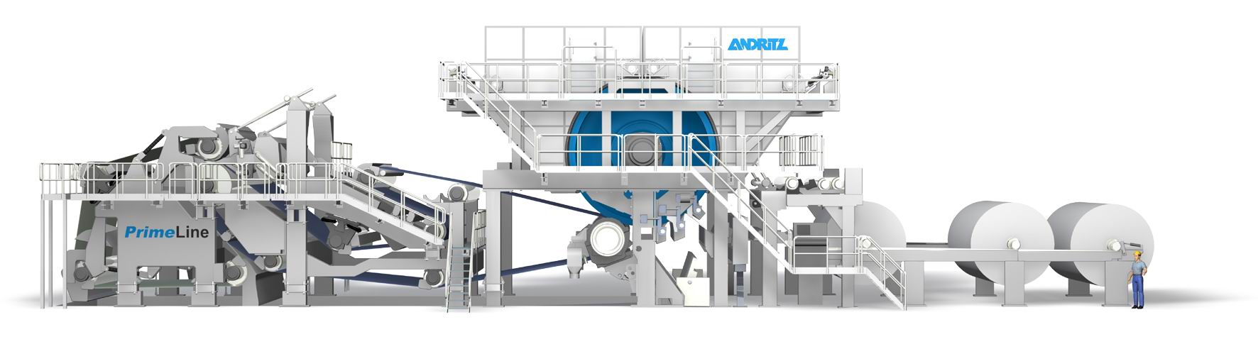
Process Stability Requirements
1. Measure & Control
3. Quality and Productivity
Water
© Andritz AG 2007
Fiber
Wet end
additives
2. Maximize Potential
By measuring, controlling and reducing process variations from the wet end, the creping performance can be significantly improved
Notes:
So far in the course we‘ve talked about the importance of properly managing the wet-end of the process. This part of the process is sometimes neglected when it comes to consistency and flow measurement and control. If we don‘t have the fiber prep, sheet forming and pressing part of the process optimized, it makes the next part of the process (drying and creping) extremely difficult.
So, if we measure and control accurately we will reduce process variation and maximize the potential at the creping blade. This will ensure optimum quality and productivity.

Slide 9
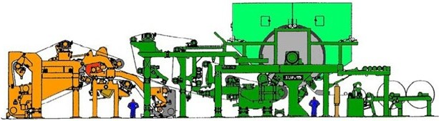
Simple Creping Schematic
Hood
Yankee
Cut off blade
Reel
Felt
Creping blade
Web
Pressure roll
Cleaning blade
Notes:
What we are focusing on in this session is the creping part of the process. How many people have a cleaning blade? How many people use this cleaning blade? How often do you service your creping blade? How often do you profile it? 1, 2, 3 times a year? How often do you service and profile your cleaning and cut-off (skinning) doctors?
Why don’t we spend as much time servicing and profiling our cleaning and skinning doctors? Do they perform an important role? Could the potentially damage the Yankee surface?

Slide 10
Optimizing Blade
Holder Performance
Notes:
We’ve summarized the creping process to establish our baseline. Now we will move onto optimizing blade holder performance.

Slide 11
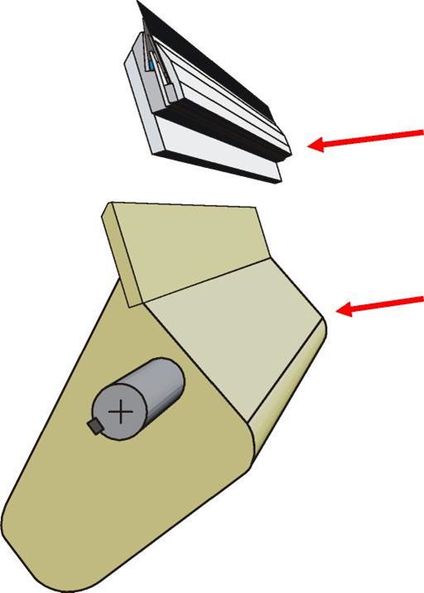
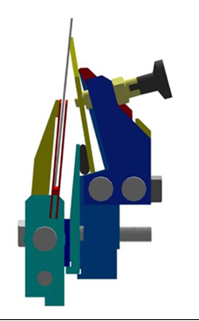
Blade Holder Components Review
Stickout
Blade
Pressure Blade
Blade Holder
Loading
Spring
Plunger
Cartridge
Blade Holder Beam
Loading Tube
Notes:
As a quick review, let’s identify the key components of the blade holder system

Slide 12
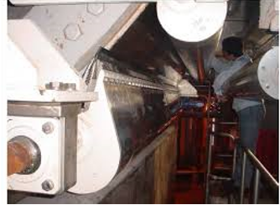
Four Critical Requirements
Properly Profiled
Loading Verification
Oscillation
Preventative Maintenance

Slide 13
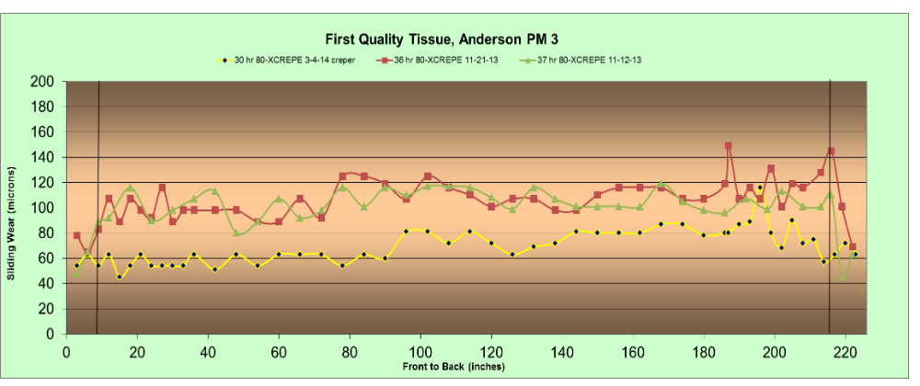
Blade Sliding Wear Profile
Typical blade wear sliding wear analysis
Any areas of possible concern?
Notes:
Typical sliding wear profile of three different blades taken from the machine at different times over several weeks. The green line is the oldest, followed by the red and the yellow line is the newest. Do you see anything that may raise some level of concern? Is there something you’d like to check?

Slide 14
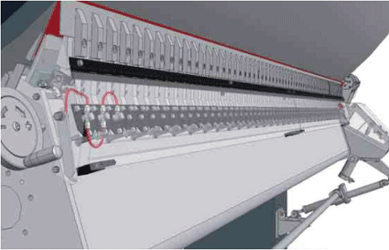

Importance of Blade Wear Analysis
Story board of the Yankee dryer surface
Provides valuable information about
  How uniformly the blade is loaded?
  Coating uniformity
  Uniformity of blade holder set-up
    Wear Angle matches Holder set-up angle
    Levelness of the holder from front to back
    Loading Pressure uniformity
  Blade Life
Notes:
Why is it important to do blade wear profile analysis?
First, it’s the story board of the Yankee dryer surface. It provides an valuable information about:
-How uniformly the blade is loaded? Is it wearing uniformly across the width of the blade? Is the wear rate uniform?
-Is non-uniform wear rate the result of poor coating uniformity as a result of plugged nozzles, wet streaks or poor BW profile
-Is the holder set up properly? Has the wear profile been changing over time?
-Am I getting the blade life I expect? Can I improve blade life and creping efficiency by making some adjustments?

Slide 15
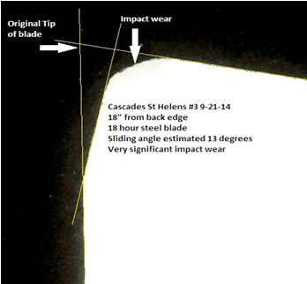
Wearing Surfaces
Sheet
Sliding
Wear
What do you think causes sliding wear?
What do you think causes impact wear?
Zero
Reference
Line
Sliding
Wear
Line
Notes:
This is a picture of the blade tip. A mold is made of the tip and then looked at under the microscope. Two parts of the blade tip are analyzed:
The sliding wear. What do you think causes sliding wear?
The impact wear. What do you think causes impact wear?
If we extend the lines on the back and tip of the blade we can get an idea of how much of the blade tip has been removed.
What measurements can we get from the sliding wear line? What can we verify with this measurement?

Slide 16
Blade Sliding Wear Profile
What could be wrong?
Notes:
This chart illustrates the history of six different blade wear analyses over a couple month period of time. The red lines are the oldest, while the black line is the most recent analysis. Do you see anything here that may raise some concern? What could possibly be wrong? I just had the holder profiled.

Slide 17
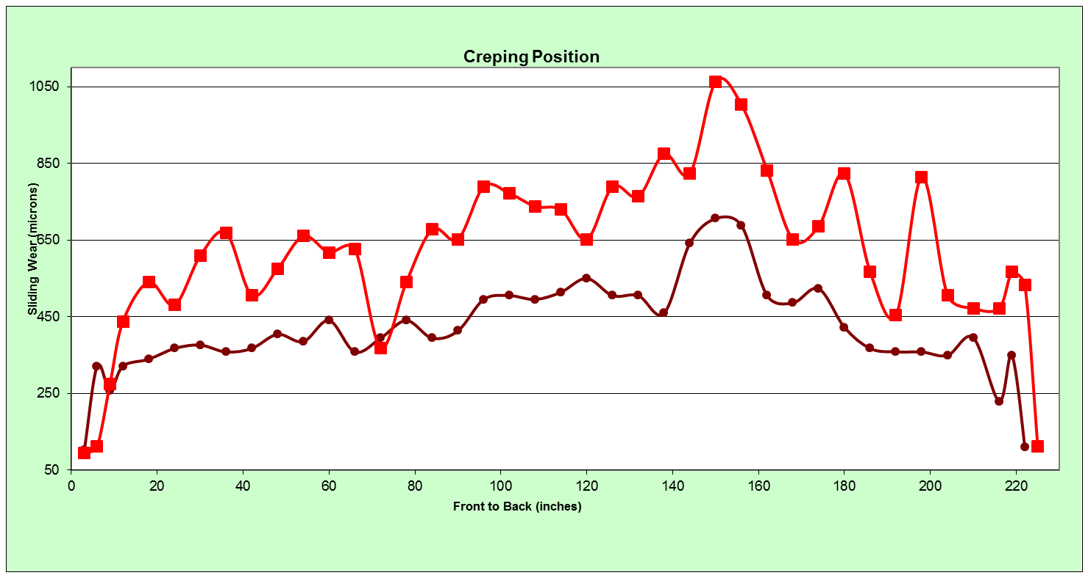
Sliding Wear Profile
70 hr blade
25 hr blade
What could be wrong?
Notes:
This chart compares the wear pattern of a 25 and 70 hr blade. Do you see anything here that may raise your level of concern? Why does the 25 hr blade show so much wear to a blade that lasted 70 hrs?

Slide 18
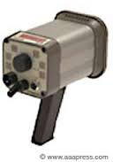

Important Blade Wear
Process Parameters
Picture of the Moisture & Basis Weight Profiles
Blade holder angle and pressure (pli or kN/m)
Blade stickout (inches or mm)
Coating add-on rates (mg/m²)
Coating uniformity on the Yankee surface
  Visual with flashlight
  Visual with strobe light
  Compare to BW, Moisture and Blade wear profiles
How long the blade has run?
Reason for removal
Grades being produced
Furnish
Notes:
There are a number of important process parameters to monitor and track when doing blade wear analyses to get a good picture of what is going on and to start building a historical data base. This historical data base can be extremely helpful in troubleshooting problems when the blade wear profile changes, like we discussed earlier in this session.

Slide 19
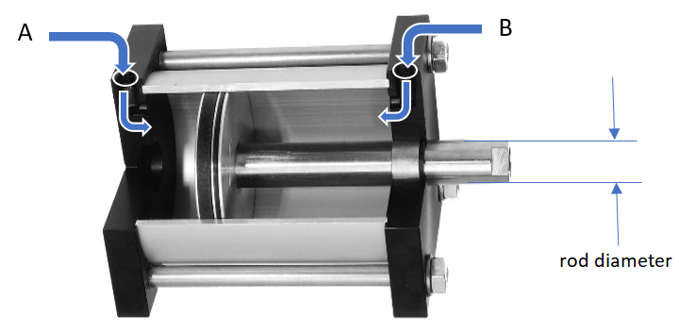
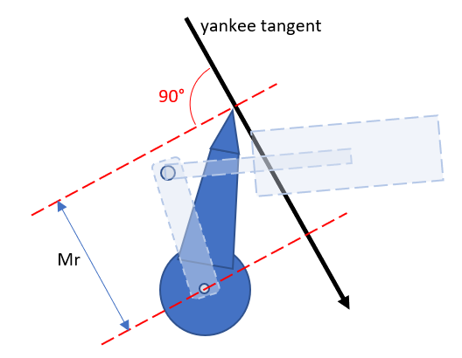
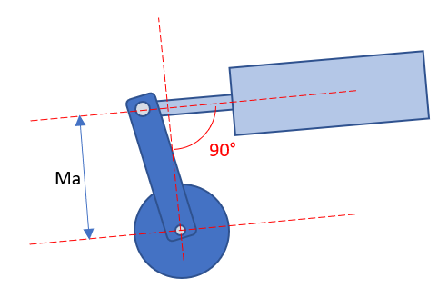
Loading Verification
All Holders
Confirmation of OEM Calculations
  Pressure = correct lineal load
Loading Sequence
Smooth Operation

Slide 20
Critical Operator Routine Process Checks
Yankee surface with a flashlight
  Coating uniformity
  Sprayboom nozzles
Yankee and sheet surface with a strobe light
  Coating uniformity
  Coating integrity (smooth or chatter)
  Sprayboom nozzle spray
  Sheet imperfections
Blade loading pressure
  Uniform front and back
Blade loading sequence
  Moved into position
  Loading tube pressurized
Blade oscillation
  smooth
Notes:
We all see many things when working in a mill. We sometimes wonder why people do the things they do and don’t react until something critical happens that adversely impacts the performance of the machine or more seriously, damage to the Yankee surface or a safety incident.
Each operator should routinely check a number of process variables around the Yankee to ensure there are no issues with the blade, blade holder and creping process. These process checks are:
Check the Yankee surface with a flashlight
Check the Yankee surface, sheet and sprayboom with a strobe light
Verify blade loading pressure, front and back
Verify blade loading sequence, front and back
Is blade oscillation working and smooth?

Slide 21
Doctor Blade Loading Tubes
Load Tube Failure
  Frequent, if not most common cause of doctoring problems
  Environment (high heat) and age
    Tubes become brittle and fail
  Relatively easy to replace
  Check with doctor supplier on best material and replacement schedule

Slide 22
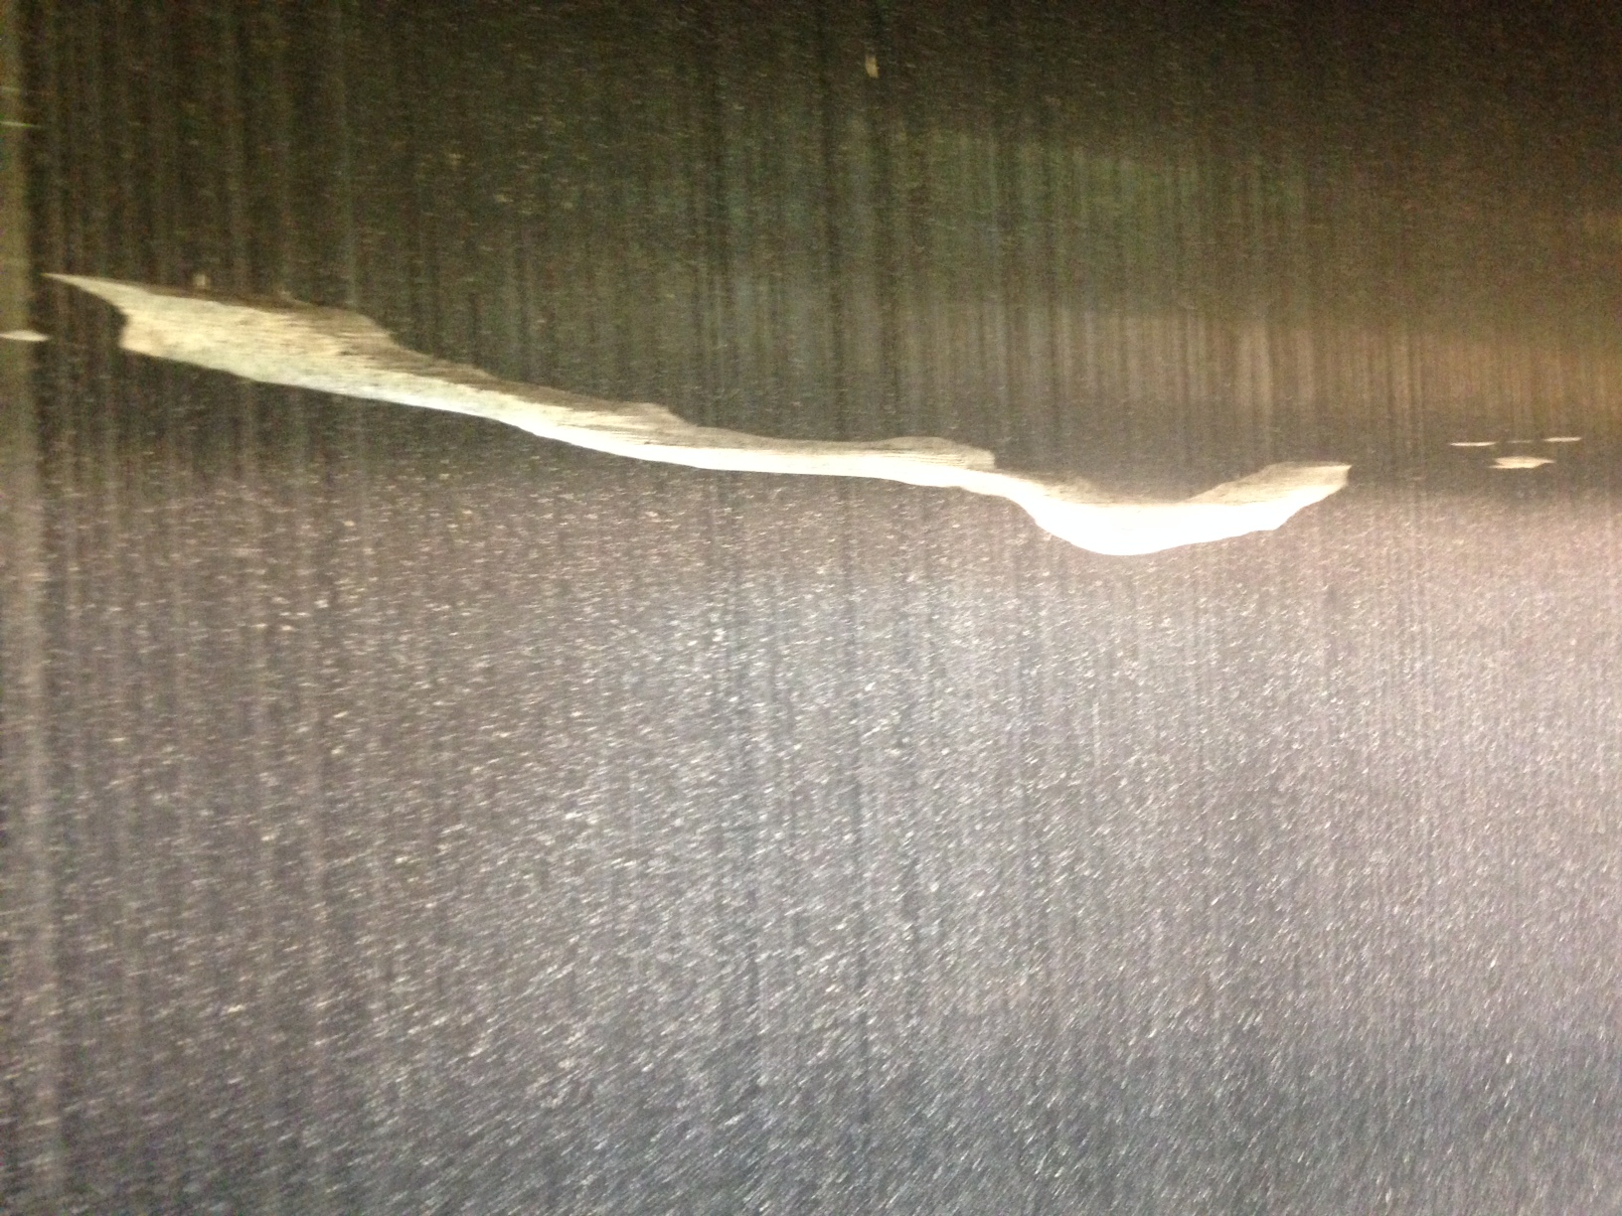
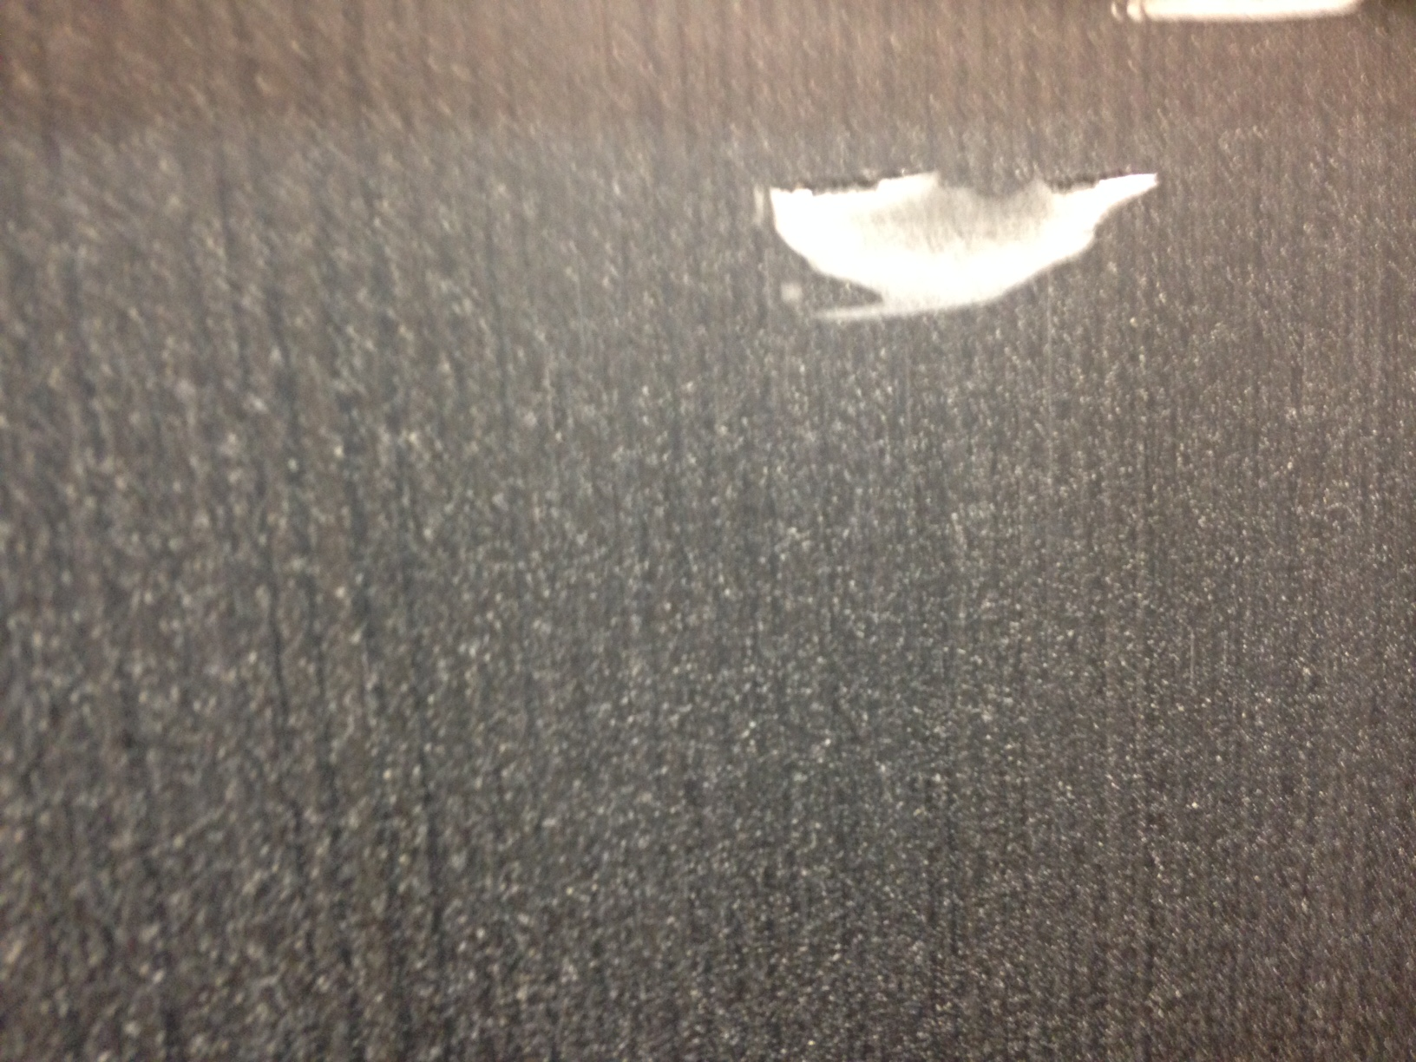
What Happened Here?
Notes:
Nobody seems to know what happened? All we heard was a very load noise and the creping blade was mangled.

Slide 23
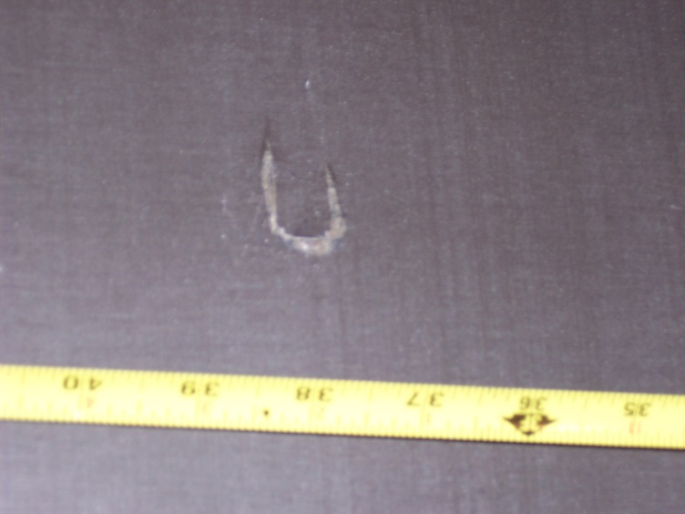

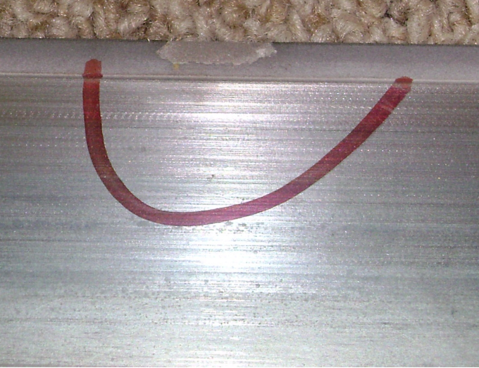
Please Don’t Do This
Yankee
Notes:
I’ve seen this happen a couple times, yet no one admits they ever do this. Please don’t do this, especially with a ceramic blade as you run the risk of chipping the blade tip and damaging the Yankee surface.

Slide 24
Yankee Doctor Maintenance Quick Reference Chart
Item/Schedule | Daily | 3 Months | 6 Months | 1 Year | 3 Year | 5 Year | As Needed
Holder
Hygiene ¹ | ü
Set-Up ² |  |  | ü
Rebuild³ |  |  |  |  |  | ü
Holder Components
Cartridge (Cartridge Type) ⁴ | ü |  |  | X
Step Up Strip (Ladder Type) ⁴ |  | ü |  |  |  |  | X
Backing Blade | ü |  |  |  |  |  | X
Edge Fingers ⁵ |  | ü
Tube Liquid | ü |  |  |  |  |  | X
Tube Poly |  | ü |  | X
Air Tube (for air loaded holders)
Doctor Components
Bearings |  |  | ü |  | X
Air Cylinders ⁶ |  |  | ü |  | X
Load Control Components |  |  |  | ü |  | X
Oscillation | ü |  |  |  |  |  | X
Interlocks |  |  |  | ü
ü= Inspect X = Replace
Holder Hygiene – remove components from holder and clean internal cavities and individual components prior to re-assembly
Set Up – confirm doctor is square and level. Profile to Yankee surface and graph results. This should be done at every grind.
Rebuild – should consist of holder disassembly, cleaning, replace all mounting bolts and adjusting screws. Re-tap as necessary.
Cartridge / Step Up Strip – blade is registering against this components so it should be checked for wear (especially at TS) to confirm uniform stickout
Edge Fingers – confirm that no debris has infiltrated preventing movement or pushing fingers towards Yankee surface. Confirm dust shield is intact. Disassemble and clean.
Air Cylinders – confirm connections at lever and base, check for wear, confirm air cylinder condition by checking for blow by.
Notes:
The Yankee Doctor Maintenance chart was developed by a sub-committee of the Yankee Dryer Safety and Reliability Committee. This is a good guideline to follow, in addition to your manufacturer’s recommended maintenance schedule to ensure reliable, trouble-free performance from your blade holders. The check marks refer to inspect and the ‘X’ refers to replace.

Slide 25
Summary
Establish a routine inspection/maintenance schedule
  All doctor holders
Oscillation Strongly Recommended
  More uniform blade wear
  More uniform sheet quality
  Less than ¾”, 6 cycles/min
  Doctor blade should never overhang the edge of the Yankee
    Especially on metallized surface
  Must be interlocked with Yankee rotation
Utilize blade wear analysis to confirm profile alignment
  Optimum profile + 0.1º , tolerable +0.3º
  Level within 0.005” at primary crown
Notes:
We talked about some of the tools we have at our disposal to help verify if our blade holders are properly aligned and operating as intended. Let’s review some of the steps we should take to ensure we are optimizing the blade holder performance.

Slide 26
Factors Affecting
the Creping Process
Notes:
Getting the blade holder set up properly is critical to a successful creping operation. We discussed the importance of blade wear analyses and how they are a valuable tool to assist in ensuring our blade holders are properly aligned and functioning properly. Now let’s talk about some of the blade related factors that affect the creping process.

Slide 27
Creping Geometry
Yankee Dryer
Angles:
α – Blade Wear Angle
β – Blade Bevel Angle
δ – Creping Pocket Angle
δ
α
β
α
β
Creping Pocket Angle = 90º - +
Typical Creping Pocket Angle: 65º – 95º
Notes:
Let’s talk about creping geometry and the impact it has on sheet properties. We will start by reviewing the common definitions used in the industry.
Blade Wear Angle ‘α’ (alpha) is the angle which is measured from the line tangent to the Yankee surface to the blade. The range varies depending upon the type of tissue being made. We will discuss in detail later in the presentation.
Blade Bevel Angle ‘β’ (beta) is the angle on the tip of the blade.
The creping pocket angle ‘δ’ (delta) is the angle from the line tangent to the Yankee and the tip of the creping blade.
The creping pocket angle is calculated using the following formula (90 – α + β) when the blade bevel angle is reported, for example, as 0, 10, or 20 degrees, etc. The formula is (180 – α + β) when the blade bevel angle is reported, for example, as 90, 80, 70 degrees, etc.
Typical creping pocket angle varies from 65 degrees for budget quality/towel grades to 95 degrees for ultra premium and premium grades.

Slide 28
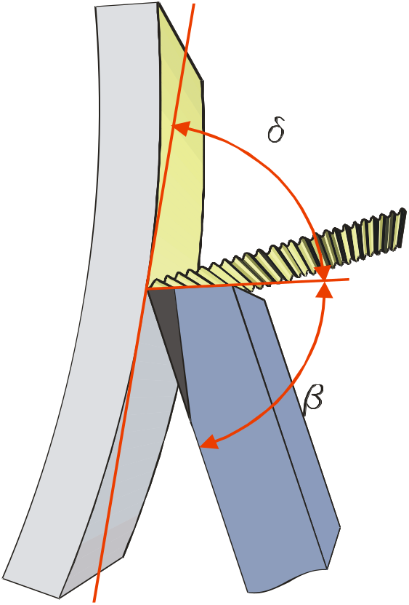
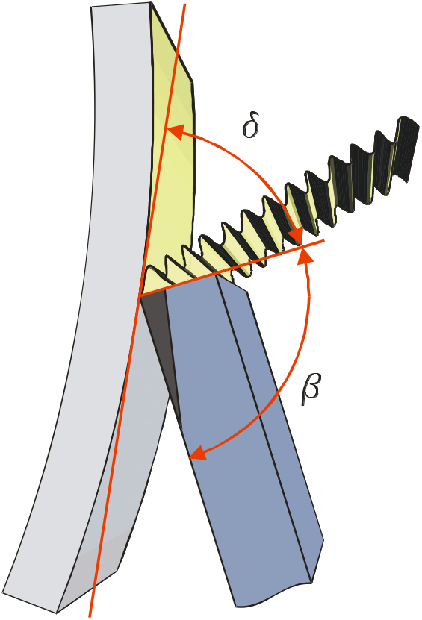


Influence of Pocket Angle
Pocket Angle
Pocket Angle
Yankee-
Cylinder
Yankee-
Cylinder
Sheet
Sheet
High Pocket – Fine Crepe
Small Pocket – Coarse Crepe
Notes:
2
The size of the creping pocket will influence the type of creping produced and the final sheet properties.
An increase of the creping pocket angle δ has the effect that the creping quality gets finer with a lower caliper, shorter wavelength and a softer hand feel of the paper.
A decrease of the creping pocket angle δ has the effect that the creping quality gets coarser with a thicker caliper, longer wavelength and a coarser hand feel of the paper.

Slide 29
Ways to Change the Creping Pocket
Blade Holder Angle
Blade Bevel Angle
Blade Height or Stickout
Blade Loading Pressure
Blade Thickness
Blade Material
All these influence
CREPING POCKET
or
IMPACT ANGLE
Notes:
So, if the creping pocket has such a large influence on our final sheet properties and we make multiple grades on the same machine, what are some of the ways we can change the creping pocket? Some ways are more difficult than others.

Slide 30
Blade Holder Angle
The angle between the lower face of the creping blade and the tangent to the Yankee surface
Typical range is 10 to 30°
  15° to 20° (Conventional)
  20º to 30º (Structured)
Lower blade angles provide finer
crepe and minimize wear
Higher angles more aggressive on the coating
Yankee Dryer
δ
α
β
α = blade holder angle
Notes:
Changing the blade holder angle is one way to alter the creping pocket, but this can be a difficult and time consuming project. It usually requires the machine to be down so the holder can be loosened and moved to the new position.
The remainder of the slide is self-explanatory.

Slide 31

Crepe Blade Bevel Angle
+15°
+10°
+ 5°
0°
- 5°
-10°
-15°
-20°
}
Positive Angle
No Angle
}
Negative Angle
Thickness
1200 1000 880 635 μm
.050 .040 .035 .025 inch
What side of the blade do you put toward the dryer? High side or low side?
What impact will this have on the crepe type and sheet properties?
Notes:
Another option is to change the creping blade bevel. This is very easy to do, as blade suppliers offer blades in a multitude of angles, so it’s just a matter of switching one blade bevel angle for another if two different grades require different finished sheet properties.
As illustrated here, blades come in a variety of angles, from positive to negative.

Slide 32
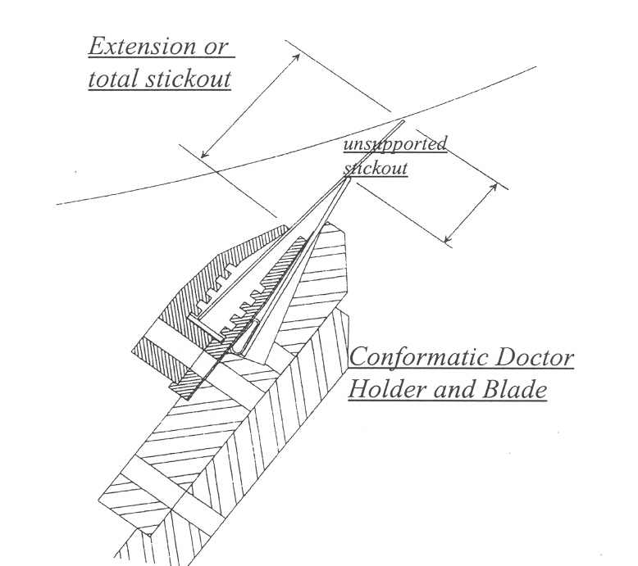
Blade Stick-out/Height or Free Height
The distance the crepe blade sits out of the holder (“stick out”)
Typical is ½” to 1-½”
At equal pressure, the higher the blade height, the less coating will be removed.
An increase in blade height results in less creping and reduced blade wear
Notes:
Blade stick-out or free height is another common way to alter the creping pocket. The stick-out or free height is referred to as the portion of the blade that sticks out beyond the backing blade. If you have a holder with a ladder type adjustment, it is rather easy to adjust the stick-out by removing the ladder shim and moving it up or down in the various slots. The increments are typically 1/8”. A good rule of thumb is, at equal pressure within the normal operating range, an 1/8” change in stick-out will change the pocket angle by 0.75 to 1 degree.
Typical stick-out is ½” to 1-½”. The majority of the stick-outs run between ¾” and 1”.

Slide 33
Blade Pressure
The force used to keep the blade in contact with the Yankee Surface
Varies based on blade thickness and height
Typical range:
  15 to 25 pli (conventional)
  25 to 45pli (structured)
As the blade wears and the wear pad increases, blade tip pressure drops and crepe quality changes
Excessive pressure relates to more Yankee wear and possible generation of chatter marks
Notes:
Blade pressure can also be used to alter the creping pocket, however this technique is generally not used as mills will find a range where the machine runs best. Too much pressure can strip off too much coating and too little pressure can result in excessive coating build-up.
The first three bullet points are self-explanatory
The final two bullet points read:
As the blade wears and the wear pad increases, blade tip pressure drops and crepe quality changes
Excessive pressure relates to more Yankee wear and possible generation of chatter marks

Slide 34
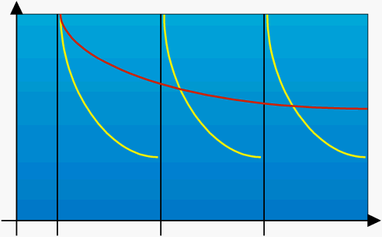
Contact Pressure vs Blade Changes
Initial loading: Blade has the sharpest edge and highest specific pressure
blade specific pressure
Steel blade
Ceramic
As the sliding wear increases, the specific pressure drops
As the specific pressure drops, the coating builds and the blade rides more into the sheet/coating interface
Time
Blade
change
Blade
change
Blade
change
Notes:
4
With both steel and ceramic blades, the initial loading on a sharp tip gives the highest specific pressure. This strips coating to a thinner level and as the blade wears the specific pressure drops and the coating builds. As this process continues, the specific tip pressure will drop to a point that will cause a degradation of qualities or sheet breaks. This process is much faster with steel vs ceramic blades.
What do you think happens to the sheet properties every time a creping blade is changed?

Slide 35
Blade Thickness
The depth of the blade from the back to the front
Typical is 0.035” to 0.050”
Blade thickness determines how
much “flex” a blade will have
against the Yankee surface
  Industry rule of thumb, each ¼” stick-out
  change results in a 2º pocket angle
  change (0.050” blade @ 16-20pli)
  May not hold true for structured tissue
Thicker blades require less
pressure to provide effective crepe
Thinner blades may give finer crepe
Notes:
Blade thickness can also have an impact on the creping pocket and sheet properties.
The first two bullets are self-explanatory. The next bullet point is:
Blade thickness determines how much “flex” a blade will have against the Yankee surface
What blade do you think will flex more, a thin blade or thick blade?
The last two bullet points are self-explanatory

Slide 36
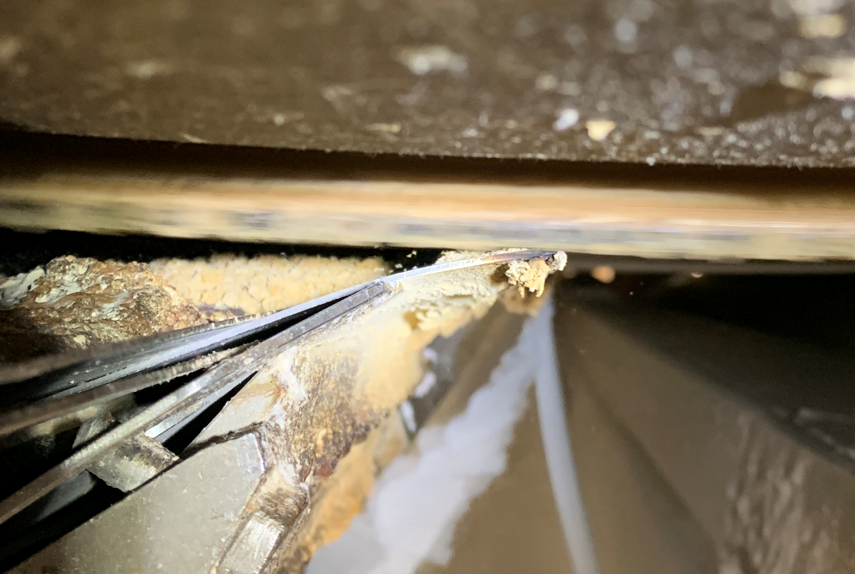
Extent of Deflection
Here as we start to zoom in, we will start to highlight the free portion of the blade deflecting greatly over the backing blade tip, with the captive portion that is in the cartridge having little to no deflection at all. The flanks of the cartridge and the backing blade are labeled overleaf.
cartridge flank
backing blade
cartridge flank

Slide 37
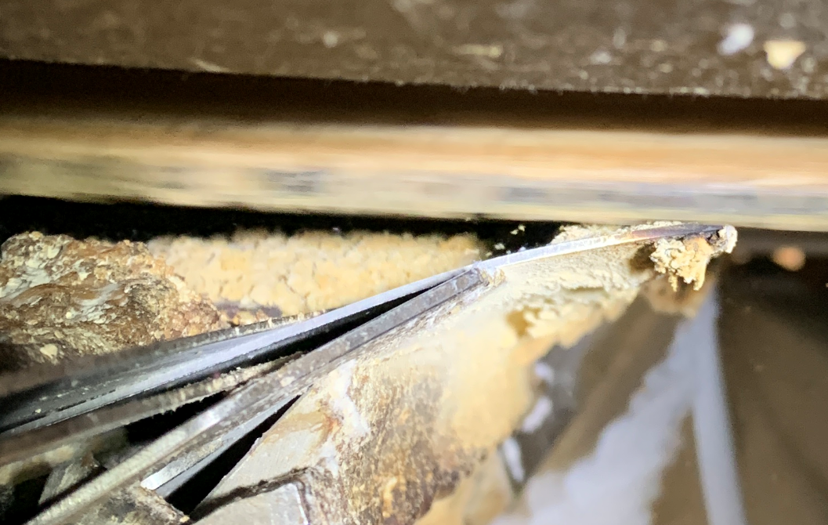
Extent of Deflection
backing blade

Slide 38
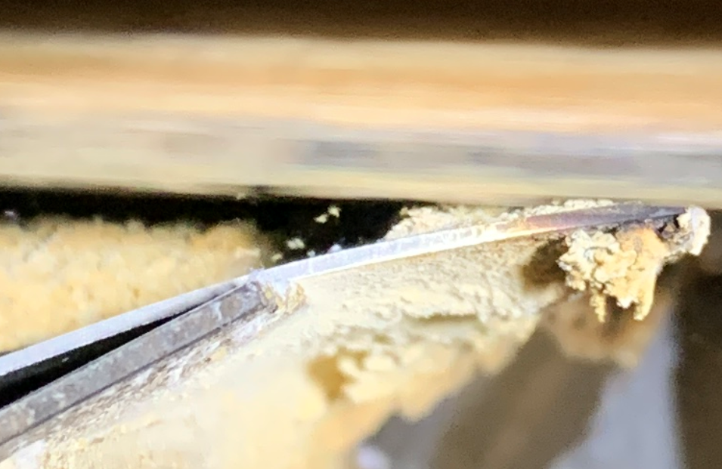
Extent of Deflection
~7°
backing blade

Slide 39
Extent of Deflection
yankee tangent
~7°
contact tangent (est.)
22-23°
original (captive) tangent (est.)
Overlaying tangents for the blade contact and the undeflected (captive) portion of the blade, the incredible extents of deflection are made more evident.

Slide 40
Extent of Deflection
From simple (cantilevered) beam deflection theory, we understand that for a given cross-section moment of inertia, I, (∝ blade thickness) and a given Young’s modulus, E, (i.e. 1074 BSS vs 1095 BSS vs 4130 SS, etc) the deflection, x, of a creping blade will be:
directly proportional to your lineal load (F)
directly proportional to the third power of length (L³)
inversely proportional to 3x the product of E and I
dx/dL = (FL³ ) / 3EI

Slide 41
Extent of Deflection
…and the angle of this deflection, θ, follows similarly:
dθ/dL = (FL² ) / 2EI
The lessons here are:
be 100% certain what your lineal load (force, F) is !
be 100% certain what type of blade material is being used !
be 100% certain what your length (stickout, free height) is !
be sure to correctly measure the static angle by putting the foot of the instrument on the right part of the arc, otherwise the actual sliding angle might be WAY OFF – your blade impression analysis is still the best technique to tell.

Slide 42
Maximizing Doctor Blade Life and Sheet Quality
Notes:
We’ve learned about the impact of blade holder angle and blade geometry on the creping pocket and sheet properties. Now, let’s shift gears and talk about the things we can do to maximize doctor blade life and stabilize sheet quality.

Slide 43
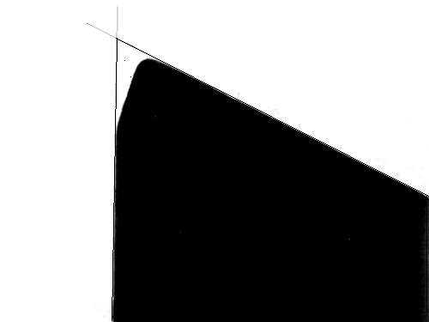
Typical Blade Life Cycle
Coating
Coating
Yankee
Blade
Coating
Yankee
Blade
New Blade
Yankee
Blade
Mid Life
End of Life
Notes:
We’ve looked at several different charts of blade wear profiles and talked about the things we can do to alter the creping pocket and sheet properties. Now let’s focus our attention on the typical life cycle of a creping blade and what can be done to maximize blade life without sacrificing product quality. When we first install a blade, we can all agree the tip is very sharp. This sharp tip will initially strip a lot of coating off of the dryer. The goal is to strip some of the old coating off from under the sheet and get rid of any hard coating build-up on the edges.
As the blade begins to wear, the tip is not as sharp, the specific tip pressure begins to drop and coating will begin to build-up on the Yankee dryer surface.
Eventually, the blade will no longer be able to effectively manage the coating and sheet properties will start to go our of spec or picking and tear outs (sheet breaks) may occur. Now it will be time to change the blade and start the process all over again.
What do you think happens to the creping pocket as the blade wears?

Slide 44
Creping Coating Control
Coating
Yankee Surface
Paper Web
Remaining coating
after creped sheet
Crepe
Doctor
Coating Dust
Cleaning Doctor
(levels coating)
Level and manage the coating
Notes:
To assist with maximizing creping blade life, some mills use a cleaning blade. The cleaning blade will help remove excess coating and prepare the surface for coating refreshment. Since this blade can be changed without breaking the sheet, it is much more economical to change a cleaning blade to extend creping blade life.

Slide 45


Wear Phenomena
Sliding wear between Yankee and blade
Unused steel blade
x 43
Worn steel blade
x 43
Lifetime: 6 hrs
Notes:
We talked about the wear phenomena earlier in the presentation. To further expand on this topic, the tissue maker must maintain tissue target values for as long as possible, optimizing wear conditions for both dryer and creping blade. Therefore, the understanding of wear mechanisms – in relation to changes in tissue quality – becomes very important.
Two different wear processes occur simultaneously at the blade tip:
Blade / dryer interaction, called sliding wear and
Blade / sheet interaction, called impact wear
Sliding wear
The blade / dryer interaction is called “sliding-“ or “friction wear”. In a conventional situation, the steel blade is loaded onto a cast iron dryer, the surface of which is covered with a thin organic coating. When loading a new blade, the theoretical contact is, at first, only at the sharp blade edge. However, the edge is quickly smoothed off and a small bevel is formed depending on the α angle.
The linear load is generally obtained by a pneumatic setting of the blade holder and is maintained constant during the process. However, the contact pressure decreases rapidly as the contact area increases. Therefore, the effect of sliding wear on the blade reduces the doctoring effect of the blade. The balance between adhesive force and release force acting upon the sheet is progressively modified. If the blade action is decreased too much, plugging of the sheet may occur. In such a situation, the only possible action is to change the blade, unless web adhesion can be decreased. Any attempt to increase the load will probably result in decreased contact angle α by the blade being further bent. Due to the fact that a sliding bevel already exists, the sheet will most probably pass through the small gap created by the blade running on the heel of the bevel and wrap around the dryer.

Slide 46
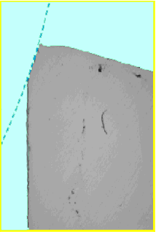
Wear Phenomena
Impact wear between paper and blade tip
Impact Wear
What effect would you
expect this impact wear
to have on sheet properties?
Yankee
Life time: 1h30
Notes:
Impact wear
The web is continuously impacting the blade tip at high speed. Over time, this situation results in a progressive but significant change of the impact area. The impact of the sheet has created a deep, longitudinal groove along the steel blade in approximately one and a half hours’ lifetime.

Slide 47
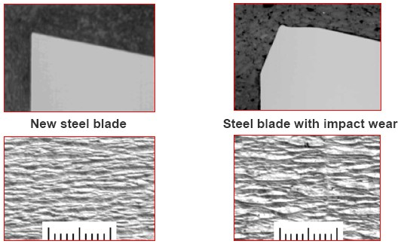
Impact Wear Effect on Crepe Quality
Notes:
As we mentioned in the previous slide, impact wear will result in closing of the creping product, producing a coarser, more bulky crepe. This slide illustrates the change in crepe quality as the blade wears.

Slide 48
How to Extend Doctor Blade Life
    Reduce Dryer Surface Friction Coefficient
    Crepe with Less Load on the Doctor Blade
    Use Harder, Thicker Blade Materials
    Reduce Doctor Blade Friction Coefficient
    Use a Cleaning Blade
Notes:
What steps can we take to extend doctor blade life?
Reduce dryer surface friction coefficient. How do we do this? Conduct an audit of your process to ensure the coating you are applying to the Yankee surface is not loaded with fines and ash, which can make the coating very abrasive. Use the right coating package for the application.
Crepe with less load on the doctor blade. In theory this will work, however in practice it may not be practical. You will find a certain blade load level is required to effectively manage the coating and creping process
Use harder, thicker blade materials. Again, in theory this will work, but a harder, thicker blade may not be practical to achieve the final sheet properties. The right coating needs to be used to properly protect the Yankee.
Reduce doctor blade friction coefficient. We will be covering this topic in the next couple of slides
Lastly, use a cleaning blade. The cleaning blade will help manage the coating taking some of the load off of the creping blade.

Slide 49
Reducing Blade COF
What is a “Ceramic” blade?
The wear resistant material is applied only to one corner of the blade tip.
Bevel angle
Width
steel
Wear resistant material
Length
Thickness
Notes:
A very common way to reduce the blade friction coefficient is to change the portion of the blade tip that is contact with the Yankee dryer from steel to ceramic. So, what is a ceramic blade? A ceramic blade is a steel blade that has been modified by replacing a portion of the blade with ceramic. This ceramic tip is the part of the blade that is loaded against the Yankee surface.

Slide 50
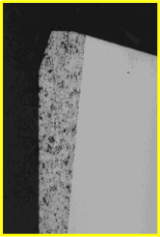
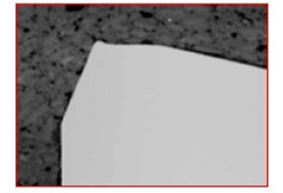
Sliding and Impact Wear Comparison
Worn Steel
Lifetime: 6 hours
Worn Ceramic
Lifetime: 78 hours
Notes:
This slide compares the blade wear of a steel and ceramic blade used on the same machine making the same grade. Please note, the ceramic blade is submitted to the same types of wear as the steel blade. However, thanks to the characteristics of ceramics the wear is much slower. The result is a more stable creping quality which allows the product to be produced within specification for a much longer time.

Slide 51
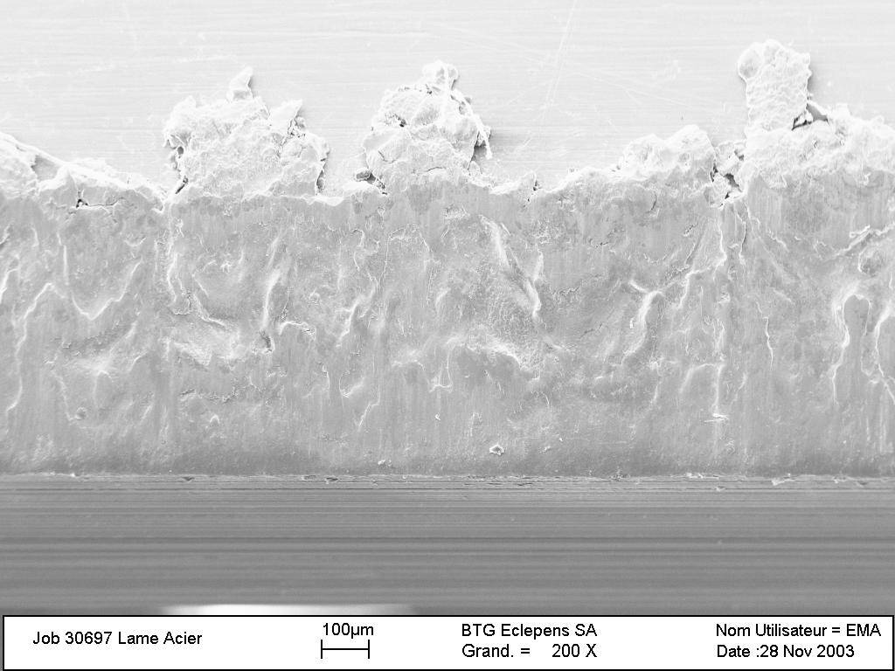
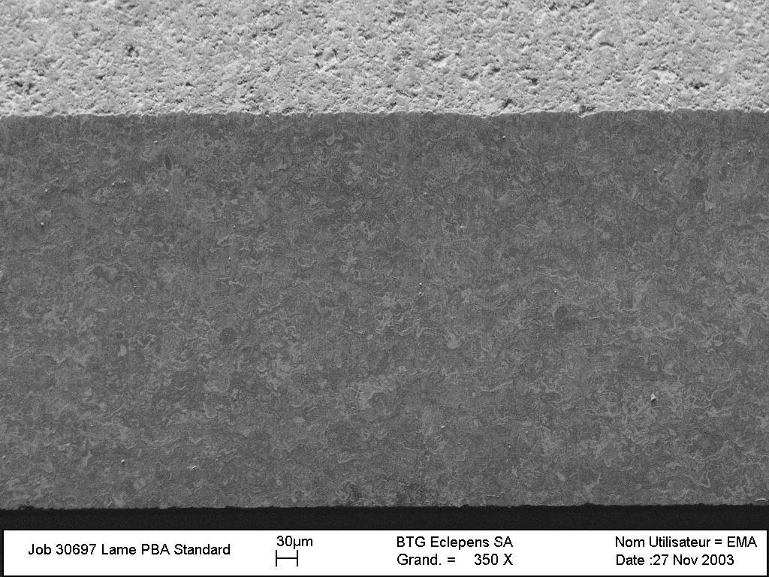
Friction Results
SEM views of blade tip
Smooth ceramic surface
Smeared steel surface
Blade temp raised up to 180°C
Blade temp raised up to 110-130°C
Notes:
This slides illustrates the difference in blade tip wear between a steel and ceramic blade using a scanning electron microscope. Note how the steel sliding wear surface is smeared metal versus the ceramic which is just worn. Also note how much hotter a steel blade runs versus a ceramic. This makes sense, since the bottom of the space shuttle was covered in ceramic tiles so it didn’t burn up on entry into the earth’s atmosphere. How many people have seen steel blades where the surface has gotten so hot that the metal was actually smeared on the blade tip? The blade tips of steel blades can become very sharp, so make sure you are wearing your PPE when handling blades.

Slide 52
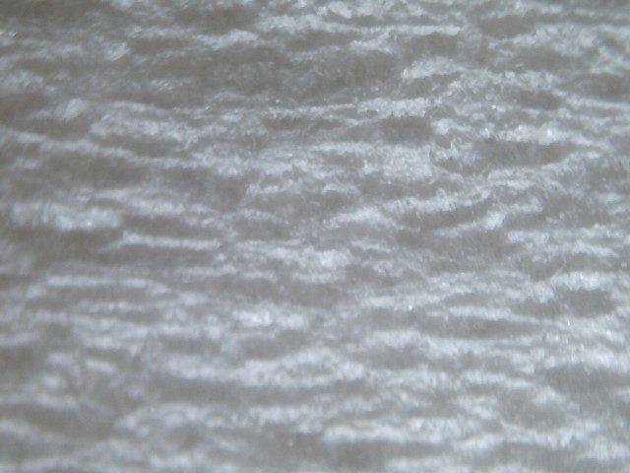
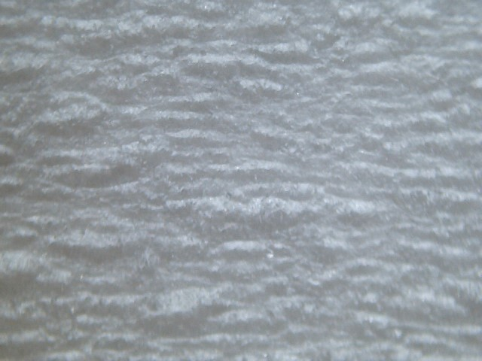
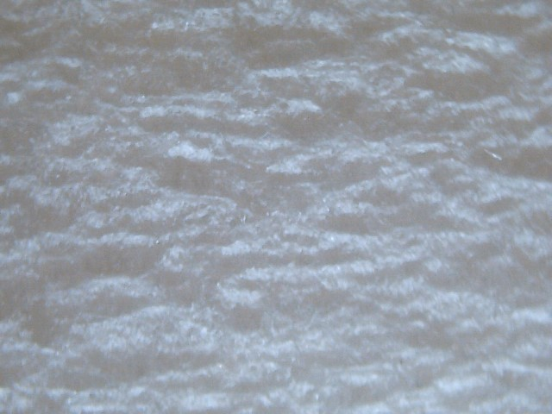
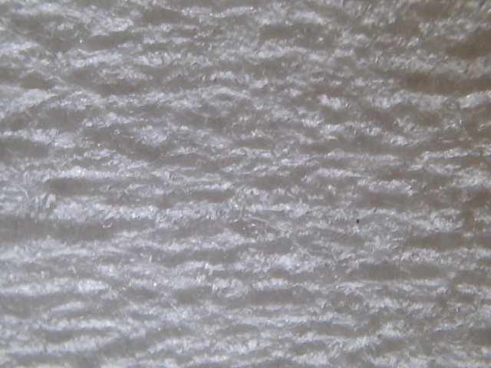
Impact of Blade Type on Quality
80-Steel
80-Ceramic
Premium Bath
100% Virgin
Crescent Former
Steel Life – 3 hrs
Ceramic Life – 24 hrs
1st Reel
56 crepe bars/in
1st Reel
80 crepe bars/in
Last Reel
48 crepe bars/in
Last Reel
80 crepe bars/in
Notes:
In this final comparison slide, it illustrates how much faster the sheet crepe quality can degrade for a steel versus a ceramic blade. There are many blade options available on the market today from steel, hardened steel tip, to ceramic and cermet. If you are looking to improve product quality stability and machine uptime, consult your blade supplier to assist you in selection of the right blade for your application and needs.

Slide 53
Frequently Asked Questions
Q: What is the typical blade stick-out?
A: ¾“ – 1-1/2“
Q: What is the typical loading pressure?
A: 15 – 25pli (wet/dry crepe); 25 – 45pli (structured)
Q: What is the typical blade holder angle?
A: 15 – 20º (wet/dry crepe); 20 – 30º (structured)
Q: What is a typical creping pocket angle?
A: 65 – 95º (82 – 87º premium, 87 – 95º super premium)
Notes:
I’m going to wrap up this session with some Frequently Asked Questions. The rest is self-explanatory.

Slide 54
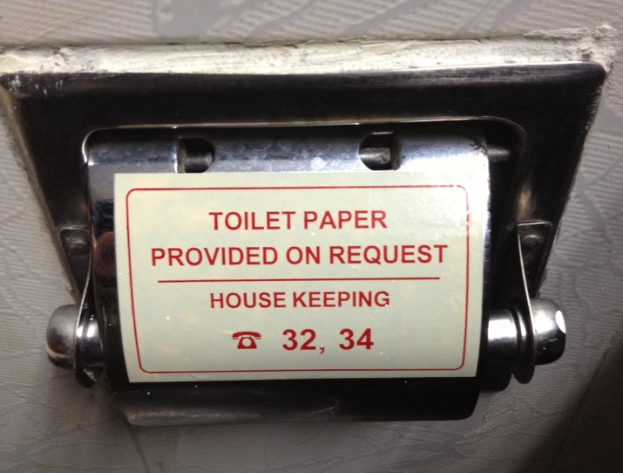
Summary
Creping Best Practices
Optimizing Blade Holder Performance
Factors Affecting the Creping Process
Maximizing Doctor Blade Life and Sheet Quality
Notes:
In summary, we started with an overview of creping best practices. We then discussed the importance of good blade holder maintenance and troubleshooting techniques to ensure optimum blade holder performance. We discussed the blade related factors that affect the creping process and wrapped up the session discussing ways to maximize doctor blade life and sheet quality. We only touched the surface on many of these topic areas, if you would like to learn more about any of these topic areas please let me or TAPPI know and we will work on developing the next level of training curriculum.

Slide 55

Thank you for your attention…
Any questions?
Jeff Peters
BTG Americas
Tissue Applications Manager
Jeff.peters@btg.com
(269) 823-3137
Notes:
55
Thank you for your time and attention. I will now open up the floor to address any final questions or concerns.

Slide 56
Case Study – Bulk Management
Grade 5 is a tissue grade with a very tight bulk target. It is a 100% recycled sheet made on a Crescent former with single pressure roll. The bulk target is 81, with a maximum of 83. The grade is currently produced using an 80º ceramic blade. Every time a new blade is inserted, the bulk will drop below the minimum target of 80, unless 5 – 8 points (350 – 500fpm reel speed reduction) of crepe are backed in (reel speed slowed down) for the first 2 – 3 sets (takes 45 – 60 mins per set). The reel speed is slowly increased back to normal range (30 – 33% crepe ratio, calculated as (Ys – Rs)/Rs)) over the next 28 – 32hrs, at which time the operators will struggle to keep bulk from getting too high. As bulk gets higher, operators pull crepe to the point where stretch is at the minimum and then the blade must be changed. Blade life on this grade is typically 28 – 36hrs. The objective is to achieve 40 to 48 hrs. Although the target bulk is 81 (max 83), operators like to keep bulk between 80.5-82.5, so the winder can more easily meet their bulk target of 79, without having to pull a lot of the stretch out of the sheet. There is typically a 1.5 - 2pt. drop in bulk through the winder. The calenders on the winder are no longer being utilized as they are in need of repair.
What steps would you take to eliminate the need to back in crepe at the blade change? What can be done to improve blade life? Note: Repairing or installing new calenders is not an option.

Slide 57
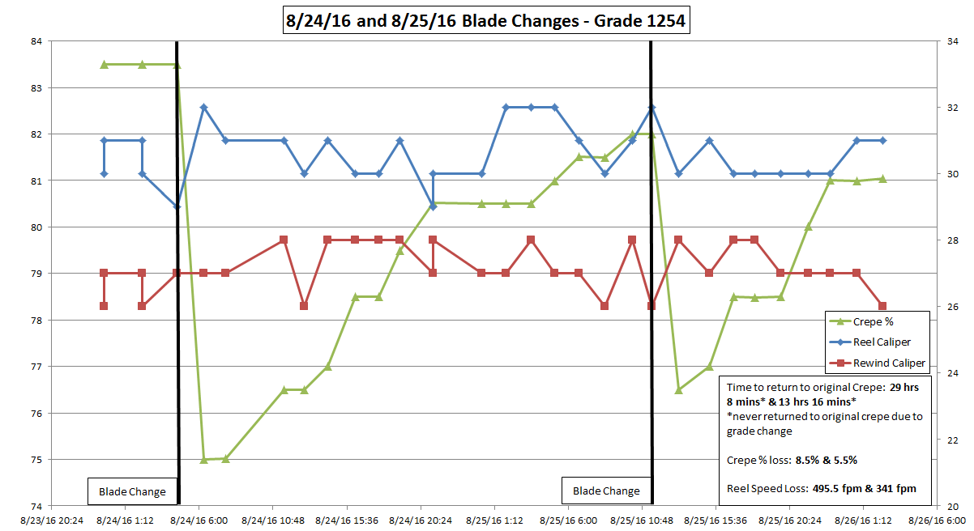
Case Study – Bulk Management
Impact of Blade Change on Crepe Ratio
% Crepe
Caliper
First Blade Change
Reel Speed Loss – 500fpm
% Crepe Loss – 8.5%
Second Blade Change
Reel Speed Loss – 340fpm
% Crepe Loss – 5.5%
5/20
5/20 20:25 1:15 6:00 10:50 15:35 20:25 5/21 1:15 6:00 10:50 15:35 20:25 5/22 1:15 6:00

Slide 58
Case Study – Potential Solution
Make adjustments to Yankee coating package to change the way the sheet is being creped off the dryer
Investigate different blade geometries to evaluate impact on coating removal at blade change and sheet properties
Investigate impact of changing drying balance between the Yankee and hoods

