Slide 1


Yankee Dryers
Safety, Steam & Condensate Systems
Presented by:
Mike Soucy
President
Kadant Johnson Systems

Slide 2
Objectives
Increase the understanding of Yankee operational risks
Purpose of a Yankee steam system
Components of a Yankee steam system
Control methods of a Yankee steam system

Slide 3
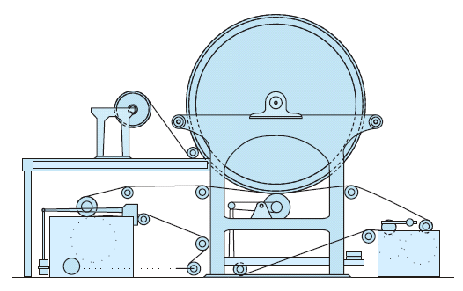
The Yankee Dryer Evolution
1820 the paper drying cylinder was first patented.
Normally heated by charcoal fire.
~1850 the “Yankee paper making machine”
Steam heated drying cylinders came into use.
~1900 Yankee diameters 2-3 m, steam pressures 0-200 kPa.
~1950 Yankee diameters 5 m.
1959 the internally ribbed Yankee
dryer shell invented by Beloit.
~1960 Yankee diameters 5.5 m
(18’) and above, steam pressures
up to 1100 kPa.

Slide 4
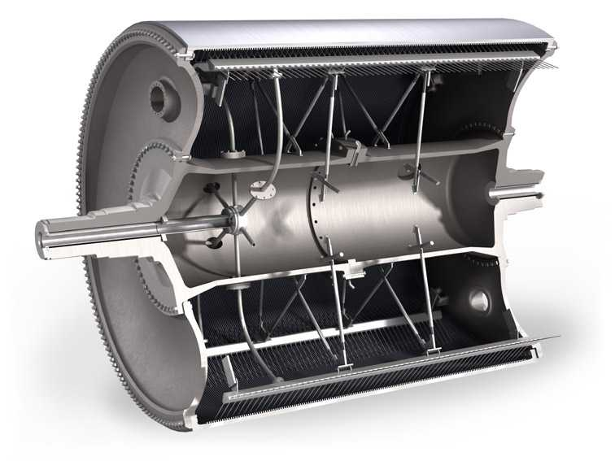
The Yankee Dryer Evolution
~1970 computer aided Yankee design (FEA).
~1980 - improved NDT
and quality control.
~1990 - improved full
face metallizing methods
and breakthrough.
~2000 ENP against the
Yankee. “high load Yankee
dryers” 120-200 kN/m
~ 2003 Steel gains traction
~ 2020 Steel dominates the market

Slide 5
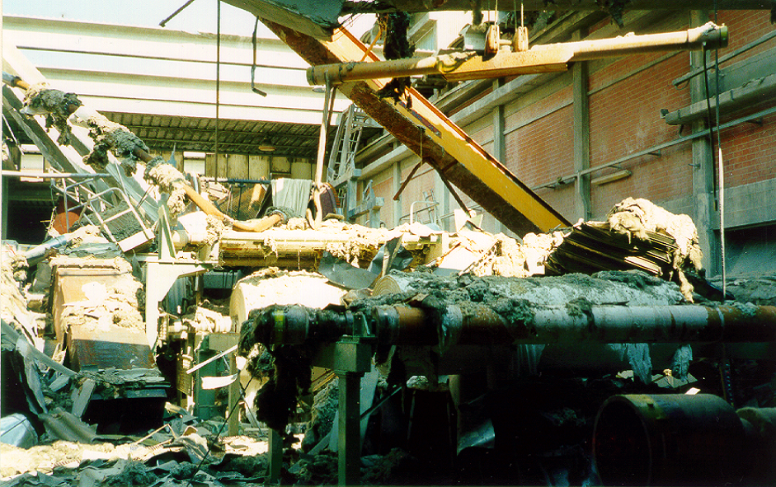
Yankee Safety Risks
Notes:
Target
Give understanding of the forces when you combine pressure and volume.
Discussion
Picture showing the power pressure and volume.
Notice the great damage that is done, their have been cases where the walls has moved.
The date on the picture should be removed.

Slide 6
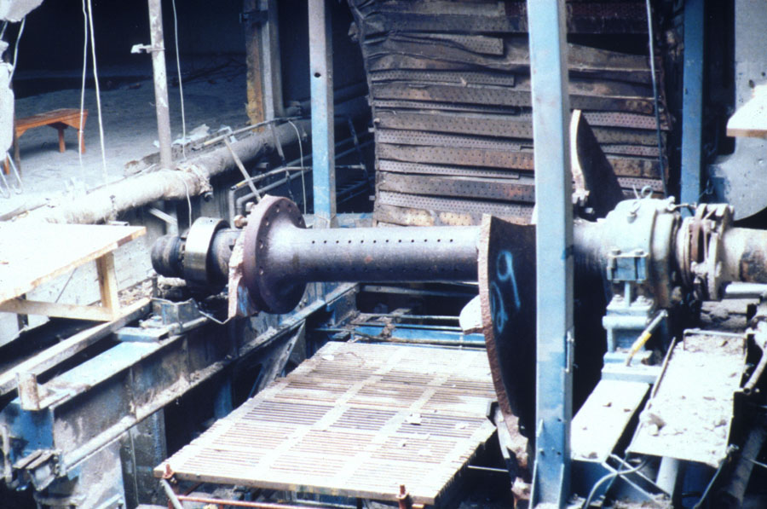
Yankee Safety Risks
Notes:
Target
Give understanding of the forces when you combine pressure and volume.
Discussion
Picture showing the power pressure and volume.
Notice the great damage that is done, their have been cases where the walls has moved.
The date on the picture should be removed.

Slide 7
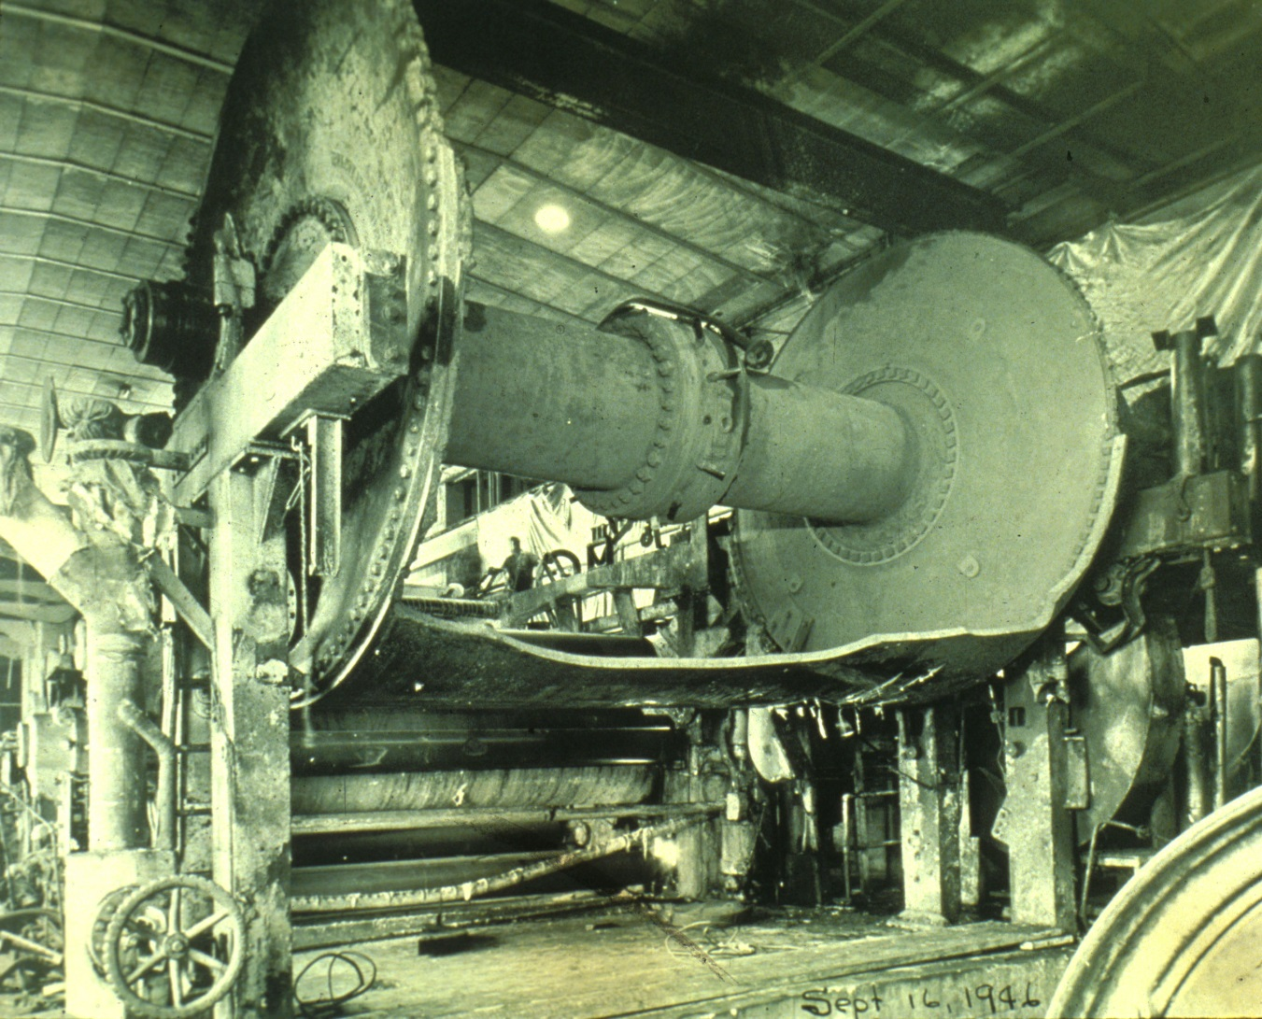
Yankee Safety Risks
Notes:
Target
Give understanding of the forces when you combine pressure and volume.
Discussion
Picture showing the power pressure and volume.
Notice the great damage that is done, their have been cases where the walls has moved.
The date on the picture should be removed.

Slide 8
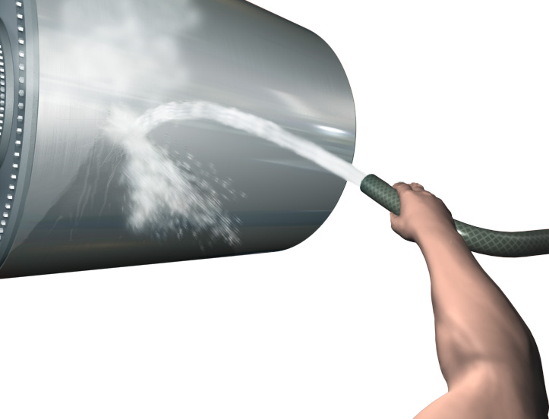
Would you Light the Fuse ?
D.5500 x 4500 @ 600 kPa
70 kg TNT
=

Slide 9
Material failure, different types of failure in metals
Ductile material, as example Structural Steel
  1. When stress has reached yield strength, a plastic deformation (change of shape) occurs. This deformation comes from sliding between planes in lattice structure of the material.
  2. Failure when the material is strongly deformed.
Brittle material, as an example Grey Cast Iron
  1. Fracture without change in form.
  2. Fracture in a plane between two atom layers in the grain structure.
Notes:
Target
Give the group an understanding of the different failures it is for steel and cast iron.
Discussion
Read the text material in the slide

Slide 10
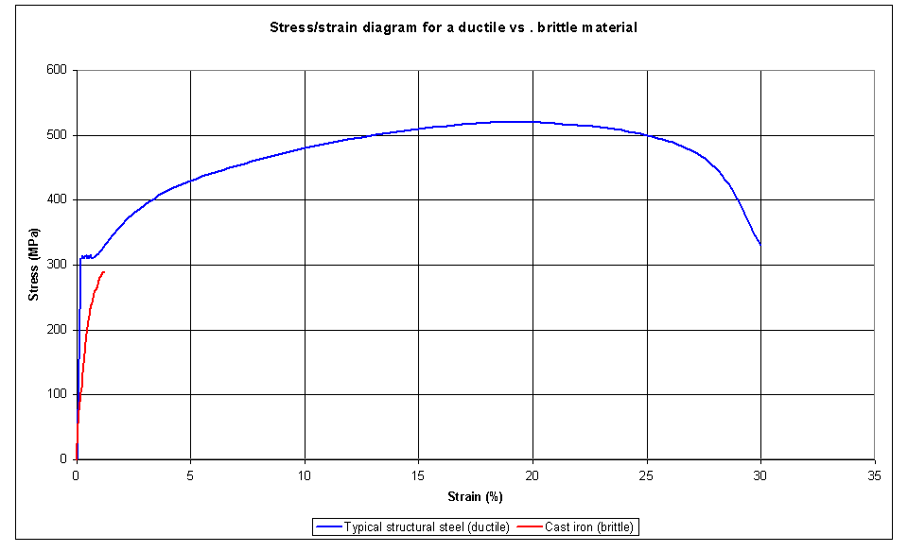
Fracture for a brittle material without any deformation before the fracture
Fracture for a ductile material after a large deformation
Strain = relative deformation
Notes:
Target
Give the group an understanding of the different failures it is for steel and cast iron.
Discussion
We can see that a ductile material would change shape and for a case pressure vessel it means that the volume would increase and could make a pressure drop.
This is not the case for a brittle material, which not give this warning signals.
Show also example from tension bars made of steel and cast iron.

Slide 11
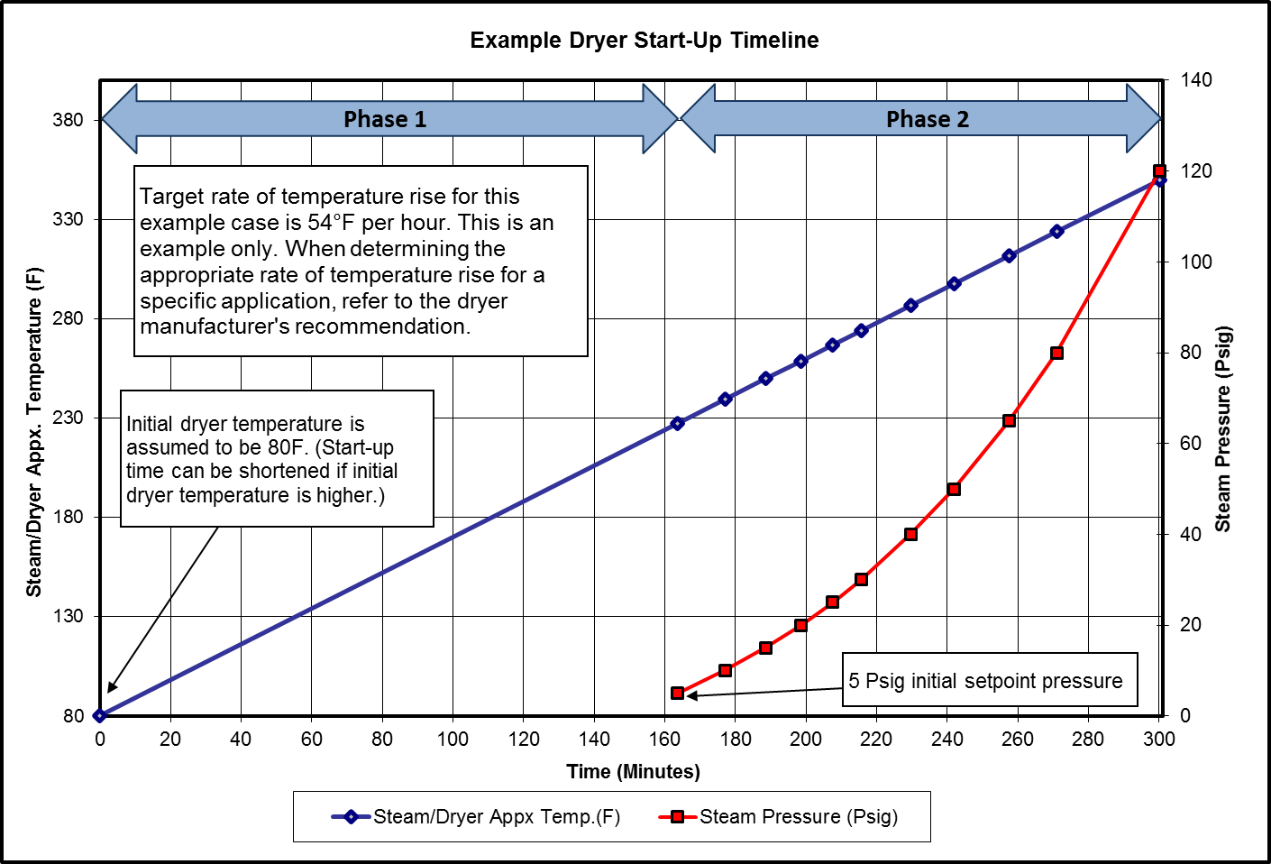
Typical Warm-up Process
Phase 1
  Steam is bled into the Yankee dryer.
  The Yankee dryer pressure control loop is not relied on.
  With an appropriate bleed flow, the building of pressure in the Yankee dryer should be very slow.
Phase 2
  The Yankee pressure control loop is active.
  The pressure setpoint for the Yankee dryer is incrementally increased until the Yankee is at the desired operating pressure.

Slide 12
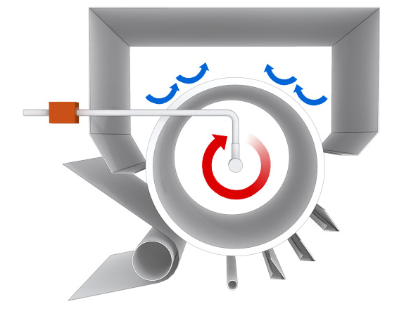
Shut-down
Cooling whilst rotating at operating speed
  Shut down the steam
  If quicker cooling, draw room air over the Dryer by using hood exhaust fans
  Close
  valve

Slide 13
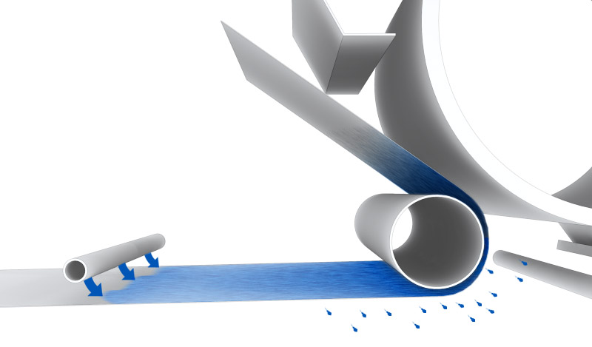
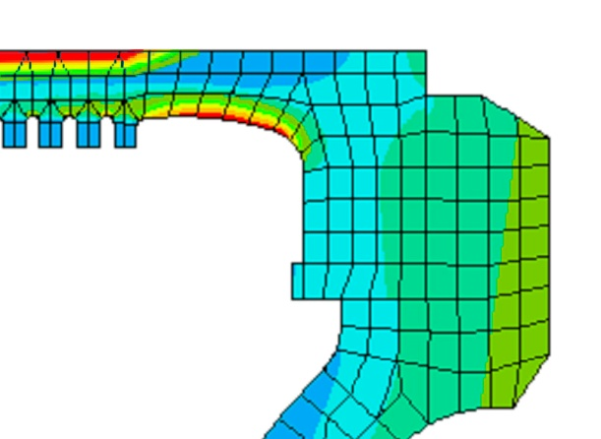
Shut-down
Do not use saturated felts, can produce dangerous stresses in the Dryer
stress

Slide 14
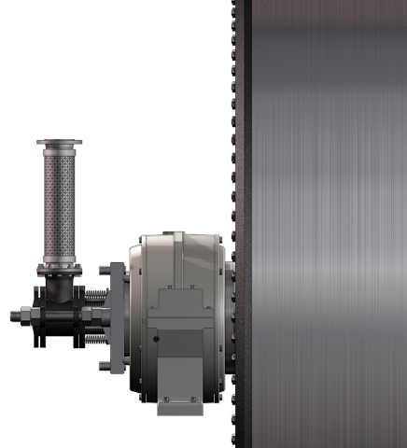
Yankee Safety Risks
Steam & condensate rotary joints
Flexible hoses
Uninsulated piping

Slide 15
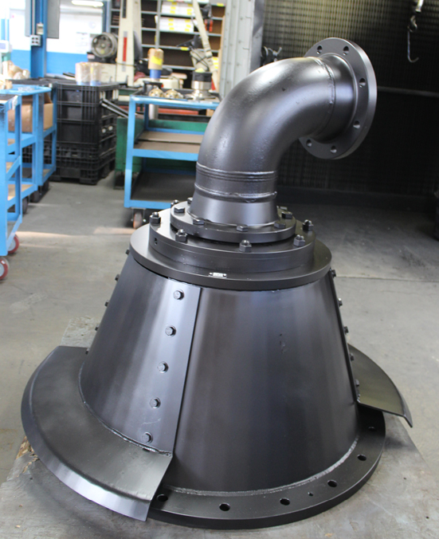
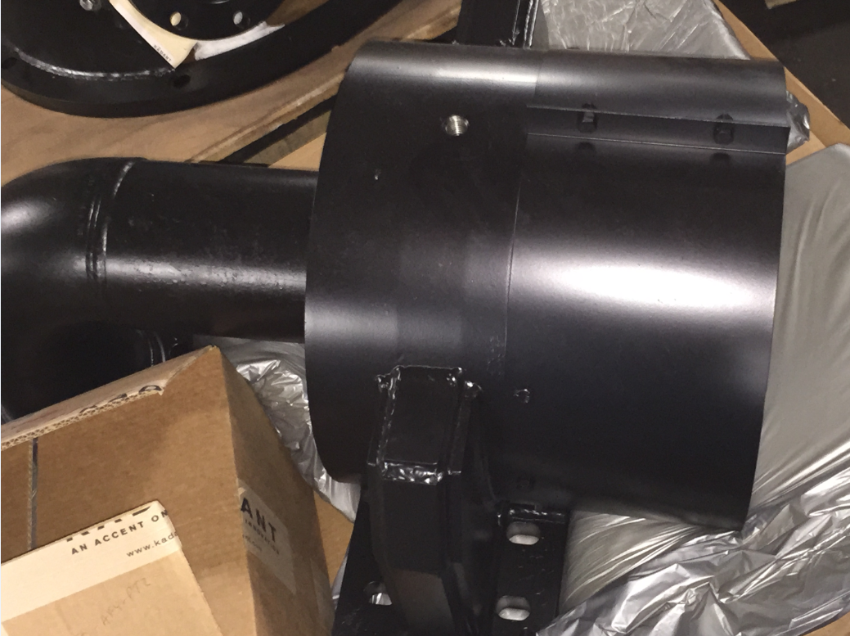
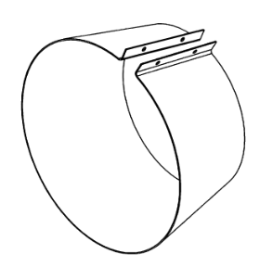
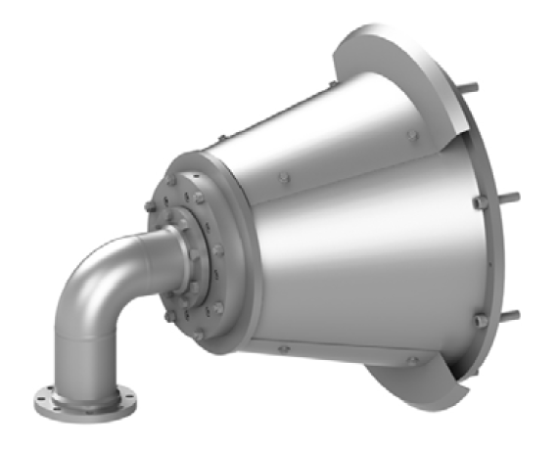
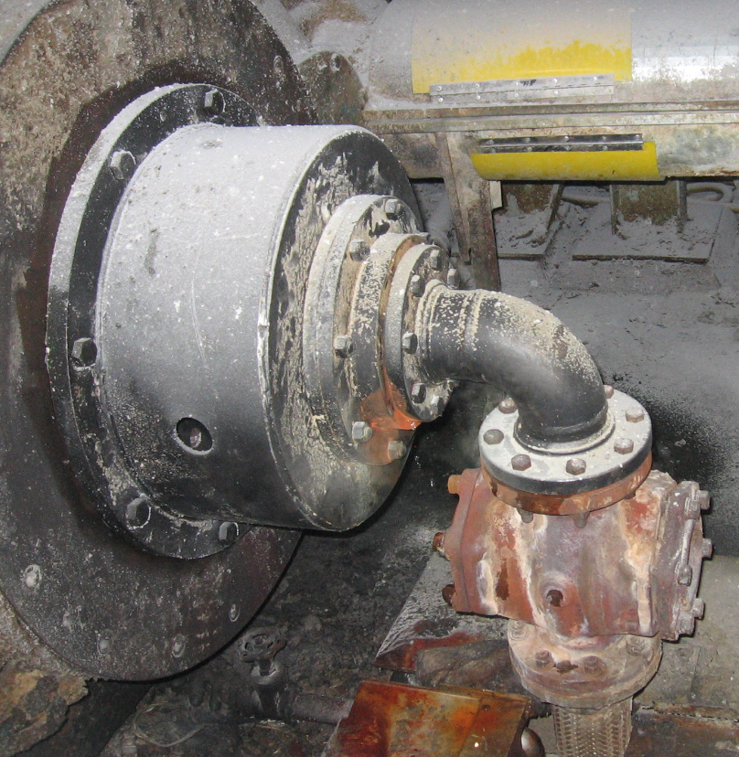
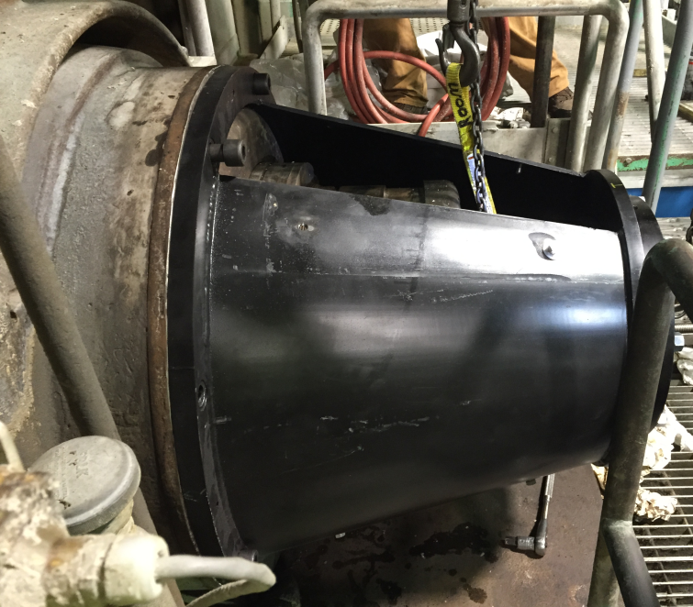
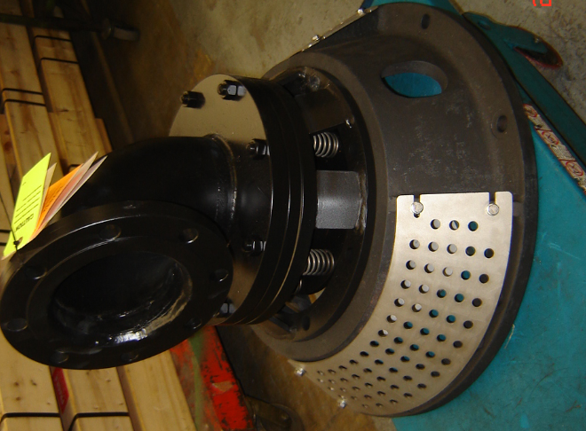
Rotary Joint with Safety Cover

Slide 16
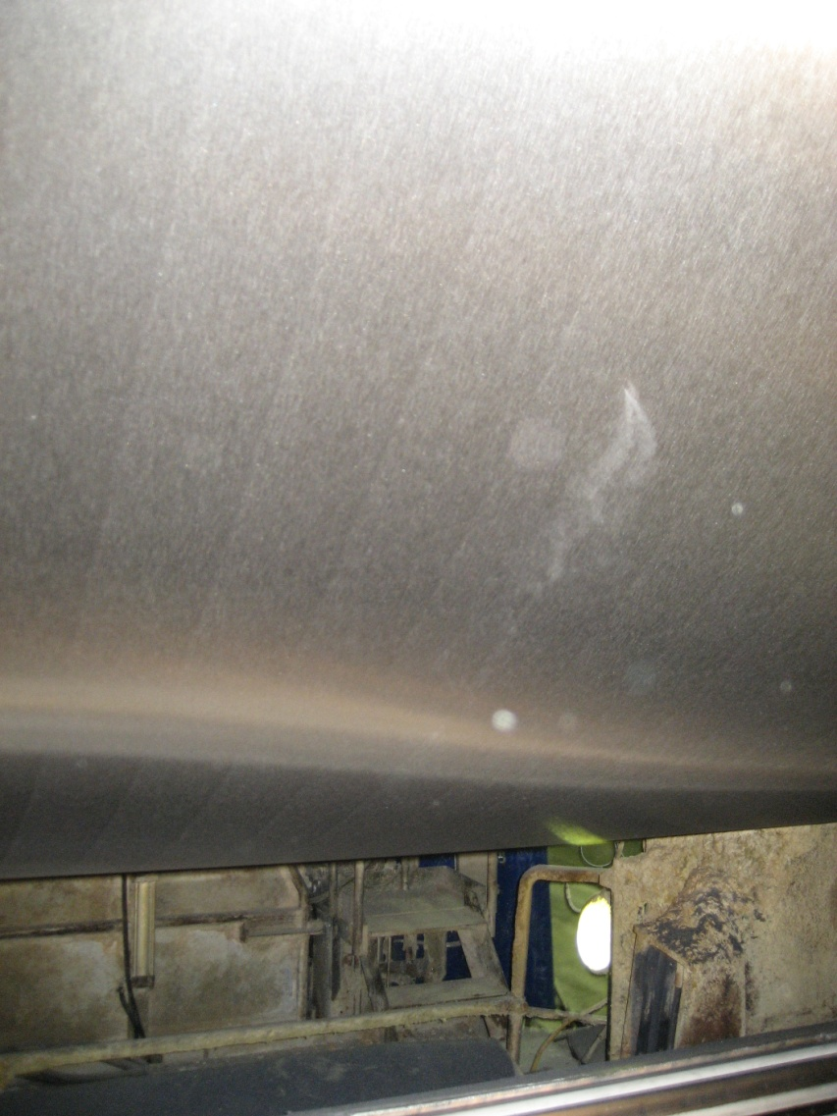
Through-shell steam leakage

Slide 17
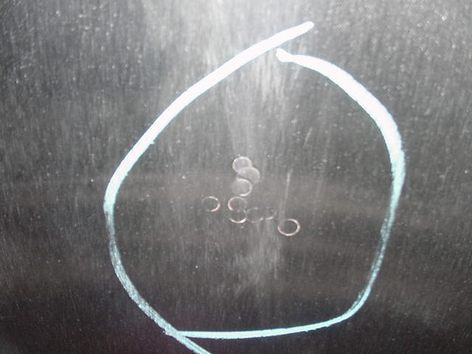
Yankee Cylinder Shell Plugging
Notes:
Target
Give the group understanding of risks with pluging and plug in plug.
Show example of when it’s better to spot metalize.
Method
Cracks, inclusions, difficulties when it wear down.

Slide 18
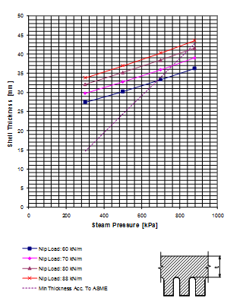
Derate Curves
Example Only
Consider Each Cylinder as Unique

Slide 19
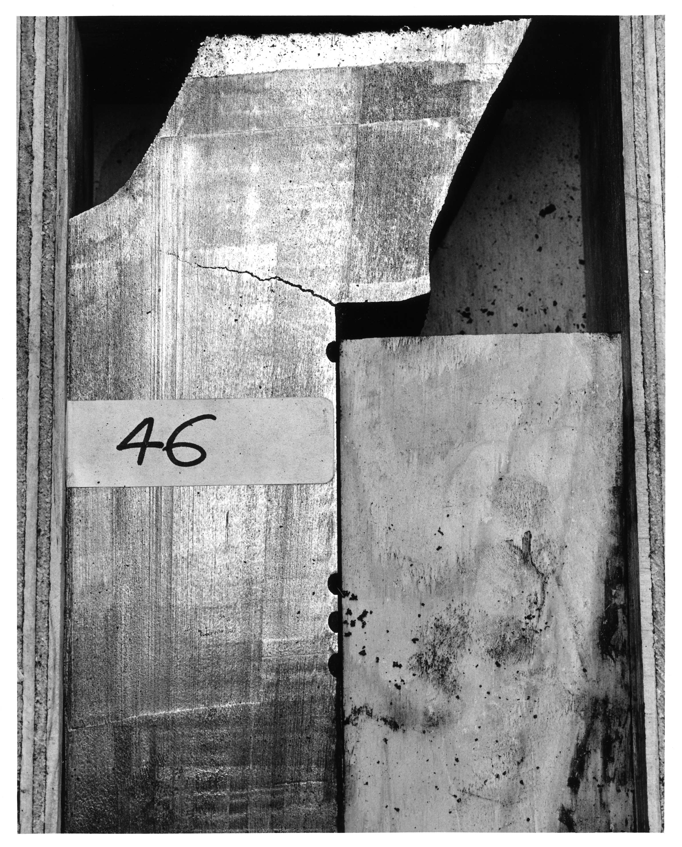
Head Crack

Slide 20
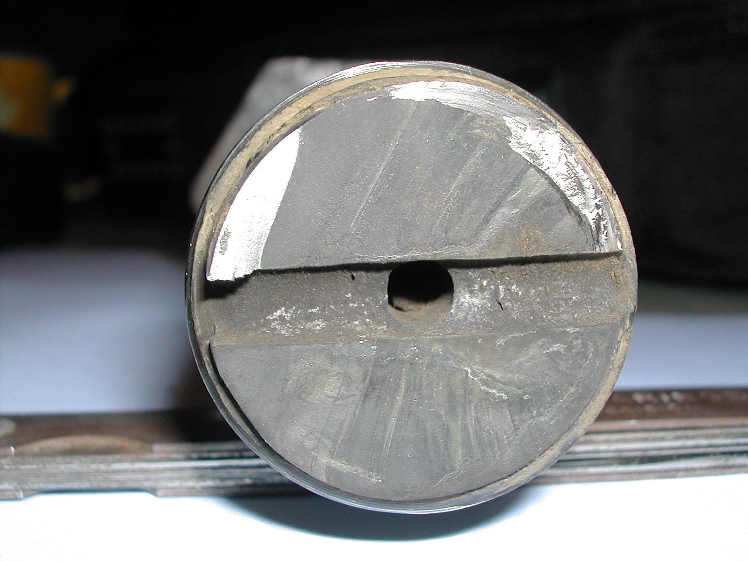
Yankee Safety Risks / Bolt failure
Notes:
Target
Make the group to understand that it’s important to check bolts.
Discussion
Reasons for bolt failures
- environmental, corrosion or changes in the material
- overloaded bolts
- bending stress
- shear stress
- defects from manufacturing
- defect made on bolt, in this case drilled hole

Slide 21
Inspection methods
Ultrasonic testing
Magnetic particle testing (Penetrant testing)
Acoustic emission testing
X-ray testing
Hydrostatic testing
OTR measurement
IR measurement
Visual inspection
Dimensional checks

Slide 22
TAPPI
Technical Association of the Pulp and Paper Industry
  TAPPI is a non-profit, special interest organization, which promotes research and education, and serves as a technical information resource for its members.
Yankee Dryer Safety and Reliability Committee.
  YDSRC is a committee within TAPPI, which develops guidelines for YD inspections.
Most YD inspections are developed from the TAPPI guidelines.
YDSRC
Notes:
Target
The group should know what Y.D.S.S.C. (Yankee Dryer Safety Sub Committee) of the T.A.P.P.I. (Technical Association of the Pulp and Paper Industry) is, and what purpose the association serves.
Method
Explain what Y.D.S.S.C. of the T.A.P.P.I. is, and what purpose the association serves.

Slide 23
TAPPI Inspection Guidelines
Type | Methods | Location | Frequency
Routine | Mechanical lift | Relief Valves | Annual
Routine | Rebuild | Relief Valves | Annual
Routine | Operational | Interlocks/Safety Systems | Annual
Routine | Visual, Metric | Condensate system integrity, Run-out, Head Tilt | Annual
Routine | NDE | Ultrasonic bolts, MT | 5 years
Statutory | Visual, Metric | Internal/External | As Required
Non-routine | As required | Incident based | As Required
Fitness for Service | NDE | Based on age/history | By manufacturer
Audit | Compliance based | Annual inspection, document review, drawing review, interviews | 5 years

Slide 24
Documentation
Appropriate approval documentation.
Assembly drawings and design specifications
Design specifications.
Manufacturing protocols and operational protocols
Nameplate photo, de-rate curves, and crown specification
Shop Inspection Report and final dimensional details
Manufacturers instruction documents.
  Shell thickness.
  Derating curve.
  Bolt torque and bolt material specifications.
U1-A ASME Certificate and Hydrostatic test certification
Shop repair details by location
Journal and shell run-outs, head tilts, hot and cold

Slide 25
Record keeping
Shell thickness
Grind reports
Surface repairs
Steam leaks
Mechanical history , Damage reports
Dryer inspections
Alterations
Metalizing Reports
Safety relief valve testing and settings

Slide 26
What is the Purpose of a Yankee
Steam System?
Supplies steam to the Yankee and maintains pressure
Evacuates condensate from the Yankee and re-circulates blow-through steam.
Returns condensate for reuse.
Incorporates “failsafe” systems to protect people & equipment during operation.

Slide 27
Steam System Design Considerations

Slide 28
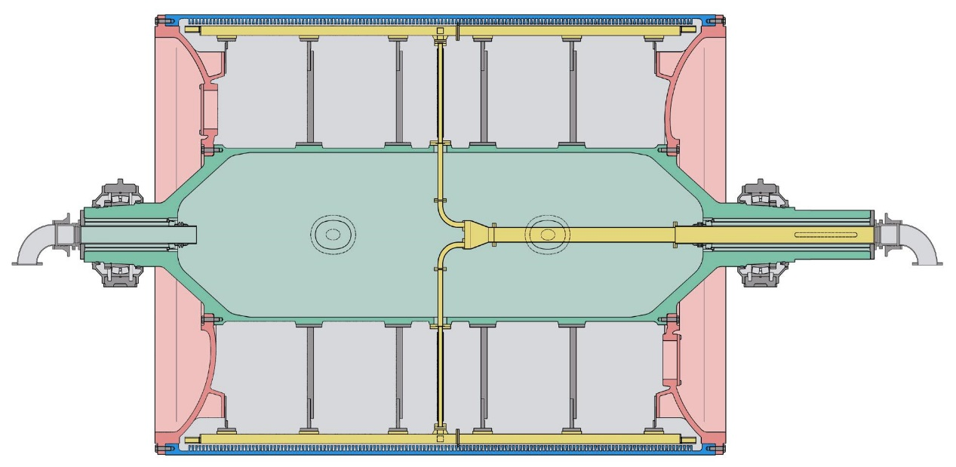
Yankee Dryer Steam System Design
Each Yankee dryer and syphoning system is unique
Each steam and condensate system must be tailor made
Even replacement Yankees will behave differently

Slide 29
Yankee Dryer Steam System Design
Condensing load and syphon flow characteristics must be accurately established
Determining condensing load
  Yankee drying programs
  Condensate rise tests useful on existing Yankee cylinder
Methods for establishing the syphon flow characteristics:
  Observed operating parameters
    Existing Blow-through flow indication
    Existing differential pressure
  Syphon analysis
    Allows syphon system to be modeled

Slide 30
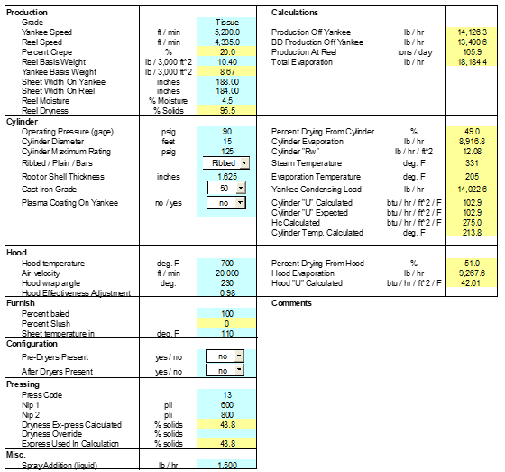
Yankee Dryer Simulation Program
Notes:
30

Slide 31
Equipment Design Parameters

Slide 32
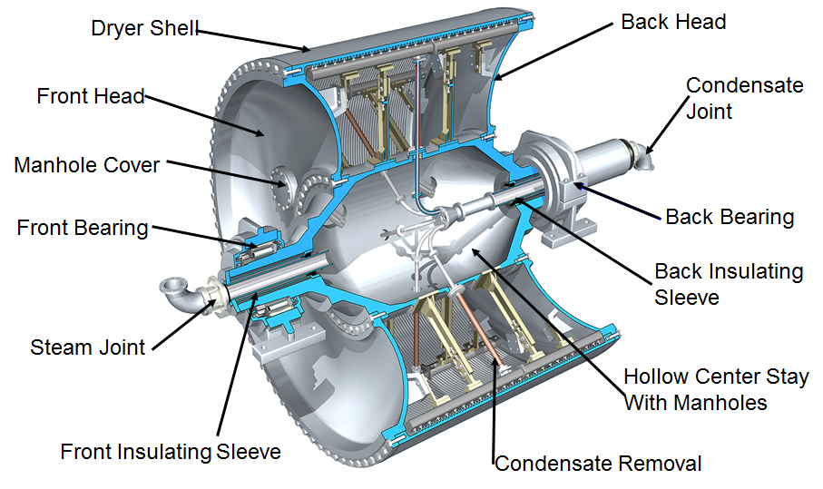
Components of a Yankee Dryer

Slide 33
Typical Steam System
Main Steam Valve
Warm-Up Valve
Make-Up Valve
Thermocompressor for recirc
and pressure set-point
Steam fit
Low Pressure Steam
Blow-through Control Valve
Sight glass
Flash Vessel
Separator
To Boiler
Drain
Drain

Slide 34
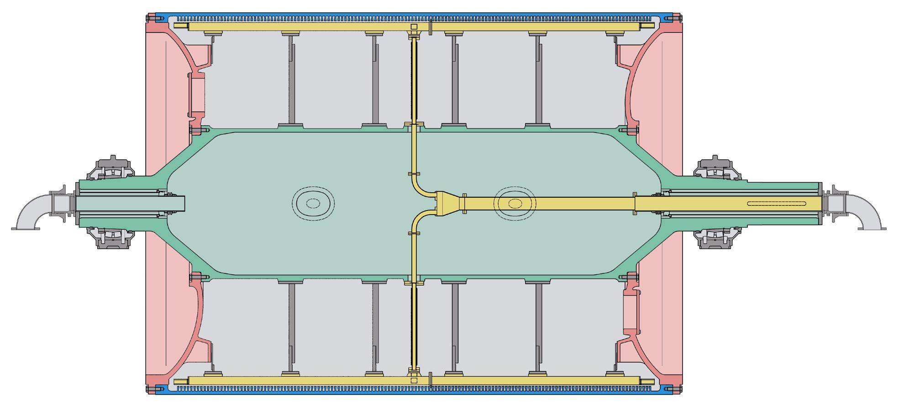
Yankee Syphons

Slide 35
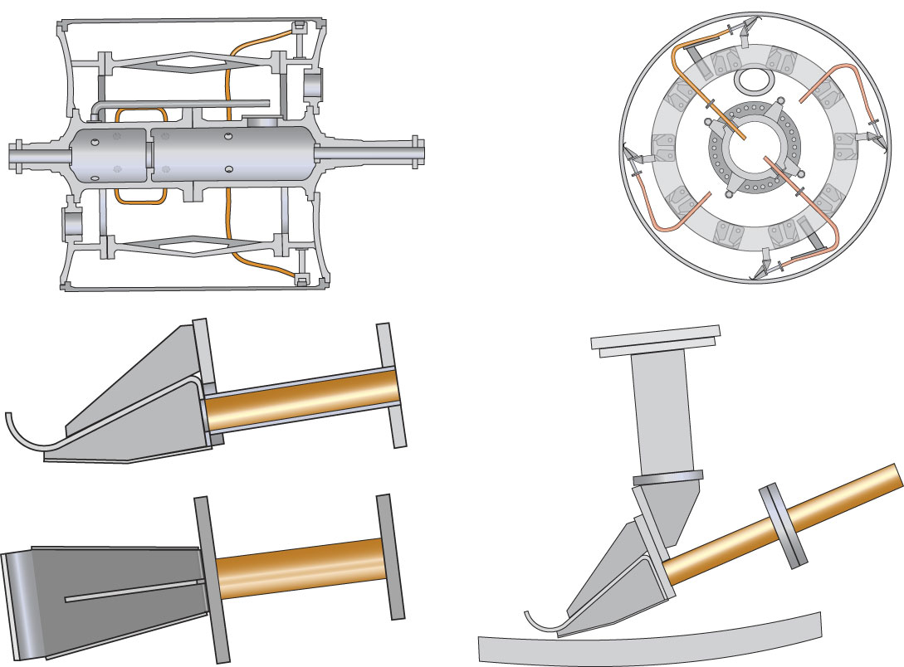
Condensate Removal with Scoops

Slide 36
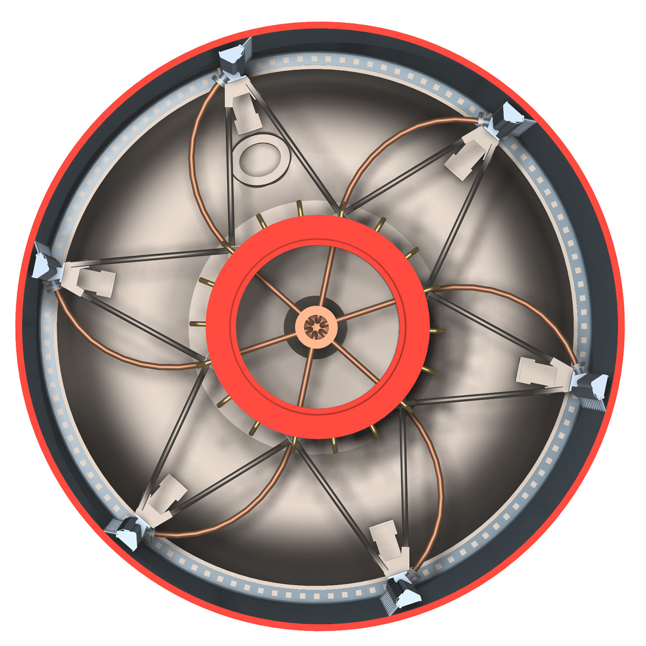
Yankee Dryer - Six Header System
Notes:
Side view of a system with six headers.
Curved riser pipes.
Headers supported from center journal.

Slide 37
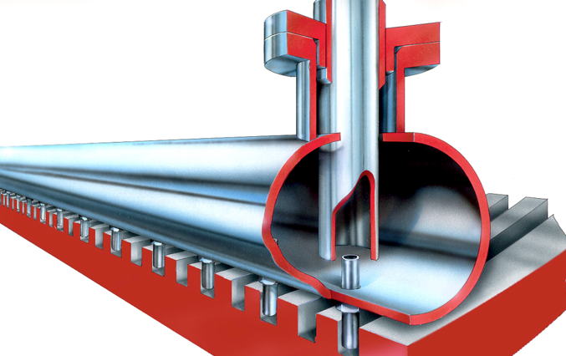
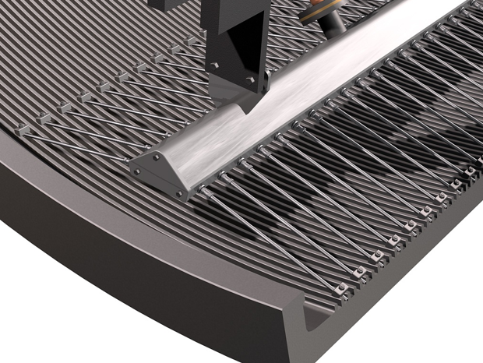
Ribbed Yankees Have Soda Straws
Radial Straws
Circumferential Straws

Slide 38
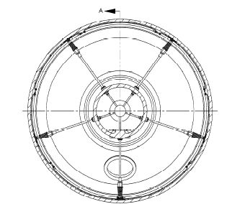
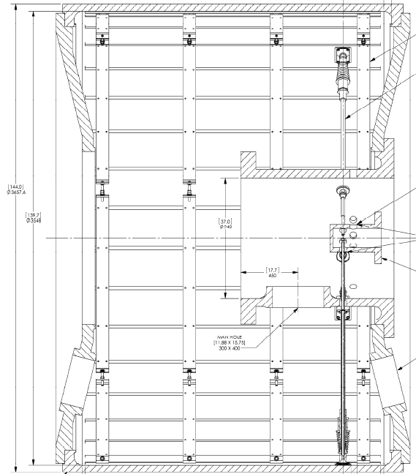
Diameter Smooth Bore Yankee

Slide 39
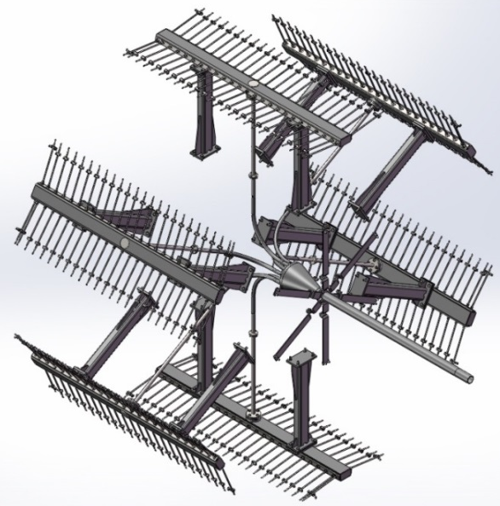
Estimation Of Blow-through Flows and Differential Pressures
The most important part of Yankee steam system design is an accurate estimation of blow-through flow and differential pressure required
Too little blow-through steam
  Poor cross machine profiles
  Flooding
Too much blow-through steam
  Steam waste (venting)
  Possible hot spots developing on cylinder
Blow-through flow can be 40% to 90% of Yankee condensing load
Differential pressures can range from 5 to 30 psi
All blow-through flow must be conserved by steam system and reused for good energy efficiency

Slide 40
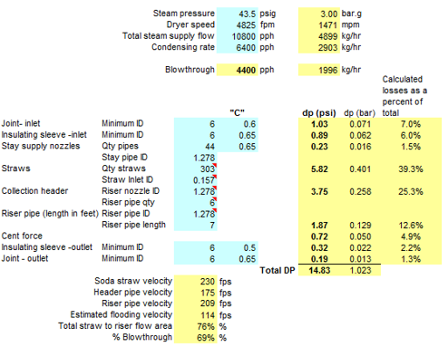
Yankee Syphon Calculation
Notes:
40

Slide 41
Yankee Syphon Calculation
Notes:
41

Slide 42
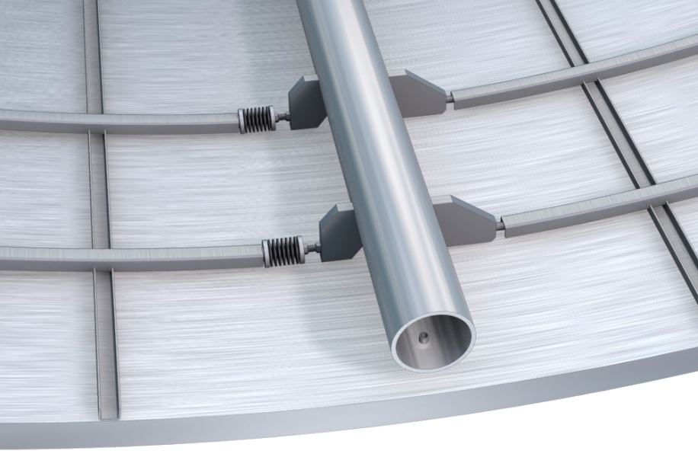
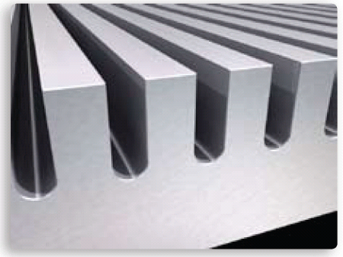
Methods for Increasing Heat Transfer/Drying Capacity
Turbulator bars
Internally grooved shell
Notes:
Condensate removal in grooved cylinders with soda straws and blow through steam.

Slide 43
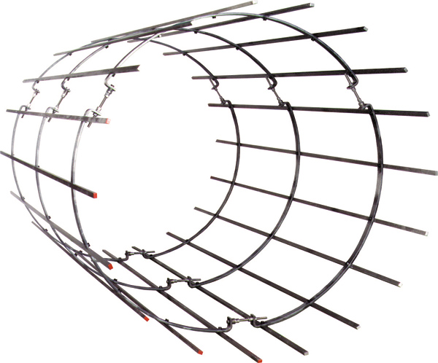
Yankee Turbulator Tube Bars
“to create resonant waves in the condensate film to increase condensate turbulence and therefore, increasing the rate of heat transfer”
Axial bars that can be applied to smooth bore Yankee dryers
Stainless or steel bars
Held by segmented rings or screwed to the Yankee dryer shell
Increased condensate turbulence
Improved heat transfer and drying capacity
Improved CD surface temperature profile
Scoop syphons replaced with conventional large shoe rotary syphons
Potentially extend life of a Yankee
Notes:
Yankee Dryer Design and Yankee Dryer Steam Systems
Johnson Systems International Ltd
43

Slide 44
Condensate Coefficient - No Dryer Bars
2,000 fpm
3,000 fpm
4,000 fpm
Notes:
44

Slide 45
Condensate Coefficient with Turbulator Bars
Turbulator bars
3,000 fpm
2,000 fpm
4,000 fpm
Notes:
45

Slide 46
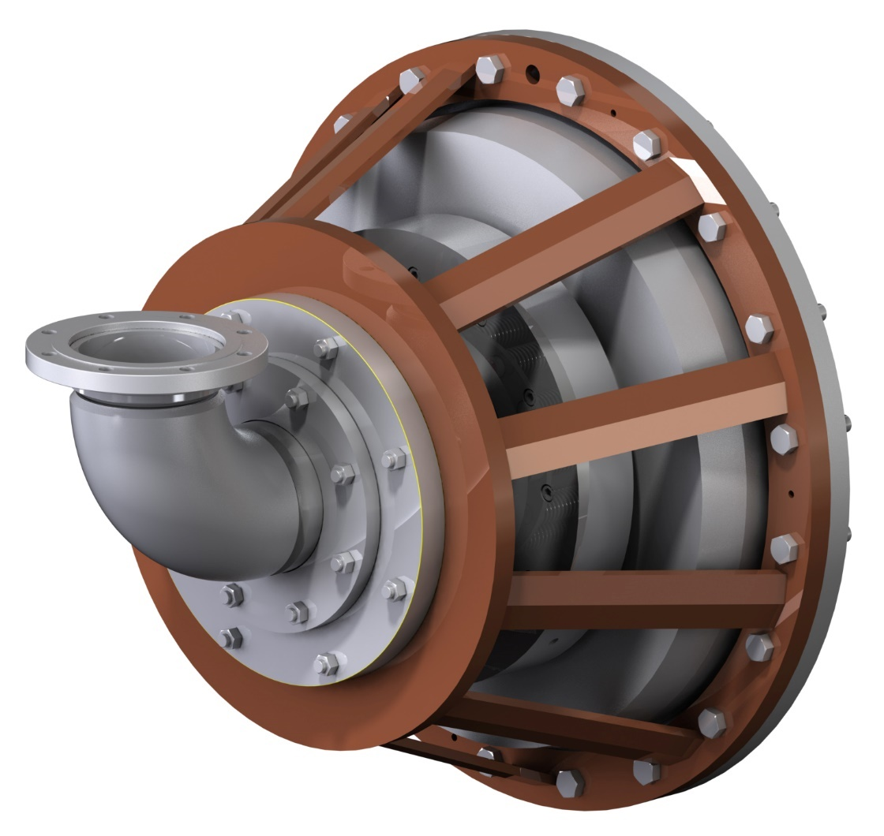
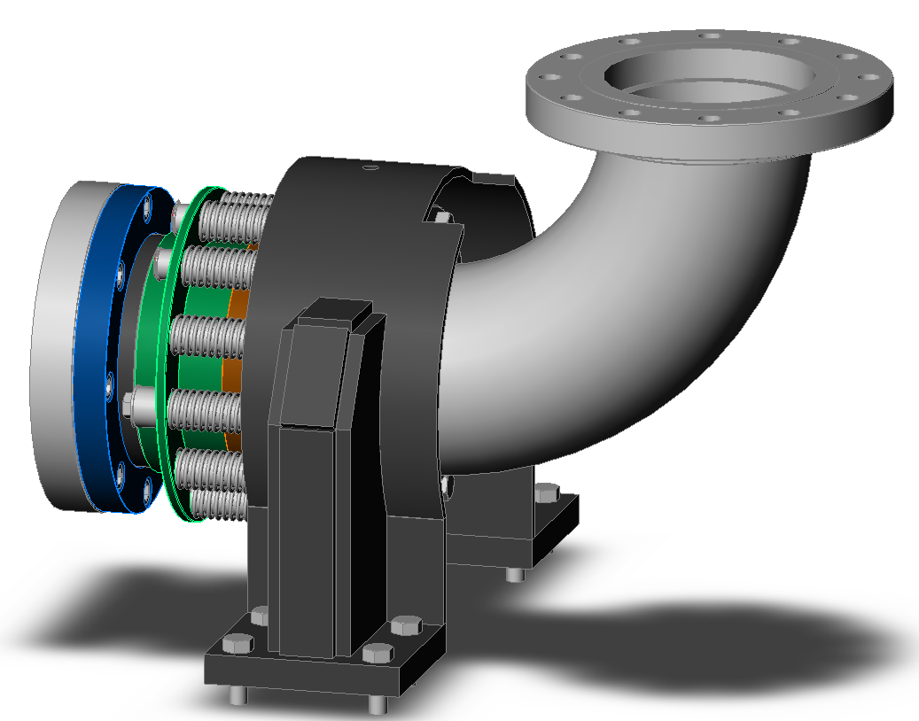
Rotary Joints

Slide 47
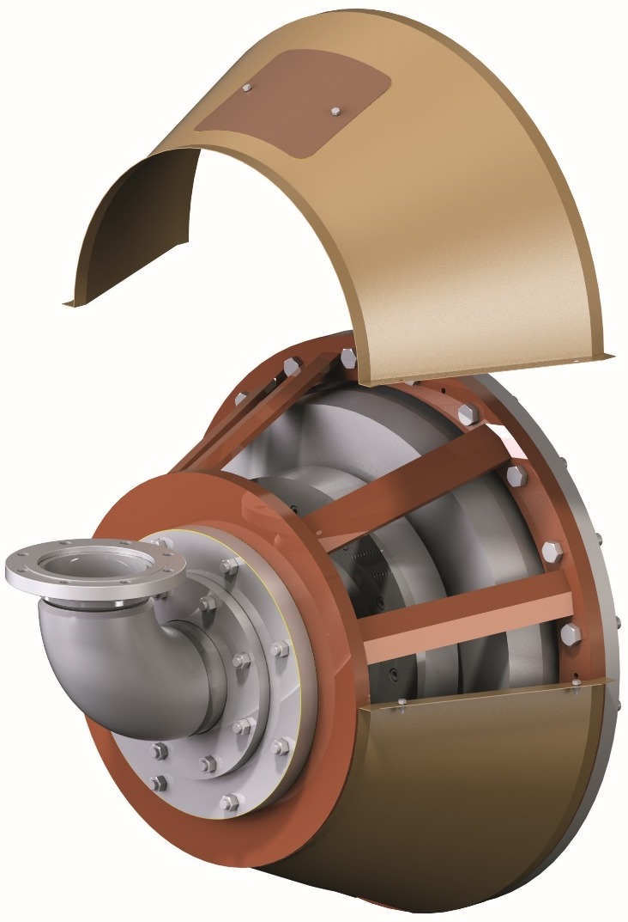
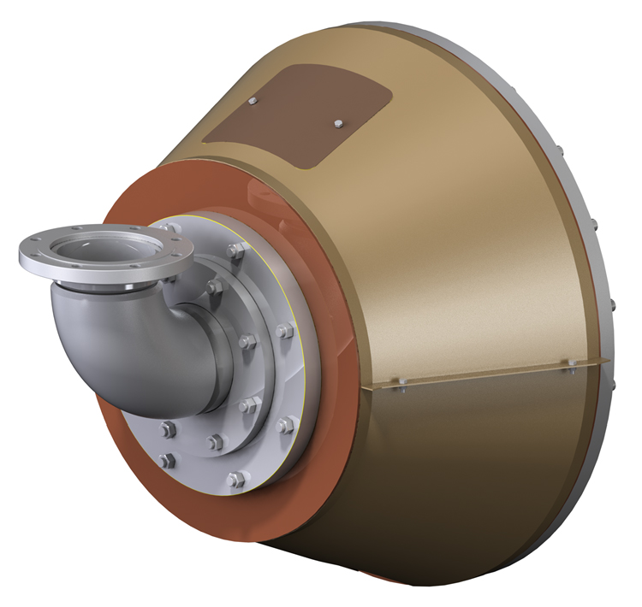
PT Rotary Joint with Safety Cover

Slide 48
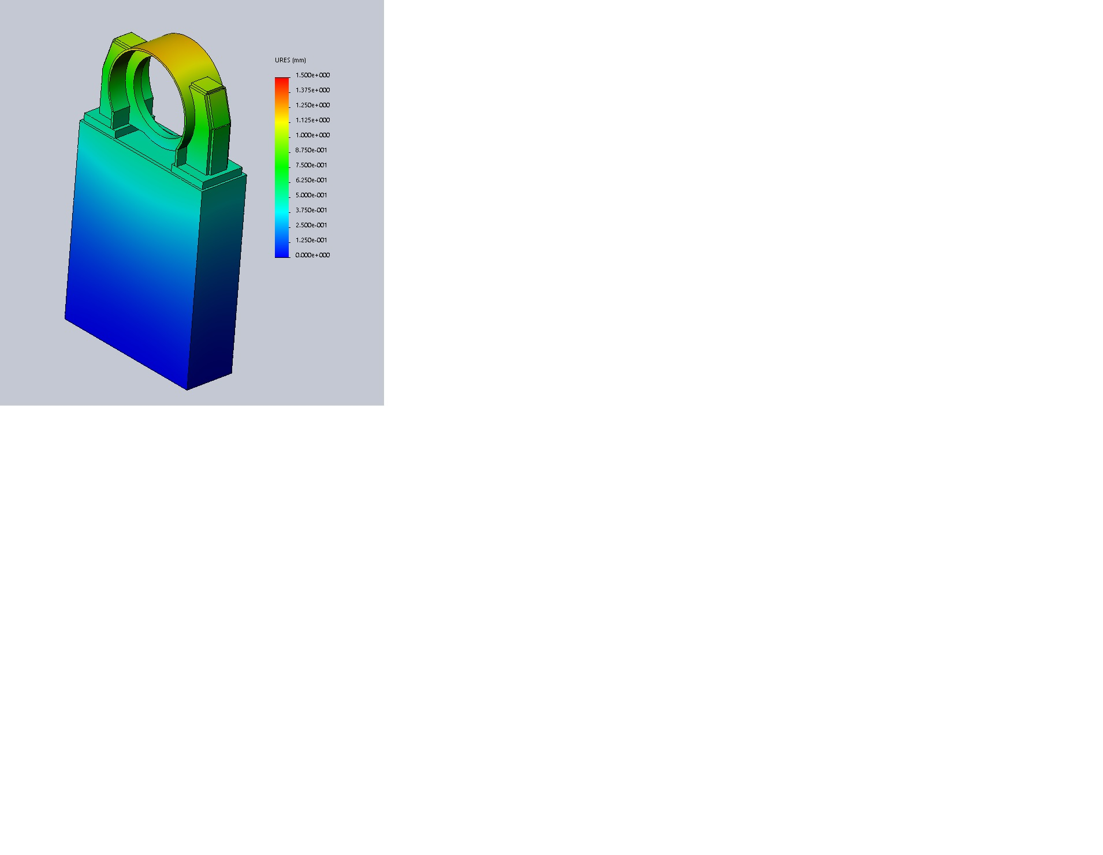
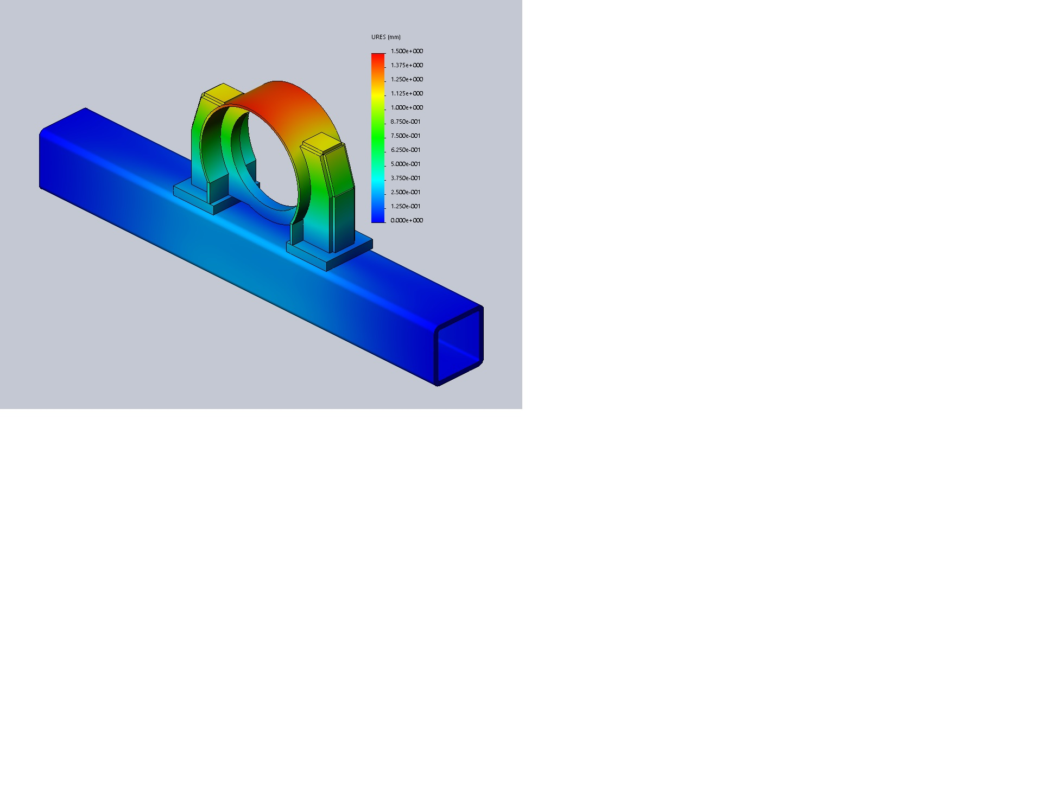
Rotary Joint Mounting Considerations
Stand and Beam Mounting
  Deflection and stress analysis

Slide 49
Insulating Sleeve

Slide 50
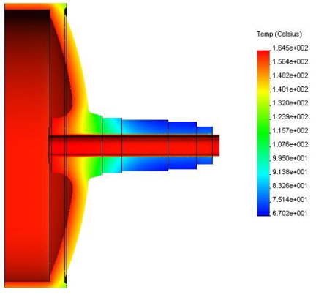
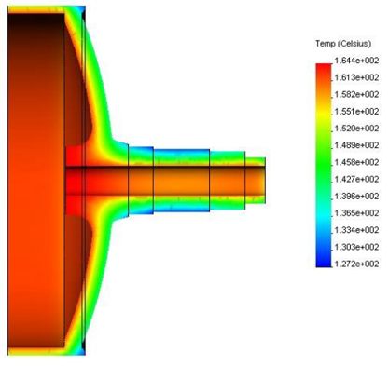
Insulating Sleeves
100 psig steam pressure with and without insulating sleeve

Slide 51
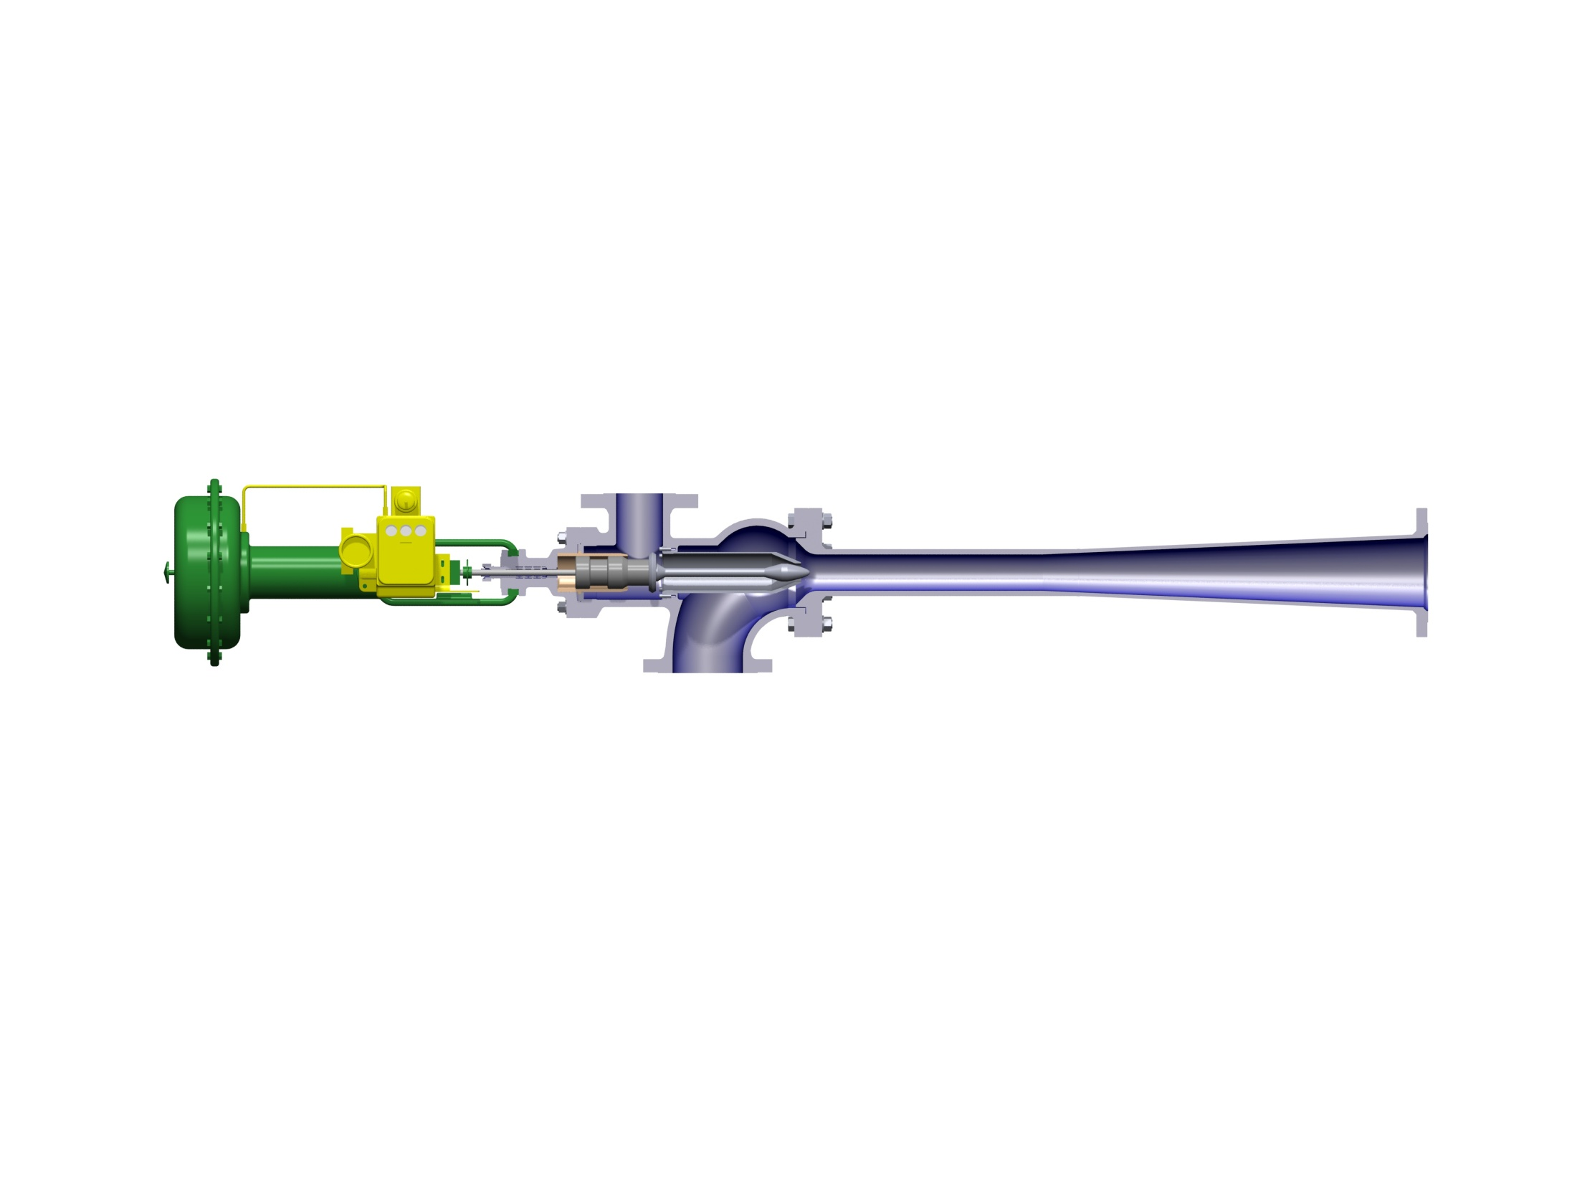
Thermocompressor Components
“Spindle” controls motive steam flow through nozzle
Motive steam “nozzle” where steam expands and discharges at high velocity
Actuator
High pressure motive steam enters
“Throat” where mixture accelerated to high velocity
Discharge at higher pressure
Low pressure suction steam enters
“Diffuser” reduces velocity converting velocity energy to pressure

Slide 52
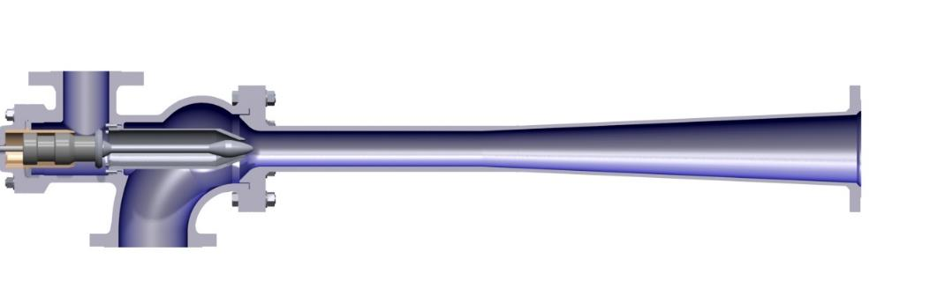
Bernoulli's Equation
As Pressure Is Reduced Velocity Must Increase
  Motive steam expanding from nozzle to high velocity
As Velocity Is Reduced Pressure Must Increase
  Velocity is reduced in diffuser to discharge at higher pressure

Slide 53
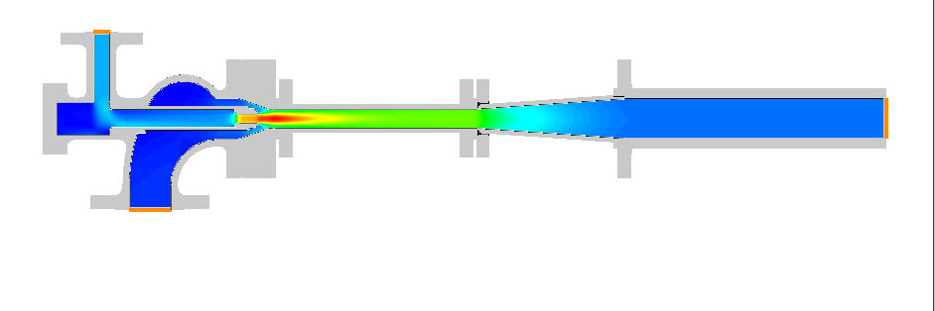

Steam Velocity Profile
Motive steam
low velocity
550 fps
Expansion chamber
velocity falls
Discharge steam
sow velocity
100 fps
Motive jet
very high velocity
1830 fps
Suction steam
low velocity
50 fps
Mixing chamber
fairly high velocity
950 fps

Slide 54


Steam Pressure Profile
High-pressure
motive steam
200 psi
Expanding motive
pressure reduces and velocity increases
Expanding “tail”
pressure rises as
velocity is reduced.
Discharge at
Increased pressure
105 psi
Low-pressure
suction steam
80 psi
Mixed flow
pressure lower than suction
70 psi

Slide 55

Typical Design Ratios
Pm = Motive Pressure
Mm = Motive Flow
Ps = Suction Pressure
Ms = Suction Flow
= As high as possible!
P = Absolute Pressure
Pd = Discharge Pressure
Md = Discharge Flow = Ms + Mm

Slide 56

Thermocompressor Efficiency
High-efficiency thermocompressors are an advantage on Yankee systems
  Blow-through flows and differential pressure are high
  Motive steam flow can often equal or exceed Yankee condensing load
    Causes system to vent
  High-efficiency thermocompressors reduce the motive steam requirement and reduce venting
    Can reduce motive steam use by 20% to 25% over conventional thermocompressor designs
Notes:
56

Slide 57

Thermocompressor Efficiency

Slide 58

Condensate Separator Stations
Condensate separator stations must remove all free condensate from the blow-through steam
  Condensate carry over to thermocompressor will cause erosion
  Condensate carry over will add to load
    Reduced drying capacity
    Higher differential pressures
    Flooding
    Unstable blow-through control

Slide 59

Separator Station Design
Vapor velocity through tank is used as key sizing criteria to determine separation efficiency
  98% to 99% steam quality leaving tank
  Vapor velocities vary with dryer pressure and steam density
Tank baffling determines vapor distribution within tank
  Vapor distribution must be uniform for efficient separation
Liquid retention time should be taken into consideration
  1.5 to 3 minutes
Pump is critical
  Liquid height for NPSH
  Minimum losses to pump inlet
  Ensure proper level control (no dumping of condensate)
  Mechanical seal w/ seal cooler vs. seal water

Slide 60

Magnetic Level Indicators

Slide 61

Pump By-Pass

Slide 62

Steam Control Valves

Slide 63


Transmitters

Slide 64


Safety Valves - Conventional vs Pilot Operated
ATM
ATM
Steam
Steam

Slide 65
Yankee Control Methods

Slide 66

Thermocompressor Control
Method 1 - Control thermocompressor from pressure control loop (preferred)
  Thermocompressor opens fully, then make-up valve
  Blow-through meter controls valve at thermocompressor inlet
  Used when make-up and motive steam from same source with no electrical power generation
  Used when motive steam pressures are low and Blow-through rates are high
  Used if motive flow is a high percentage of total make-up
  Avoids the controller deadband that can exist with traditional logic (with “low select” function block)

Slide 67

Thermocompressor Control
Method 2 - Control thermocompressor motive based on blow-through flow or DP transmitter
  Used if motive steam pressure is high
  Used if blow-through flow rates are relatively low
  Motive steam much more costly than make-up steam
  Motive steam flow is only a small portion of Yankee condensing load
  Yankee might be operated over such a wide pressure range there is risk of thermocompressor “choking
Notes:
67

Slide 68

Differential Pressure Control

Slide 69
Differential Pressure Control
Advantages
  Simple to understand and operate
  Can be set at a “safe” level to handle all operating points
  Reliable and well accepted method
  Less equipment
Disadvantages
  Operators are required to set differential pressures
  “Worst case” differential pressures are usually used
  Higher blow-through steam flows when “worst case used”
    Steam venting and waste possible
    Increased losses to condenser
    Potentially high motive steam use depending on the thermocompressor control method
  Excessive venting & waste on breaks
Notes:
69

Slide 70
Blow-through Control

Slide 71
Blow-through Control
Advantages
  Reduced venting on sheet breaks
  Adjusts blow-through flow as Yankee pressures & condensing loads change
  Adjusts to flooding Yankee or high load situations
  Senses loss of blow-through flow and automatically increases differential pressure
Disadvantages
  More difficult to understand
  Requires more equipment flow orifice, flow transmitter, & differential transmitter
  Tanks must have good condensate separation to provide a good control signal
Notes:
71

Slide 72
Yankee Steam System Design
Vortex flow meters are preferred in most cases where Yankee will be operated over a narrow pressure range
  Measures steam velocity
  Good turndown
  Reliable
  Accurate
  Simple
  Velocity in blow-through line is proportional to soda straw velocity
For cases where Yankees will be operated over a wide pressure range, consider blow-through control with an orifice plate flow meter instead
  Maintains constant momentum of blow-through (Vortex does not.)

Slide 73
Yankee Steam System Design
Yankees should be equipped with both a blow-through flow meter and a DP transmitter
  Instrumentation is needed to allow monitoring of syphon condition.
  If blow-through increases relative to differential pressure, there is likely a breach in the syphoning system.
  If blow-through decreases relative to differential pressure, soda straws and/or riser pipes might be plugging with magnetite.

Slide 74
Flash Steam Utilization

Slide 75

No Flash Steam Recovery
Flash steam is generated as condensate pressure is reduced through level control valve.

Slide 76

With Flash Steam Recovery - Condenser

Slide 77

With Flash Recovery – Condenser + Shower

Slide 78

Condensate Direct to Boiler

Slide 79
Summary – Safety
Avoid rapid temperature changes and uneven heating or cooling
Have the cylinder rotating whenever possible
Ensure your de-rate records are complete and accurate
Inspect when accidents happen and investigate the impact
Keep thorough records of all Yankee Cylinder maintenance and incidents
Use manufacturer instructions for Yankee Cylinder operations
Notes:
79

Slide 80
Summary – Steam System
Thermocompressor systems used almost exclusively on Yankee dryers
Blow-through steam is required to evacuate condensate from the Yankee
Very high blow-through flows and differential pressures typical
Design of thermocompressor is critical and must match syphon curve
  High-efficiency designs are advantageous
Separator design is extremely important
Vortex flow meter are commonly used for condensate evacuation
  Produces correct velocity in syphon straws and risers
Yankees should be equipped with both a blow-through flow meter and a DP transmitter for trending and troubleshooting
Flash steam from high temperature condensate should be used in process
Notes:
80

Slide 81
Thank You!
Mike Soucy
President
Kadant Johnson Systems
mike.soucy@kadant.com

