Slide 1


Tissue Fabric
Cleaning & Conditioning
Presented by:
John Neun
Engineer
Kadant

Slide 2
Objectives
Introduction
  What is cleaning & conditioning?
  Theory & practical considerations
Showers
  Fan Jets
  Needle Jets
Felt Dewatering – Uhle Boxes
Applications Specifics
Questions

Slide 3
Why Clean Fabrics?
Maintain fabric properties over life of fabric – as “steady state” as possible
  remove contaminants
  combat compaction
  preserve permeability
  maintain surface
  retard wear (lubricate)

Slide 4
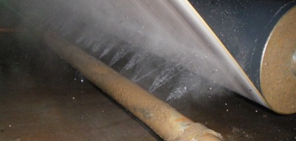
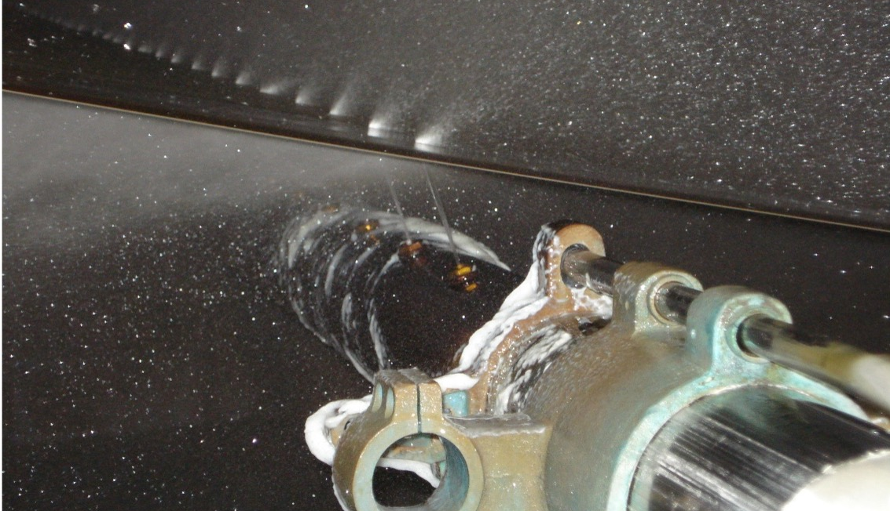
Showers
Why Shower?
  Apply chemical
  Apply water
    lubricate
    CLEAN
      flushing
        direct/suction
        flooded nip
      kinetic energy
Shower Types
  -Fan Jet
  even distribution
  -Needle Jet
  apply energy
  -Single Jet Scanning
Tappi TIP 0404-61, “Paper Machine Shower Recommendations”

Slide 5
Fan Shower Profile Management

Slide 6
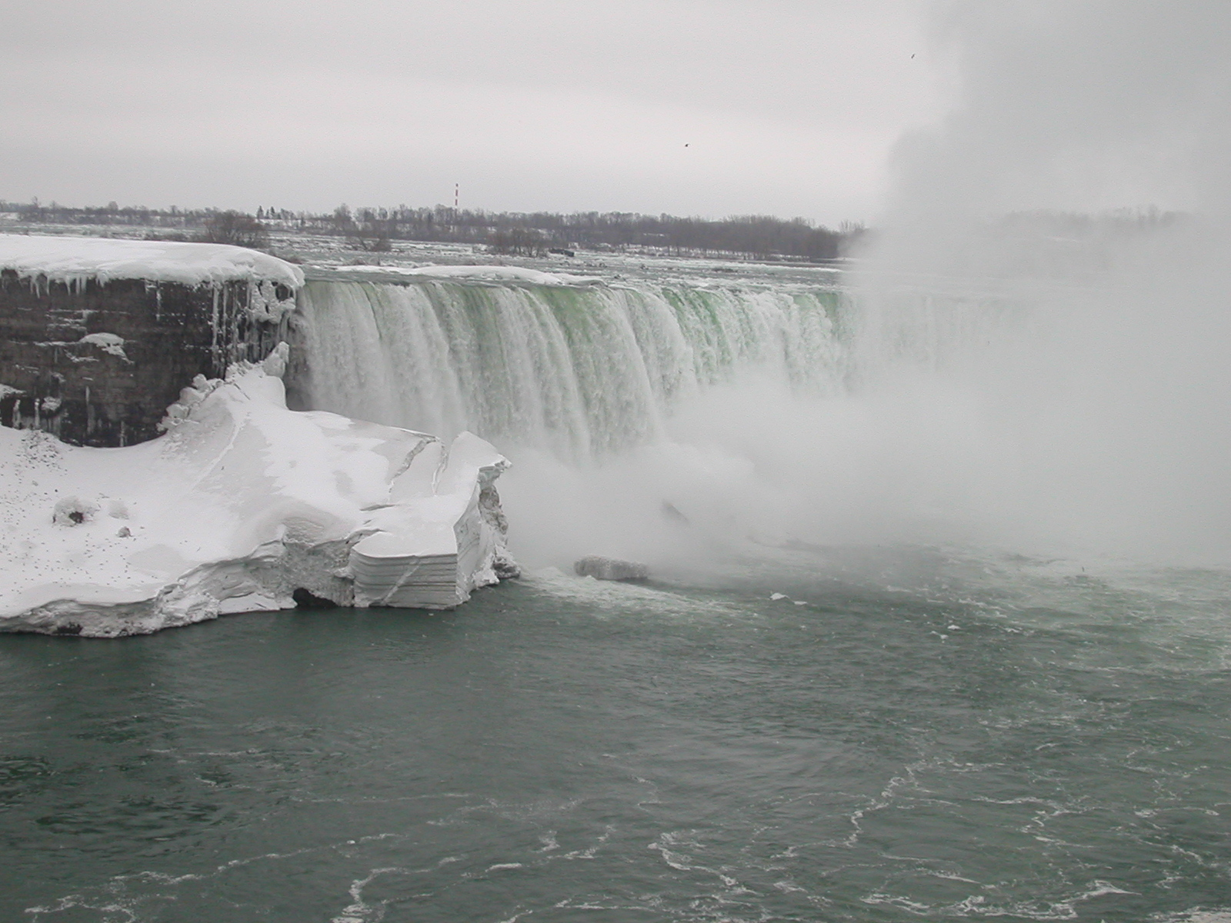
Fan Nozzle Variation:
• Flow Distribution
• Total Flow Volume

Slide 7
Nozzle Flow Distribution Tester

Slide 8
Nozzle Spray Distribution
40 - 45 degrees
.047 - .054 inch orifice
12
%-flow
0
pattern width

Slide 9
Total Flow Variations
Nozzles of the Same Type
Standard Deviation/Average Flow
Nozzle
Type 1
Type 2
Type 3
o
o
25 - 30
2%
4%
2%
o
o
6%
3%
30 - 35
o
o
40 - 45
8%
3%
3%
o
o
55 - 60
4%
3%
Flow does not vary very much from nozzle to nozzle

Slide 10
Nozzle Spray Pattern Distribution
"uncertainty
zones"
minimum
average
maximum

Slide 11
Nozzle Spacing
Spaced for average pattern width
  50% chance of dry streak
  50% chance of wet streak
Spaced for minimum width
  Probable wet streak
  No dry streaks
dry streak
wet streak
wet streak
almost inevitable

Slide 12
Overlapped Nozzles:
•Conservative Approach
•Precludes Dry Streaks
•Causes Wet Streaks

Slide 13
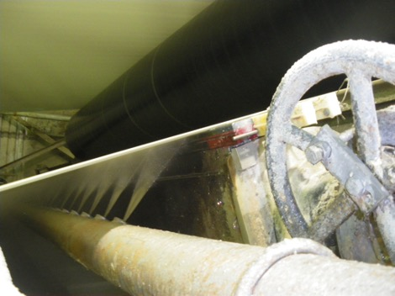
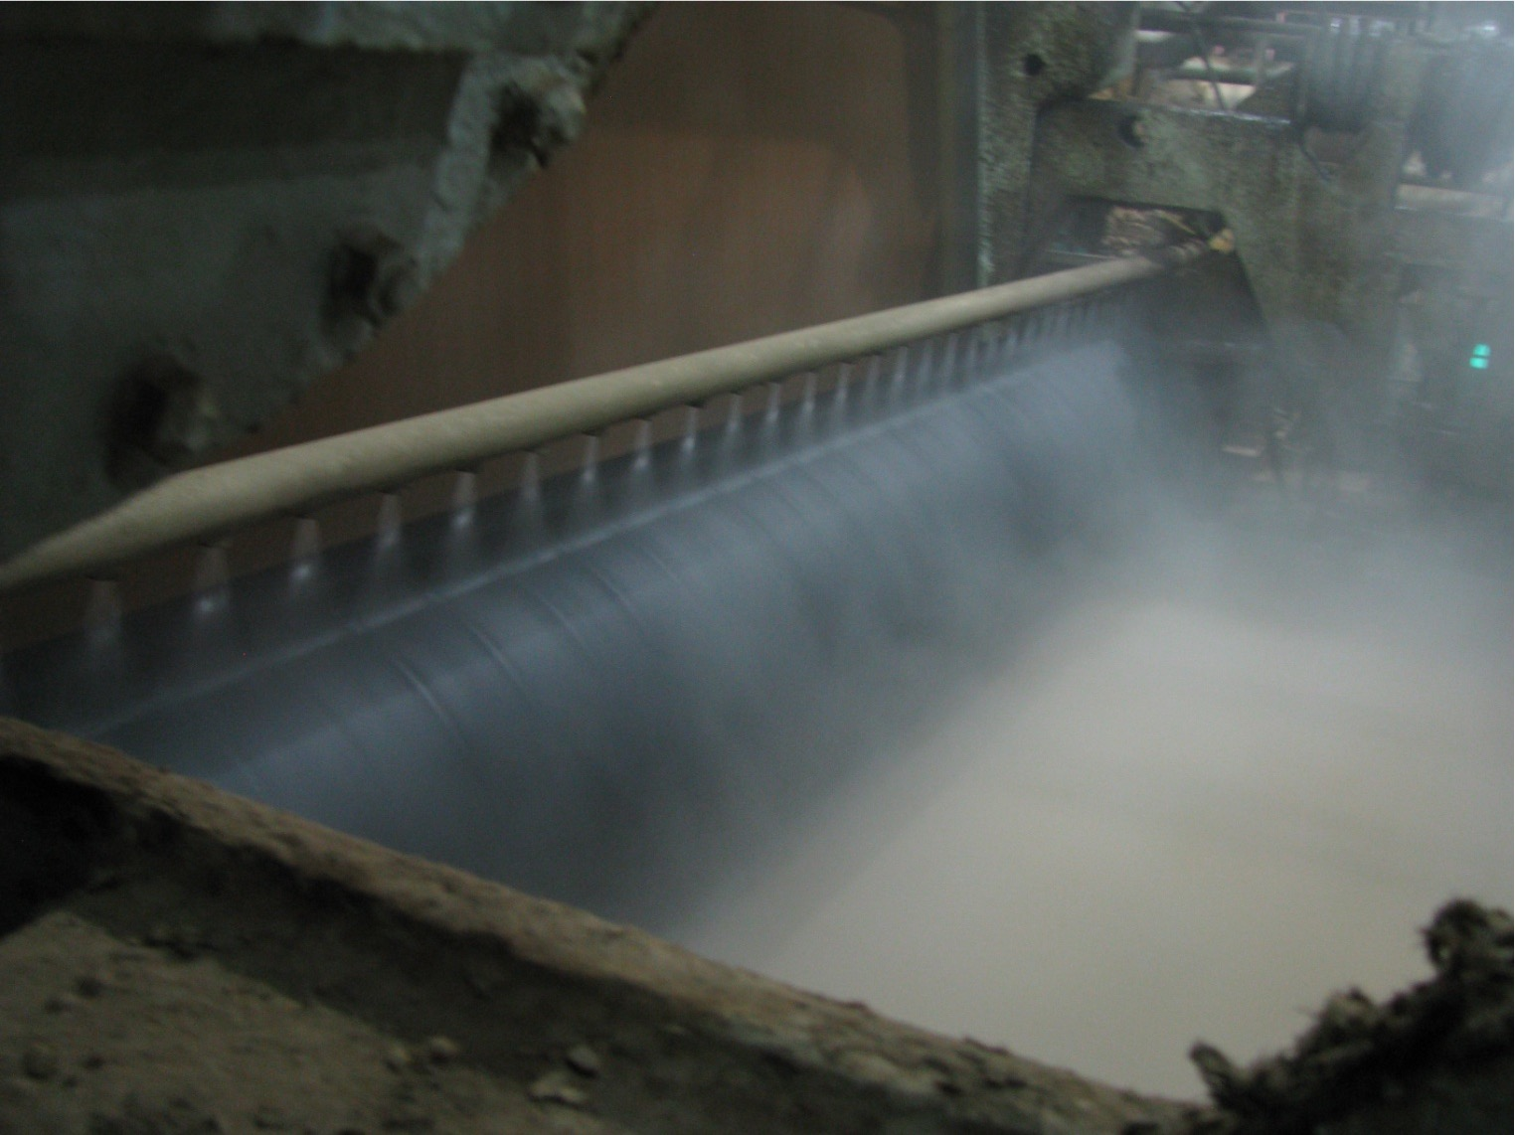
Typical Single Coverage Fan Shower Arrangement
1x coverage: each nozzle covers the same CD width
Pattern edges overlap to prevent dry streaks

Slide 14
Shower Layout
overlap areas:
single coverage
double coverage
areas
overlap areas:
double
triple coverage
coverage
areas
Single coverage is a must
Multiple coverage is better
  Attenuates variation (3:2 is better than 2:1)
  “insurance” against plugged nozzles

Slide 15
Machine Width Shower Distribution
gpm/in.
0.16
 | Not Oscillated | Oscillated
Avg. flow (gpm/inch) | .079 | .079
Standard Deviation | .019 (24%) | .003 (4%)
0.12
0.08
0.04
0
0.16
12-inch oscillator stroke
0.12
300 inches wide
45 degree nozzles
6 inch centers
1/2 inch pattern overlap
0.08
0.04
0

Slide 16
Flooded Nip Shower
Full width flooded nip shower
  Provides outstanding Knock-off & cleaning performance
Excellent tool for cleaning inside surface &
powering out voids with modest water volume
  Helps debris off fabric, provides flushing water to clean fabric
  Pointed just before nip, FORMS PUDDLE
  Puddle insures even distribution, not nozzle-shower
  configuration
  Allows roll’s fluid mechanics to force contaminates out
If it’s the only full width fan shower, consider the applied energy
  Operation below RVV yields far less driving force for knock-off
  RVV is VERY water intensive (high volume)
  Optimum cleaning occurs at RVV, BUT good cleaning can be achieved at lower volumes
NOTE: the above is for flooded nip wire showers. For felt flooded nips, volume to achieve void volume (gpm) is
Fabric Width(in) x Fabric Wt.(oz/ft²) x Speed(fpm) x C – all other shower flows
Where C = 0.000063
12”- 15”
(300 – 380 mm)

Slide 17
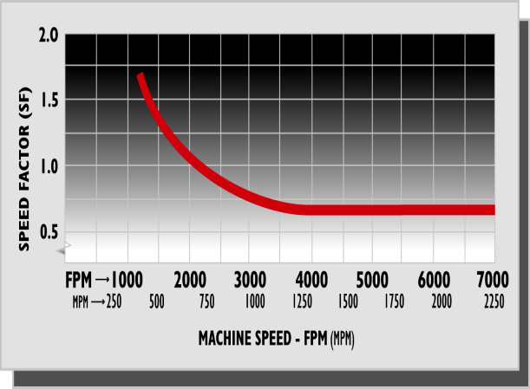
Running Void Volume
C= Caliper of Fabric in Inches
W= Fabric Width in Inches
S= Speed in FPM
V= Void Volume (use 0.6)
SF= Speed Factor for wires
R.V.V. (gpm)= CxWxSxVxSF
19.25
EXAMPLE flooded nip
1550 fpm-Speed factor = 1.3
Full coverage flow =
340 gpm on new wire
Re- calculate
Both S and SF for other
Machine speeds.
Note that void volume and
Speed factor are
Dimensionless.

Slide 18
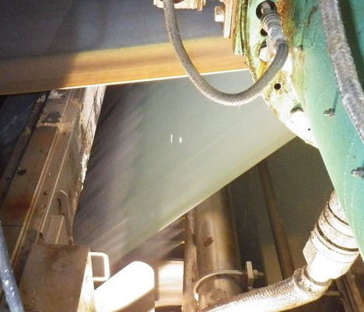
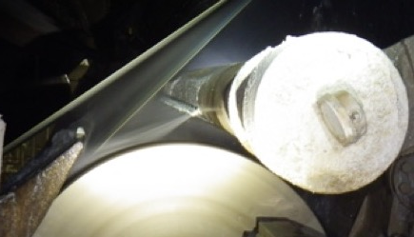
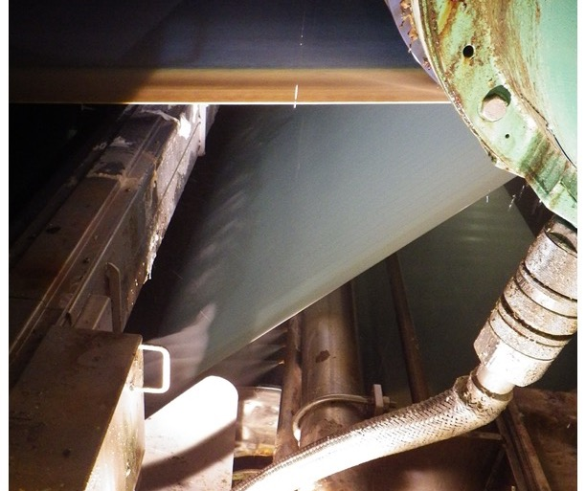
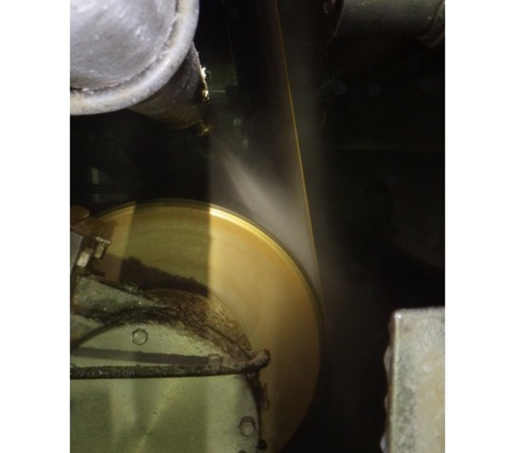
Flooded Nip Showers
FNKO running at full (knock-off) volume
Flooded nip running at reduced volume sufficient for cleaning
Flooded nip placement: note landing on roll before nip to form puddle
Tissue felt flooded nip

Slide 19
Needle Jet Showers

Slide 20
How Do Needle Showers Work?
1.Pressure,Force?
pressure
area
2. Energy, Momentum?
mass
velocity
time
mass
3. Impulse?
velocity

Slide 21
“Why’s” of Needle Jets
Cleaning depends on distance from the fabric
Cleaning is proportional to energy Cleaning = f(energy/time) = f(power)
3.
1
Energy
=
mv
2
v
∝
p
m
∝
a
∝
d
2
2
shower effectiveness

Slide 22
Inside HPS for through cleaning
Laminar flow penetrates better, jet distance < 4” for through cleaning

Slide 23
Sheet Side HPS for surface cleaning
Maximize surface cleaning effectiveness/pressure > 6 in.
shower effectiveness

Slide 24
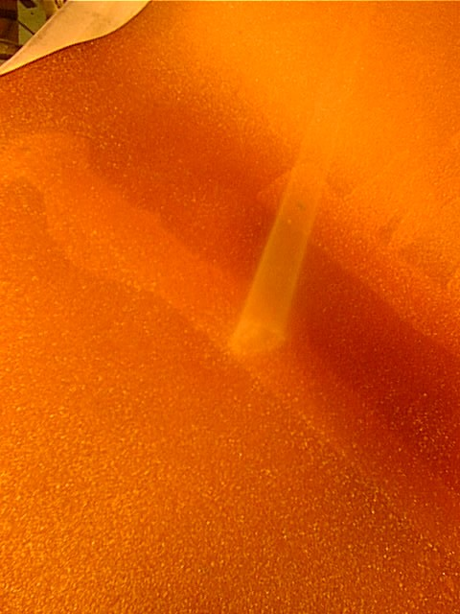
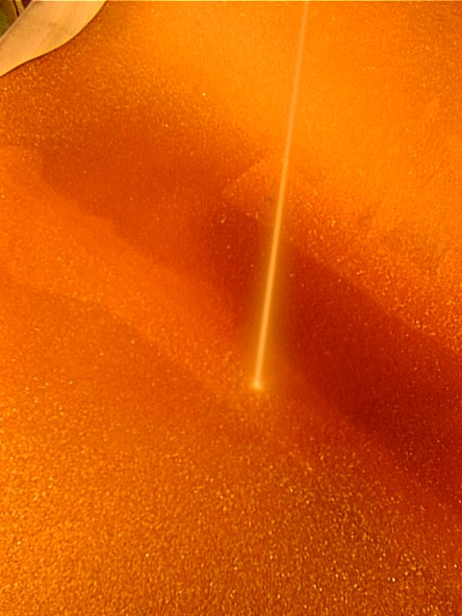
How Important is Dispersal Area?
.014 dia. nozzle
2,300 psi
4,700 rpm
.014 dia. nozzle
2,300 psi
0 rpm

Slide 25
Power Application: Jet Vs. Fan
Typical Nozzle: .040 diameter, 150 psi
.040 Jet | .040 60⁰ fan MD | .040 60⁰ fan CD
.36 gpm | .46 gpm | .46 gpm
14 watts | 19 watts | 19 watts
11,000 watts/in² | 78 watts/in² | 78 watts/in²
 |  | 467 watts/in² effective

Slide 26
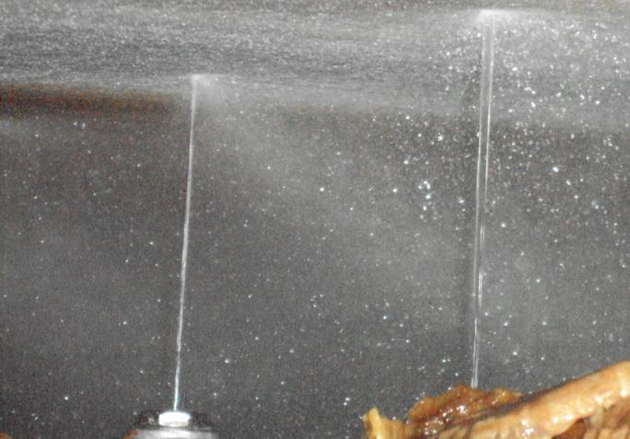
Felt HPN Jet Quality
Jet Quality, significant impact on cleaning performance
“Glass Rod” type
of appearance
GOOD
Energy is disbursed
over an area 6X greater
POOR

Slide 27
How Far From the Fabric?
Relative
Cleaning
Action
(measured with
piezocrystal
sensor)
Distance from Orifice

Slide 28
Best Jet Angle
Vector logic for “chasing” wire for INSIDE
Vector logic for “chiseling” wire for OUTSIDE
Shower stream
Resultant vector (from contaminant frame of reference) into fabric depending on speed match
“through cleaning”
Fabric speed
Shower stream
Resultant vectors apply energy to surface contaminants, and use some energy to get contaminants OFF fabric
“surface cleaning”
Fabric speed

Slide 29
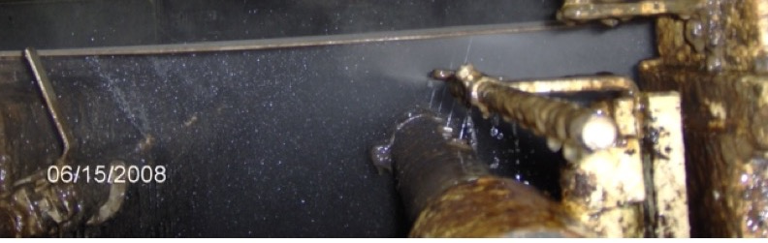
Application to Fabric Conditioning
For sheet side cleaning
  Use region of peak dynamic power
  Peak power occurs anywhere from 6 to 10 inches
  Oscillation for even effect
For inside cleaning
  Use region of optimum penetration
  Laminar flow penetrates better than 2 phase flow
  Shower should be close to fabric (3-4 in.)
Replace nozzles regularly to maintain good patterns

Slide 30
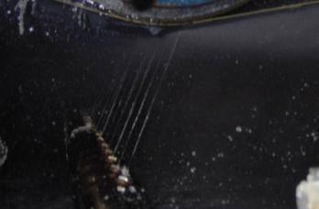
On Roll or In Space?
Energy transfer
  If wire cannot recoil on impact energy transfer is optimized → target shower on roll
Mist control
  If roll is behind wire, there is no through flow → no inside fabric run mess → target shower on roll
Chisel or following angle?
  Chisel is optimum for contaminant impact
  Mist control is probably more important → point shower in direction for best mist control

Slide 31

What About Felt Seams?
Clean vs. destroy
Seam needs to be continuous with felt
“Chiseling” angle tends to push seam batt out of seam
Following angle tends to lift seam flap
Ideal: resultant angle perpendicular, keep material in seam
Best angle for seam: slight following angle with resultant perpendicular to felt
New Condition
Energy Vector
Peel Back
Flap wornout/damaged
Shower stream
Resultant energy vector
Fabric speed

Slide 32
Oscillation of High Pressure Showers
It’s not just a good idea,
It’s the law!

Slide 33
Crank Arm Oscillators

Slide 34
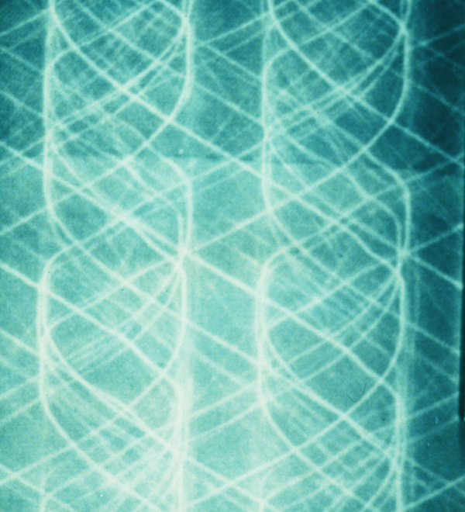
Importance of Proper Oscillation

Slide 35
Low Speed Oscillation
Coordinate oscillator speed with fabric speed
Perfect, even coverage

Slide 36
Even, Uniform Coverage
Oscillator Speed Calculations
Traversing Speed = M/C speed x Noz. Dia.
Fabric Length

Slide 37
A Note on Scanning Jet Showers
Continuous cleaning: STEADY STATE
Treat Streaks
  direct cleaning to area of greatest concern
  maintain better profiles
Reliability
  Shower beam
  High pressure supply system
  Maintenance program

Slide 38
Other Profile
Considerations
The Battle Against
Nozzle Plugging

Slide 39
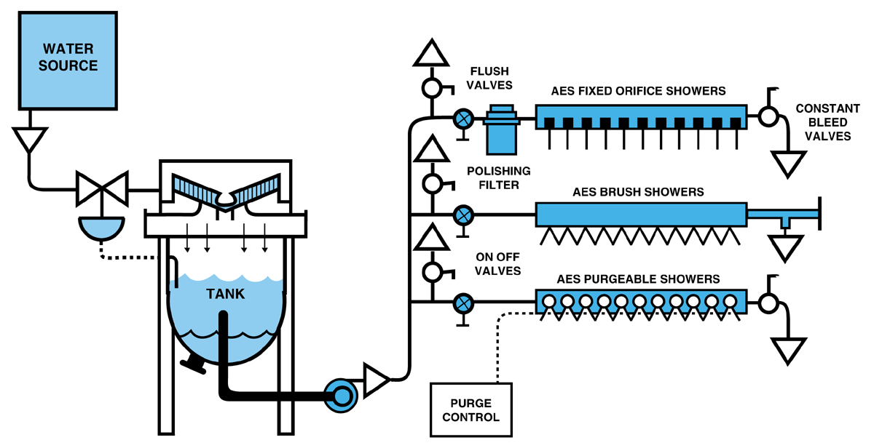
Filtration vs. Nozzle Plugging

Slide 40
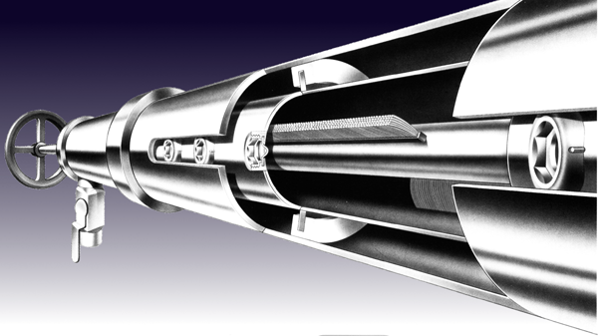
Brush Showers

Slide 41
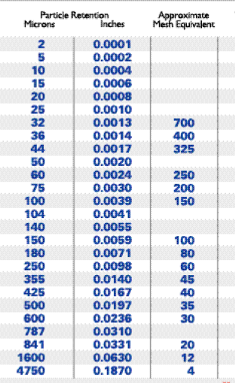
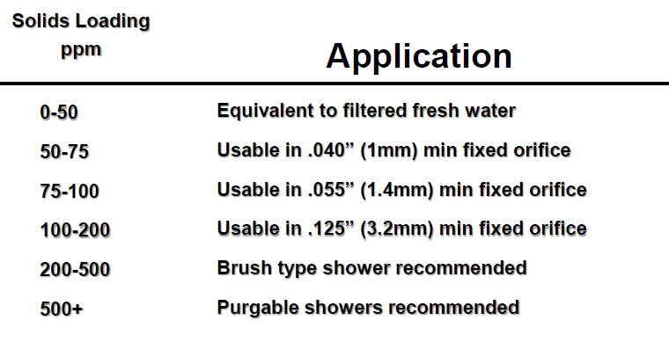
Filter media specification
Nozzle orifice size defines the barrier dimension
Loading defines the frequency of service
  The filter’s total open area determines the ΔP

Slide 42
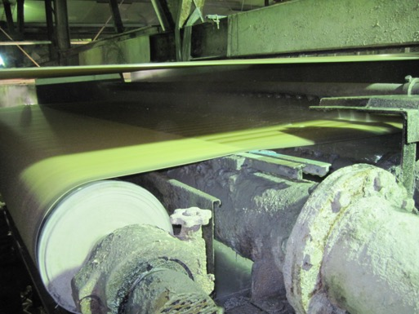
Felt Dewatering
Uhle boxes
  Remove water from the felt
  Help keep felts clean
Vacuum is applied to felts via stationary boxes to remove water from them
  Called uhle boxes or suction boxes
  Vacuum levels are conventionally up to 15 inHg, but can be as high as 20+ inHg (highly loaded presses, heavy felts)
  New, more permeable felts have lower vacuums
Conventionally, presses express water from the sheet to the felt, and water is then removed from the felt at the uhle box
  Many modern machines depend on press nip dewatering; water is removed from the felt at the press making uhle dewatering less critical

Slide 43
Traditional Uhle Sizing
Calculate dwell time for machine conditions, target moisture content.
  First press: .8 - .7 lb H₂O/lb felt
  Second press: .7 - .62 lb H₂O/lb felt
  Third press: .6 - .54 lb H₂O/lb felt
  F2 = 1.23 • F1^(.819) • Q^(-.024) • dP^(-.124) • D^(-.096)
  NOTE: this equation was determined empirically and felts have changed radically. It can be used only for rough estimates of dewatering
Calculate airflows with Decrosta equation. (still gives a reasonable estimate of airflow)

Slide 44
Decrosta Airflow Equation
.476
.11
.916
.069 x ΔP x t x perm
d
V =
.628
m
p1
ΔP t perm
d
V =
m
p1
Just like

Slide 45
Dwell Time
dwell time (seconds)
5 x no. of slots x slot width (inches)
=
speed (fpm)

Slide 46
Pipe Sizing
Air Velocity limit: pressure drop across pipe is less than 2 in.- H₂O
  <3000 fpm before separator
  <5000 fpm after separator
  <500 fpm in separator
Structure: maximum stress below 16,000 psi

Slide 47
Slot Width
Dwell time is the ONLY effect of slot width:
  1 x 1” = 2 x 1/2” FOR DEWATERING
More narrow slots are better than fewer wide slots: felt wear
Fewer wider slots are less likely to plug
“Break to atmosphere” between slots doesn’t matter.

Slide 48
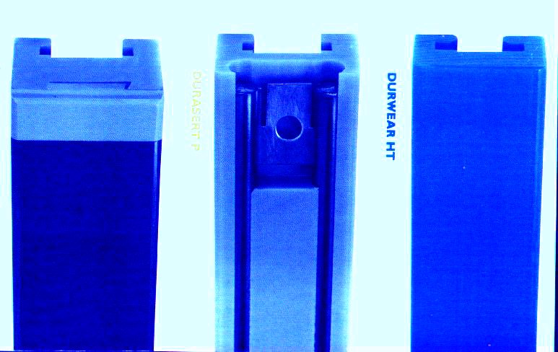
Wear Surface Materials
Cost Vs. Benefit:
cover life
fabric life

Slide 49
Slot Width, Fabric Penetration
vacuum
tension
tension
Catenary Deflection
Wide Slots
  Provide high dwell time
  Create high fabric wear
  Create high seam stresses
¾ vs 1.5 inch slot width, 15 in-Hg
  Fabric deflection: .035 vs .138 in.
  Edge angle: 10⁰ vs 20⁰
  At least twice the damage
Multiple narrower slots are better
  Less fabric wear
  Less seam wear
Slots that are too narrow can plug
  About 3/8 inch width is a good practical lower limit

Slide 50
Seamed Fabrics
Herringbone Design
Zig Zag Design
Trapezoid Design
Dwell time determines dewatering
Make sure dwell time is even across width of fabric

Slide 51
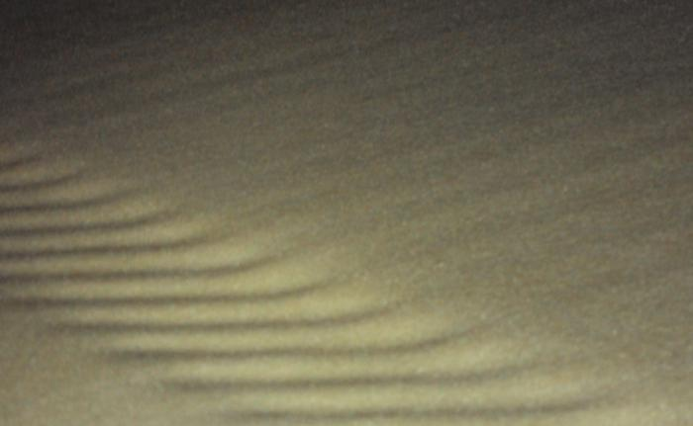
Streaks from Herringbone Covers
Worn covers are “re-injecting” water back into felt at the trailing edge of each slot

Slide 52
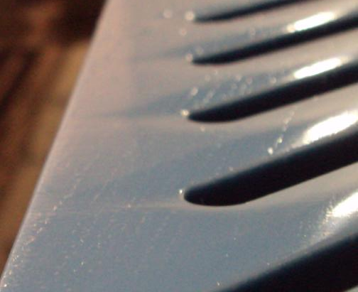
Herringbone Covers (continued)
Worn covers
  water is re-injected into the felt where the inside trailing edge has been worn away

Slide 53
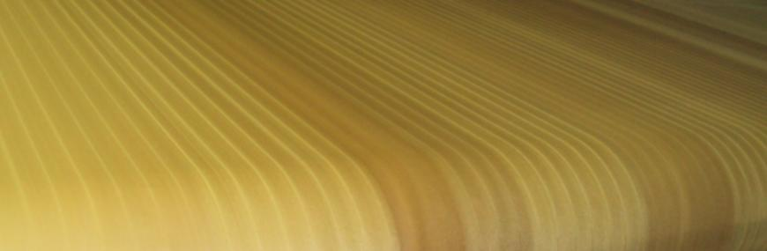
Reading streaks
Press fabric streaks (a mixed bag)
  Narrow streaks every 2” – 3”……Herringbone cover geometry or worn
  Narrow streaks every 6”…...……OPN oscillator reversal dwell
  Dark 6” bands…………………….Single plugged or poor nozzle
  Very Dark 6” band………………..Adjacent nozzles plugged or poor
  Bands after chemical wash……..Shower with plugged nozzles
  Uneven batch shows up as diminished even color change across felt
  Example of felt streaks (with typical 6” nozzle spacing & 12” oscillator)

Slide 54
Strategy for
Ideal Cleaning Applications

Slide 55
Wire Cleaning Strategy
Create constant fluid motion to the sheet side then, utilizing outside rolls with doctors and showers to flush wire.
Inside rolls & catch pans for stapled fibers

Slide 56
Felt Cleaning Applications
Create constant migration of contaminates to face side
  Inside Needle Jet
  Inside Chemical
  Nip Shower
  Finally – the Uhle Box
Face side Needle Jet Shower must be setup for Surface cleaning
Face side roll with Doctor removes surface contaminates
Uhle box removes loosened surface and interstitial debris

Slide 57
Contaminants and Conditioning
What’s the problem?
Permeability, surface, fabric life?
Fabric type
Particulate or “gel?”
Determines:
WATER CONTENT, VOLUME
Shower location and type,
flow, angle
Vacuum requirements

Slide 58
Crescent Former Machine
SPR

Slide 59
Forming Section (Crescent Former)
5
9
9
9
9
9
9
2
1
6
3
4

Slide 60
Press Section (Crescent Former)
E
A
E
Alt
C
B
D
D
SPR
E
YB

Slide 61
Suction Pick-up
Alt.
A
C
E
D
D
F
B
E
E
YB

Slide 62
Suction Breast Roll
8
7
5
10
9
6
2
1
9
4
3

Slide 63
S-Wrap
2
9
6
1
9
3
9
4
9
10
9
9
6
10
2
1
9
9
3
4

Slide 64
C Wrap
9
9
9
7
9
6
9
2
1
6
1
2
10
3
9
10
4
3
4

Slide 65
Some Relevant TAPPI TIPs
0404-27, Press Fabric Dewatering and Conditioning – Suction Box (Uhle Box) Design and Vacuum Requirements
0404-51, Paper Machine Clothing Cleaning and Conditioning for Recycled Fiber Use
0404-52, Press Section Optimization
0404-57, Troubleshooting Cross-Machine Direction Moisture Profile Problems
0404-61, Paper Machine Shower Recommendations
0404-67, Paper Machine Doctor Recommendations
0502-22, Paper Machine Water Efficiency

Slide 66
Summary
Fan Showers – Even Distribution
  Overlap nozzles, consider oscillating critical showers
  Double or triple coverage nozzle spacing is best
  Flooded Nip
    Running Void Volume for knock off
    Some volume less than RVV for some cleaning
    For felts: RVV – other shower volume
Needle Jets – Power Application
  Use 6 inch stand-off on sheet side, 4 inches or less on inside
  Use pressure as low as possible (400 psi max forming, 250 psi max felts)
  Oscillate evenly @ twice nozzle spacing, 1 noz. diameter/fabric revolution
  ”Chisel” angle, 15⁰ into fabric on sheet side showers
  Perpendicular or 15⁰ chasing angle for inside showers
Change nozzles to maintain good patterns (rule of thumb, once/year)
Basic fabric cleaning strategy: move contaminants out of fabric (flush), and then off (needle jets, wash rolls) in direction from which they came
Uhle Boxes – Dewater and clean felts
  Between 2 – 4 ms dwell
  15 inHg (or a little more) for broken-in felts

Slide 67
Thank you
John Neun
john.neun@gmail.com

