Slide 1



Factors Affecting Phosphorus Uptake/Dissolution in Slaking/Causticizing
Gateway to
the Future
Maryam Mousavi
Supervisor:
Prof. Nikolai DeMartini
University of Toronto

Slide 2

About Phosphorus
P can enter the mill with wood, biosludge and biofuels
Phosphorus is known to decrease lime availability
The main purge points are lime mud and lime kiln dust
2

Slide 3
Why phosphorus is important ?
P compounds
Formation of non-reactive Ca-PO₄
Lime availability
P decreases lime availability
Deadload in lime mud
Increased energy and lime consumption
Biofuels
  Introduction of P with biofuels

Slide 4
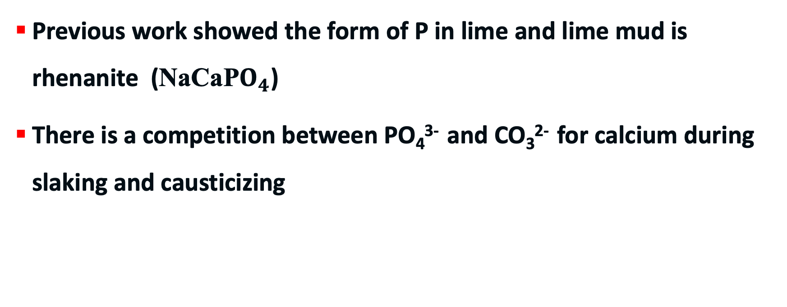
Background
Previous work showed the form of P in lime and lime mud is rhenanite (NaCaP$O_{4}$)
There is a competition between PO₄³⁻ and CO₃²⁻ for calcium during slaking and causticizing

Slide 5
Objectives
To understand factors affecting P uptake during slaking and causticizing:
Effect of ionic strength :
Change TTA (constant sulfidity)
Change sulfidity (constant TTA)
Effect of P concentration :
Change the PO₄³⁻ concentration in green liquor
Effect of liming ratio
Comparison between the behavior of reburned lime and technical-grade CaO

Slide 6
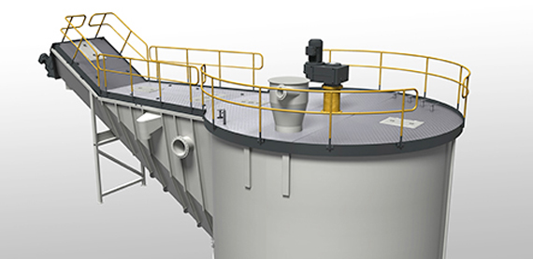
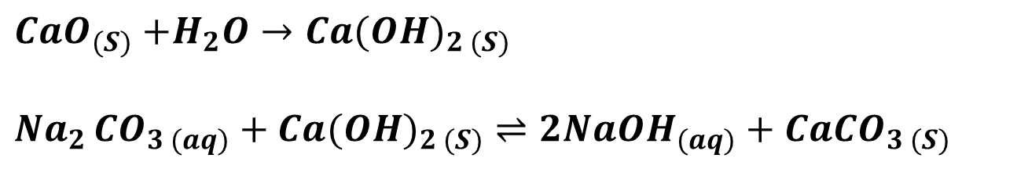
Recausticizing Process
$CaO_{(S)}$ $+H_{2}O→{Ca(OH)}_{2 (S)}$
${Na}_{2 }CO_{3 (aq)}+{Ca(OH)}_{2 (S)}⇌2NaOH_{(aq)}+CaCO_{3 (S)}$
Lime
Lime Availability :
  The amount of CaO available for slaking
Courtesy of Valmet

Slide 7

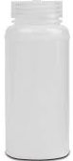
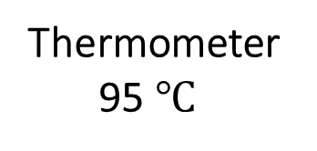
Experimental Set-up
Experimental Set-up
Thermometer
95 $℃$
Teflon Bottle
Stir Bar
Temperature Control
Stirrer Control
For all experiments, synthetic green liquor was made with Na₂CO₃ and Na₂S

Slide 8
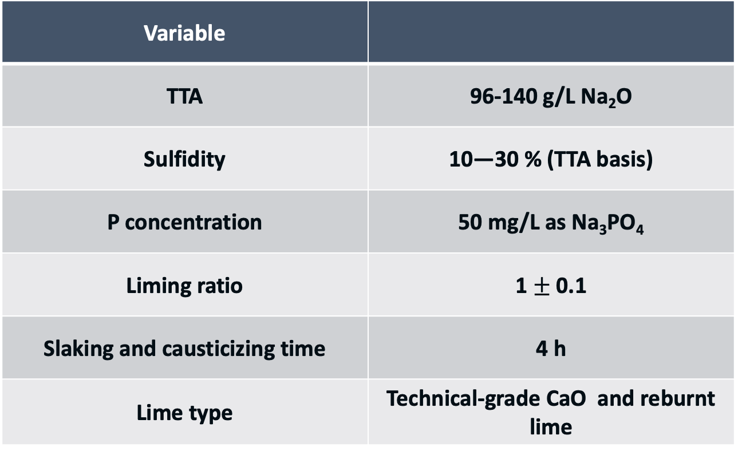
Experimental : Effect of Ionic Strength
Variable
TTA | 96-140 g/L Na₂O
Sulfidity | 10—30 % (TTA basis)
P concentration | 50 mg/L as Na₃PO₄
Liming ratio | 1 $±$ 0.1
Slaking and causticizing time | 4 h
Lime type | Technical-grade CaO and reburnt lime

Slide 9
Effect of Ionic Strength
P concentration in WL remains constant up to an ionic strength of 5.6 M. But increases linearly beyond this point.

Slide 10
Effect of CO₃ on the Final P Concentration in WL
There was no clear correlation between the final phosphate concentration in the white liquor and carbonate concentration
The P concentration at all ionic strengths was higher for Tech-grade CaO than for the reburned lime. Likely due to a difference in their reactivity

Slide 11
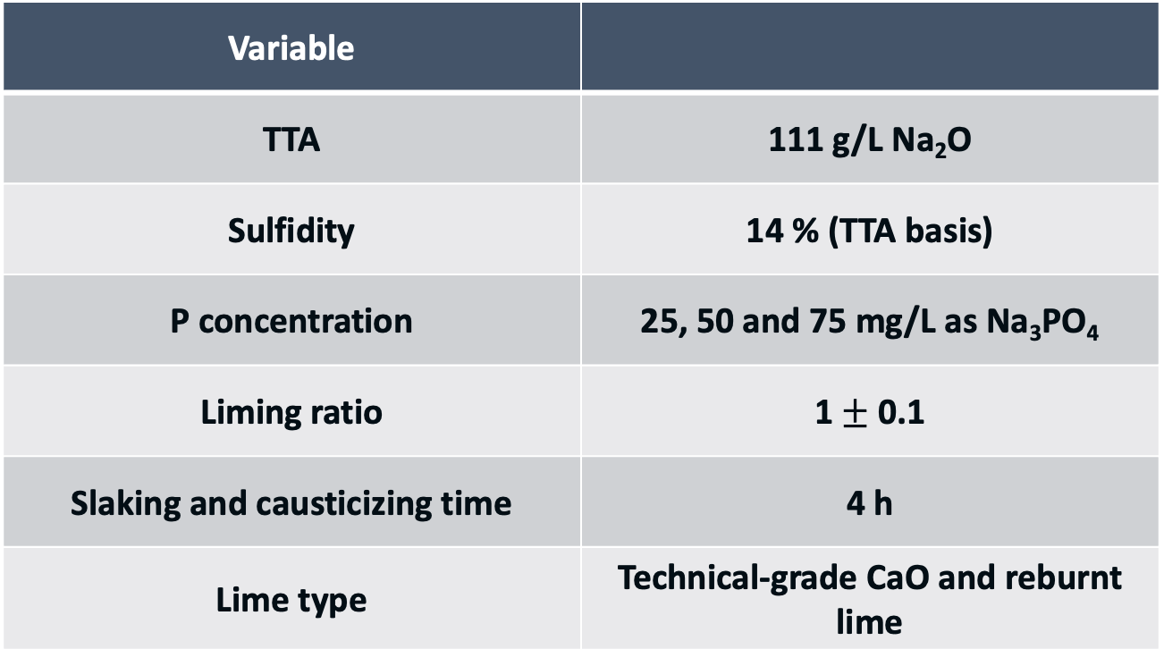
Experimental : Changing Green Liquor P Concentration
Variable
TTA | 111 g/L Na₂O
Sulfidity | 14 % (TTA basis)
P concentration | 25, 50 and 75 mg/L as Na₃PO₄
Liming ratio | 1 $±$ 0.1
Slaking and causticizing time | 4 h
Lime type | Technical-grade CaO and reburnt lime

Slide 12
Effect of P Concentration on P Pick-up/Dissolution (Reburnt Lime)
Error bars represent 1 standard deviation of at least 5 replicate analyses of the samples.

Slide 13
Effect of P Concentration on P Pick-up/Dissolution (Technical-Grade CaO)
Error bars represent 1 standard deviation of at least 5 replicate analyses of the samples.

Slide 14
Proposed Dissolution Mechanism
Ca(OH)_{2(s)} + CO₃²⁻_{(aq)} CaCO_{3(s)} + 2OH⁻_{(aq)}
Ca(OH)₂ _{(s)} + Na⁺_{(aq)} + PO₄³⁻_{(aq)} NaCaPO_{4(s)} + 2OH⁻
NaCaPO_{4(s)} + CO₃²⁻_{(aq)}⇌ CaCO_{3(s)} + Na⁺_{(aq)} + PO₄³⁻ _{(aq)}

Slide 15
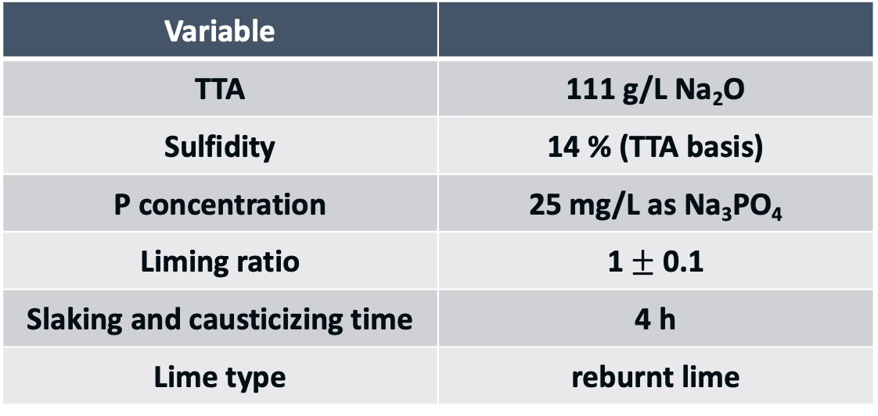
Separate Slaking and Causticizing Experiment
Reburnt lime was first slaked in water and then the slaked lime was added to Green liquor.
Variable
TTA | 111 g/L Na₂O
Sulfidity | 14 % (TTA basis)
P concentration | 25 mg/L as Na₃PO₄
Liming ratio | 1 $±$ 0.1
Slaking and causticizing time | 4 h
Lime type | reburnt lime

Slide 16
Results : Separate Slaking and Causticizing Experiment
Phosphate reacts with Ca(OH)₂, resulting in the formation of rhenanite
The rate of slaking is likely the primary factor influencing the rate of (P) uptake
Samples were taken after the pre-slaked lime was added to the green liquor

Slide 17
Experimental :Effect of Liming Ratio
Variable
TTA | 111 g/L Na₂O
Sulfidity | 14 % (TTA basis)
P concentration | 50 mg/L as Na₃PO₄
Liming ratio | 0.5 , 0.75 , 1 and 1.5
Slaking and causticizing time | 4 h
Lime type | Technical-grade CaO and reburnt lime

Slide 18
Effect of Liming Ratio : Reburnt Lime

Slide 19
Effect of Liming Ratio : Technical-Grade CaO

Slide 20
Conclusions
P in the reburnt lime can be partially soluble in water during slaking
For reburned lime, ionic strength can impact uptake of P by lime above an ionic strength of 5.6 M
The carbonate concentration does not have a clear impact beyond impacting ionic strength.
P pick-up seems to mostly occur during causticizing
-> Ca(OH)₂ seems to be the active solid
Reaction for dissolution of rhenanite has been proposed
P pick-up from the green liquor increases by increasing the liming ratio

Slide 21
Thank You

